Slide 1

Parkside, Tulsa, OK November 2019
John F. Kelly, PhD, ABPP
Treatments for SUD
Notes:
Title: Recovery From Alcohol and Drugs Problems in a National Sample of U.S. Adults: Prevalence, Pathways, and Predictors
Talk Description: While much is known about the causes, clinical course, and treatment, of addiction, little is known about the prevalence, processes, pathways, and predictors of long-term remission and recovery.
This presentation reviews and discusses findings from the first nationally-representative study of U.S. adults who have resolved a significant alcohol or other drug problem, examines their varied pathways
to problem resolution, and describes the predictors of use of those pathways. Findings regarding changes in quality of life with time in recovery and smoking status and cessation will also be reviewed.
Learning Objectives
By the end of this presentation participants will be able to:
1. Describe recovery prevalence in the United States
2. Name the major pathways that people use to recover
3. Specify the changes in quality of life that occur with time in recovery

Slide 2
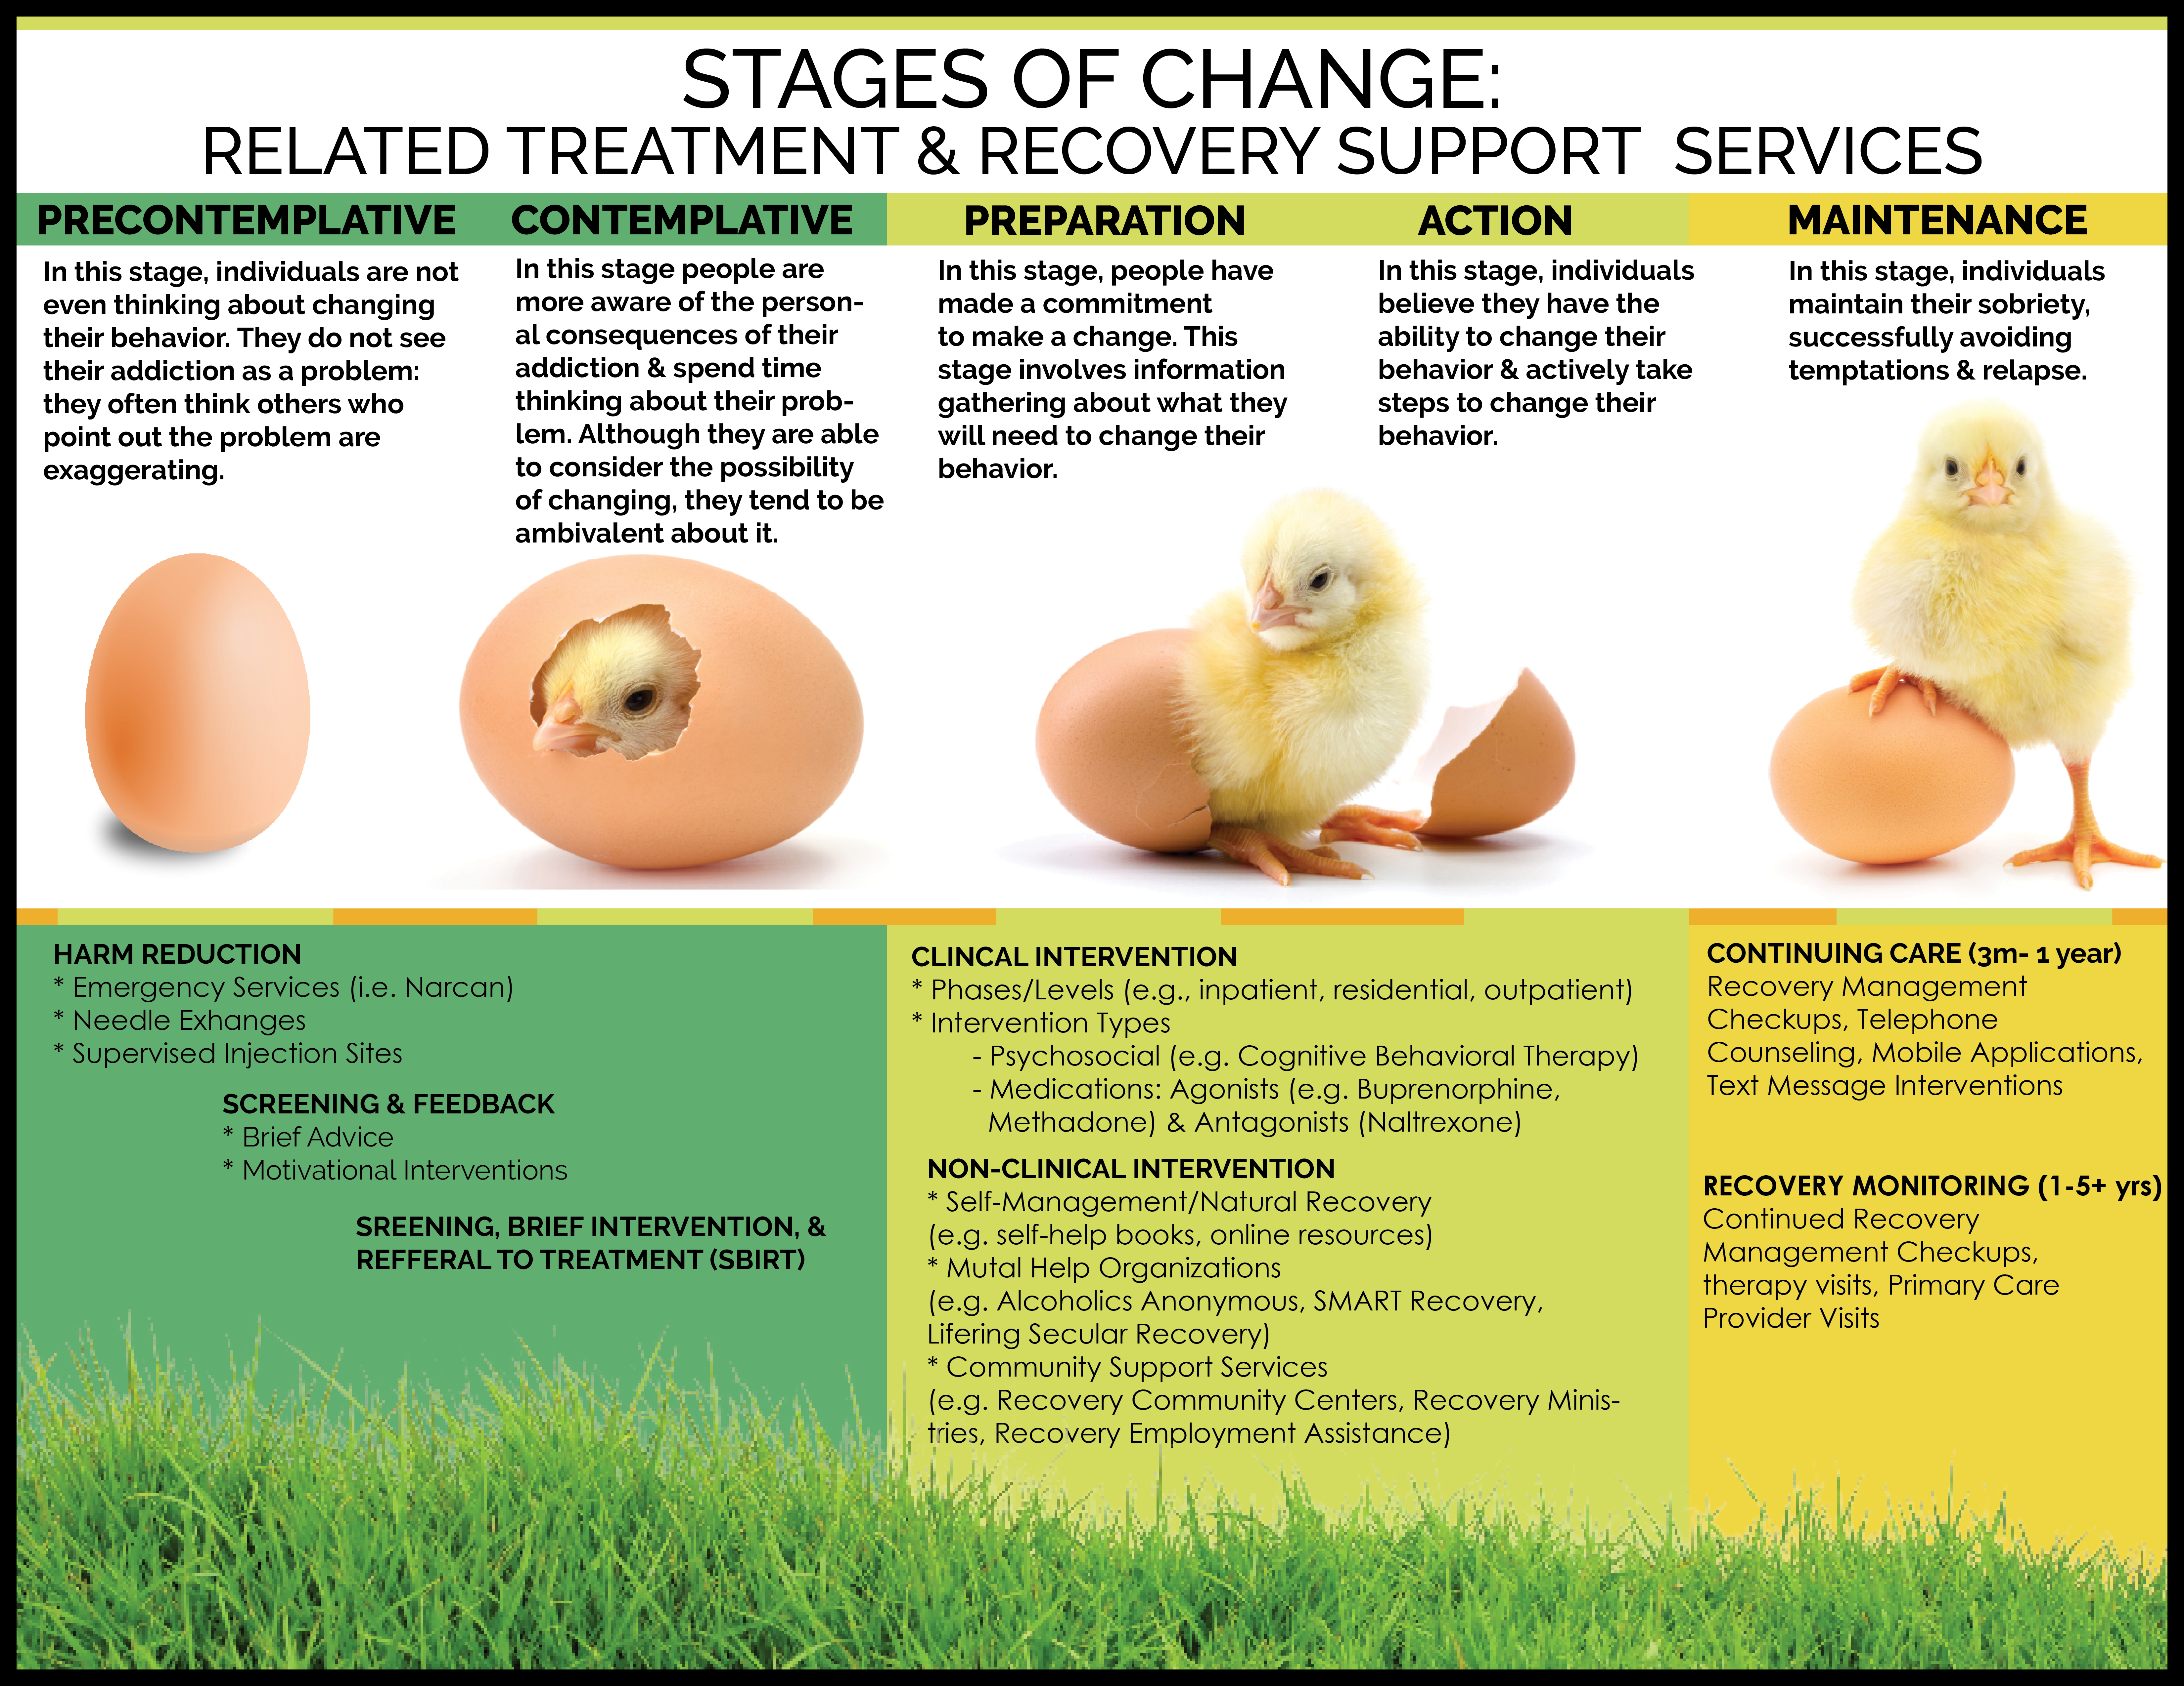

Slide 3
MI
Notes:
In theory, MI is an approach that helps people resolve ambivalence and is thus suited to pre/contemplative stages of change… that said, it has also been used as a standard “active” intervention and compared to others like CBT as stand alone interventions….

Slide 4
CBT
MI

Slide 5
CBT
MI
TSF

Slide 6


Motivational Interviewing
John F. Kelly, Ph.D.
www.recoveryanswers.org

Slide 7
“What people really need is a good listening to”
-Mary Lou Casey
Notes:
The overall style is one of GUIDING, which lies between and incorporates elements of DIRECTING and FOLLOWING styles.
Ambivalence is a normal part of preparing for change and a place where a person can remain stuck for some time.
When a helper uses a directing style and argues for change with a person who is ambivalent, it naturally brings out the person’s opposite arugments.
People are more likely to be persuaded by what they hear themselve – strengthen person’s OWN motivation for change.
Three definitions of MI:
Layperson’s: MI is a collaborative conversation style for strengthening a person’s own motivation and commitment to change.
Practioner’s: MI is a person-centered counseling style for addressing the commmon problem of ambivalence about change.
Technical: MI is a collaborative, goal-oriented style fo communication with particular attnetion to the language of change. It is designed to strenggthen personal motivation for and commitment to a specific goal by eliciting and exploring the person’s own reason for change within an atmosphere of acceptance and compassion.

Slide 8
Motivational Interviewing (MI)
Some conclusions…
What are the clinical strategies involved in MI and what is its “spirit”?
What is MI and its assumptions?
How effective is MI as an intervention for SUD?
How does it work?

Slide 9
Motivational Interviewing (MI)
Some conclusions…
What are the clinical strategies involved in MI and what is its “spirit”?
What is MI and its assumptions?
How effective is MI as an intervention for SUD?
How does it work?

Slide 10




Slide 11
What is MI?
“A collaborative, goal-oriented style of communication with particular attention to the language of change. It is designed to strengthen personal motivation for and commitment to a specific goal by eliciting and exploring the person’s own reasons for change within an atmosphere of acceptance and compassion”.
  -Miller and Rollnick, MI 3rd Edition, 2013
  It can be a helpful general style of “being with” and counseling patients and has been developed as discrete therapies (e.g., Motivational Enhancement Therapy).

Slide 12
Assumptions of MI
People often ambivalent about change, but labeled pathologically as “resistant” “in denial” “oppositional”
When a helper offers directive expert advice about change to ambivalent individuals, person likely to argue the opposite
Giving advice/education alone rarely effective in helping people change
People have experience, skill, and innate wisdom to facilitate effective change
All people have innate worth; capable and do best when making own decisions
Creating the right conditions for change catalyzes transformation (origins in self-regulation and humanistic/patient-centered psychological theories of change)
Motivation is a clinician rather than a patient issue

Slide 13
Motivational Interviewing (MI)
Some conclusions…
What are the clinical strategies involved in MI and what is its “spirit”?
What is MI and its assumptions?
How effective is MI as an intervention for SUD?
Does it work the way we think it does?

Slide 14
MI Practice Principles (READS)
R
E
A
D
S
Roll with resistance
Provide empathic understanding
Avoid argumentation
Develop discrepancies between patient’s own values and drinking behavior
Support patient’s self-efficacy

Slide 15
Essential Practice Components (FRAMES)
F
R
A
M
E
S
Provide Feedback
Encourage personal Responsibility
Give clear Advice
Provide a choice or Menu of options
Be Empathic and supportive
Support for Self-Efficacy
“Your results show…”
“It’s up to you. It’s your choice”
“Change can be tough but you don’t have to do it alone…”
“You can do this…”
“There are a number of things that you might do…”
“I would strongly recommend…”
Notes:
Six common components of effective brief treatment (Miller & Sanchez 1994)
Feedback of personal status relative to norms
Responsibility for personal change
Advice to change
Menu of options from which to choose in pursuing change
Empathic counselor style
Support for self-efficacy
What began as an interest in motivation for TREATMENT had broadened now to focusing on motivation for CHANGE.

Slide 16
Four Processes of MI
Notes:
The four processes are both sequential and recursive, represented as stair steps.
Each later process builds upon those that were laid down before, and continue to run beneath it as a foundation. In the course of a conversation or case one may dance up and down the staircase, returning to a prior step that requires renewed attention.
Therapeutic engagement is a prerequisite for everything that follows. Establishing a helpful connection and working relationship.
Focusing is the process by which you develop and maintain a specific direction in the conversation about change.
Evoking involves eliciting the client’s own motivations for change and lies at the heart of MI.
Planning encompasses developing commitment to change and formulating a concrete plan of action.

Slide 17
Four Processes of MI
Process of creating a plan for change
“What do you think you’d like to do
about your drinking/drug use?”
Having the person verbalize their own arguments for change
“What are some of the things you
don’t like about your alcohol use?”
Creating a therapeutic agenda to direct and anchor the conversation
“What’s troubling you that brings you here?”
Therapeutic/Working alliance: a prerequisite for everything that follows
“I’m glad you’re here…”
Notes:
The four processes are both sequential and recursive, represented as stair steps.
Each later process builds upon those that were laid down before, and continue to run beneath it as a foundation. In the course of a conversation or case one may dance up and down the staircase, returning to a prior step that requires renewed attention.
Therapeutic engagement is a prerequisite for everything that follows. Establishing a helpful connection and working relationship.
Focusing is the process by which you develop and maintain a specific direction in the conversation about change.
Evoking involves eliciting the client’s own motivations for change and lies at the heart of MI.
Planning encompasses developing commitment to change and formulating a concrete plan of action.

Slide 18
Motivational Interviewing and MI “spirit”
MI is now recognized more to be not a strong “technical” therapy like CBT; but rather a formalized contextual therapy with specific goals
If delivered in too technical a way diminishes benefits- it’ll be the words without the music (it should be more like improvisational theatre instead of a scripted play)
It is based in genuineness and client-centered positive regard…
MI Spirit came about after meta-analysis (Hettema et al, 2005) found that when clinicians stuck to a therapist MI manual the effect sizes were much lower…

Slide 19
The Underlying Spirit of MI
The MI spirit emerges at the intersection of these four components
Acceptance
Evocation
Compassion
Collaboration
MI Spirit
Notes:
MI appears not to be a strong “technical” therapy (and if done that way may diminish benefits- it’ll be the words without the music) but rather, one that is based in genuineness and client-centered positive regard…
The MI spirit emerges at the intersection of these four components

Slide 20
MI “Spirit”: Four Key Interrelated Elements
Collaboration
Acceptance
Evocation
There is partnership; MI is done “for” and “with” a person
Absolute worth, affirmation, autonomy, accurate empathy
People have innate wisdom and skill
Evoke and strengthen already present change motivations
Compassion
Actively promote other’s welfare and give priority to their needs

Slide 21
Core MI Technical Skills
Open-Ended Questions
GOAL:
Affirming
GOAL:
Reflective Listening
GOAL:
Summarizing
GOAL:
Informing and Advising
(with permission)
GOAL:
"You've said a number of things, so let me see if I’m understanding you right, you…”
“So, your mother really irritates you.”
“What is it that concerns you about your drug use?”
“This is hard for you.”
Elicit information/
verbalization
Support self-efficacy/
confidence
Accurate empathy
Accurate empathy
Help build knowledge, skill, self-efficacy
“Could I have your permission to make a suggestion about how your might do that?”
Engagement
Engagement
Notes:
Core Skills and the Four Processes of Motivational Interviewing
Prerequisite skills for the proficient practice of MI

Slide 22
Motivational Interviewing (MI)
Some conclusions…
What are the clinical strategies involved in MI and what is its “spirit”?
What is MI and its assumptions?
How effective is MI as an intervention for SUD?
Does it work the way we think it does?

Slide 23
Outcome Research on MI
Since 1990, the number of publications on MI has doubled about every 3 years
Currently >1200 publications, including 200+ randomized clinical trials
Meta-analyses generally conclude that MI has small to medium effect sizes across variety of outcomes, with most examining addiction
Notes:
Since 1990, the number of scientific publications on MI has doubled about every 3 years
Currently more than 1200 publications, including 200+ randomized clinical trials
Meta-analyses of MI research Appendix B
Overall messages, methodological shortcomings, hopes for future research, broader implications
Meta-Analyses focus on characterizing average effects, general conclusions have been that MI is associated with small to medium effect sizes across a variety of behavioral outcomes with the strongest body of evidence being on addictive behaviors.
HIGH DEGREE OF VARIABILITY IN EFFECTS ACROSS STUDIES, SITES, CLINICIANS
Number of clinical trials have reported no meaningful effect on a priori dependent measures
Carroll et al 2006
Carroll Libby Sheehan Hyland 2001
Miller Yahne Tonigan 2003
Well-controlled trials of manual guided closely supervised MI interventions, substantial therapist effects remain
Miller et al 93
Project MATCH 1998c
Multisite trials have also found site-by-treatment interaction effects, meaning MI showed significant efficacy at some sites and not at others, sometimes with no overall significant effect when averaging across sites
Ball et al 2008
Client response to MI is significantly influenced by clinician and contextual aspects of delivery, factors that are not adequately standardized by following a treatment manual
Hettema – average effect size of MI was smaller by ½ when intervention was manual guided
Effect size of MI was 2x larger when treated minorities rather than majority white. Compassionate listening maybe a more unusual experience for minority.
Unclear what level of MI fidelity Is “good enough” to promote change
May simply be a decrease in unhelpful counselor responses – possible that MI training improves outcomes if it suppresses counter therapeutic responses
Change talk
MI compared with other treatments
Similar overall efficacy despite the difference in treatment intensity
MI may be a reasonable and specifiable “general factor” control against which to evaluate other active treatments
Number of published trials have found no effect of MI
Some no measurement of fidelity in treatment delivery
Published quality assurance measures indicated a low level of clinician skill or at least conscientiousness in delivering MI
Some with no effect of MI found despite training and fidelity monitoring very well
Miller et al 2003 yielded no trace of efficacy, was too restrictive in therapist manual used, preventing therapists from responding appropriately to client reluctance
Restriction of clinical flexibility may account for why use of a therapist manual was associated with significantly lower effect sizes for MI – Hettema 2005

Slide 24
High degree of variability in effects across studies, sites, clinicians
Many RCTs have found no meaningful effect related to MI (Carroll et al, 2006; Carroll et al, 2001; Miller et al, 2003; Foxcroft et al, 2014)
Substantial therapist effects remain in some well-controlled trials of manual-guided, closely-supervised MI interventions (Miller et al, 1993; Project MATCH 1998c)
Multisite trials have also found site-by-treatment interaction effects: sometimes with no overall significant effect when averaging across sites (Ball et al, 2008)
Seems to work somewhat for alcohol but not for other drugs when added to standard treatment either in retaining or improving outcomes (Donovan et al, 2001; Miller et al, 2003; Rosenhow et al, 2004; Carroll et al, 2006).
Has no meaningful benefit for young adults with alcohol misuse (Cochrane Review with 66 trials of MI; Foxcroft et al, 2014)
Unclear what level of MI fidelity Is “good enough” to promote change; too technical adherence to “manualized approach” may diminish effects.
May simply be a decrease in unhelpful counselor responses – possible that MI training improves outcomes if it suppresses counter therapeutic responses (reduces counter change talk)
Similar overall efficacy despite the difference in treatment intensity

Slide 25
Motivational Interviewing (MI)
Some conclusions…
What are the clinical strategies involved in MI and what is its “spirit”?
What is MI and its assumptions?
How effective is MI as an intervention for SUD?
Does it work the way we think it does?

Slide 26
Motivation Hypothesis Causal Chain Analysis – Project MATCH
Hypothesis: Clients low in motivational readiness to change would have better outcomes in MET than in CBT
RESULTS:
No supporting evidence for any proposed treatment specific causal mechanisms
Treatments did not differentially influence working alliance, coping, or attendance during treatment, motivational readiness to change, processes of change, or abstinence self-efficacy
In general, degree of overall treatment attendance (irrespective of which treatment) and working alliance predicted outcomes
Strong support across all treatments for initial motivation on working alliance and alcohol use over 1yr follow-up and 3yr follow-up
Notes:
DiClementeConnection between readiness to change alcohol behavior with the specific motivational dimensions of MET, and lack of adequate motivational emphasis in CBT
MATCH p 206, 217

Slide 27
Dismantling MI Components Related to Alcohol use (Morgenstern et al, 2012)
Goal: To test the causal role of key hypothesized active ingredients and mechanisms of change within MI in reducing drinking.
Self-Change
Decision-making, motivation, actions individuals bring to treatment as part of change episode
Impact of study procedures (e.g., assessment reactivity)
Spirit-only MI (common therapy factors)
Therapist stance (warmth, egalitarianism)
Extensive use of reflective listening
Avoid MI-inconsistent behaviors
MI specific elements (directive/strategic)
Enhance discrepancy (structured feedback, advice, double-sided reflections)
Elicit & reinforce positive change talk (change plan)
Avoide MI specific bxs (amplified/double-sided reflections, advice, change plan)
Notes:
NOVEL DESIGN FEATURES OF R21 STUDY
Limit heterogeneity
Problem drinkers (low co-occurrence of other problems)
Study initiation of drink reduction episode
Dismantle MI to test purported mechanisms
Self-change
Common therapy factors (empathy, working alliance)
Directive/strategic factors (unique to MI)
Ecological Momentary Assessment (EMA)
Capture rapidly evolving, individual level processes (cf. Kranzler, Tennen, Armeli et al. JCCP 2006)
AIMS
Did method capture problem drinkers during initiation of drink reduction episode?
Were treatment conditions discriminable and well implemented?
Did conditions differ on drinking outcomes as hypothesized?
MI > Spirit Only MI > Self Change

Slide 28
Self-Change Condition
Self Change (SC)—incorporated elements hypothesized in MI literature to contribute to change, but not associated with relational or technical active ingredients.
included normative feedback, personal responsibility, and efforts to foster self-efficacy.
After receiving normative feedback, participants were asked to attempt to change on their own during the next eight weeks; told that research had shown that some individuals could reduce their drinking without professional help; and that completion of the IVR as well as research interviews might prove helpful in that effort. Offered treatment at end of 8 wk period.

Slide 29
Design: RCT (dismantling design)
98 assessed for eligibility, 9 excluded
Overall sample N=89
Per group:
MI = 29 lost to fu = 5 analyzed n = 26
SOMI=30 lost to fu = 4 analyzed n = 26
SC = 30 lost to fu = 0 analyzed n = 30
Followed for 8 wks using daily IVR (daily 5 minute telephone survey) and participated in in-person assessments at weeks 0, 1, 4 and 8.
Follow up rates at weeks 1, 4, and 8 were 100%, 96%, and 92%
Participants in the therapy conditions were followed one month post-treatment (week 12) by phone and completed the TLFB (followup rate 80%)

Slide 30
Study Design
Week 0
Screening and IVR Training
Week 1
Feedback and Randomization
MI
Assessment Therapy
Spirit-Only MI
Assessment Therapy
Self-Change
Assessment
Week 2
Therapy
Therapy
Week 4
Assessment Therapy
Assessment Therapy
Assessment
Week 8
Assessment Therapy
Assessment Therapy
Assessment
Do treatment conditions differ on drinking outcomes as hypothesized?
  MI > Spirit Only MI > Self Change
Notes:
Inclusion Criteria:
Age between 18 - 65
Average weekly consumption of > 24 Men; >15 Women standard drinks
Goal of moderation
Agree not to seek additional alcohol treatment during the study
Exclusion Criteria:
Substance dependence diagnosis other than marijuana
Greater than weekly use of any substance other than nicotine, caffeine, and marijuana
Serious co-morbid psychiatric disorder (depression, psychosis)
Alcohol dependence with history of severe withdrawal
Intent to become pregnant during study
SCREENED
* All groups call into the IVR system for the entire treatment period
TOLD RANDOMIZATION WOULD TAKE PLACE IN WEEK (CAPTURE TREATMENT EFFECTS)
IVR DRINKING, MOOD, SITUATIONS, ANTECEDENTS
WEEK 1 --- COMPLETE ASSESSMENT TLFB. FEEDBACK DRINKING GUIDELINES
SELF-CHANGE TOLD TO TRY ON OWN AND THAT IVR MIGHT HELP THEM
WOULD RECEIVE TX AFTER 8 WEEKS

Slide 31
Results
Effect Size Reductions and Condition Differences
OUTCOMES | EFFECT SIZE BY CONDITION |  |  | CONDITION EFFECT
 | MI | SOMI | SC
Mean Drinks per Drinking Day | .37 | .18 | .45 | NS
Short Inventory of Problems | .33 | .08 | .34 | NS
Readiness Composite Score | 3.10 | 2.21 | 2.13 | MI > SOMI MI > SC
Self-Efficacy/Confidence | .32 | .65 | .28 | NS
Behavioral Coping Score | .38 | .55 | -.26 | MI > SC SOMI > SC
Cognitive Coping Score | .55 | .21 | -.23 | MI > SC SOMI > SC
Treatment conditions had good fidelity & discriminability
No significant condition effects on drinking outcomes
Change process findings suggest conditions differed in expected differences on some measures
Absence of condition differences may reflect limited understanding of initiation of change in problem drinkers (similar to behavioral activation in Jabobsen et al study dismantling CBT for depression)
“Change talk” not examined as mediator as SOMI not sig. diff than MI on this variable
Notes:
Psychol Addict Behav. 2012 Dec;26(4):859-69. doi: 10.1037/a0029674. Epub 2012 Aug 20.
Motivational interviewing: a pilot test of active ingredients and mechanisms of change.
Morgenstern J¹, Kuerbis A, Amrhein P, Hail L, Lynch K, McKay JR.

Slide 32
Mean Drinks Per Week
Pre vs. Post-Treatment
MI only did better than SOMI on
increasing readiness to change; however,
this did not result in better ultimate
alcohol-related outcomes
Randomization
Condition | Effect Size
 | .91 | NS
 | .93
 | 1.05
Notes:
Effect Size Reductions Pre to End Treatment
MI, Spirit-only MI, & Self-change
Psychol Addict Behav. 2012 Dec;26(4):859-69. doi: 10.1037/a0029674. Epub 2012 Aug 20.
Motivational interviewing: a pilot test of active ingredients and mechanisms of change.
Morgenstern J¹, Kuerbis A, Amrhein P, Hail L, Lynch K, McKay JR.
We conducted several post-hoc analyses in order further elucidate the findings. First, we considered outcome measures including drinks per drinking day and number of negative consequences. None of the condition analyses of the secondary outcome measures were significant (all ps > .40 and none were in the expected direction). Next we examined whether there might be a problem severity by treatment condition interaction such that MI was more effective for those with higher severity. This interaction was not significant (p > .6). Follow-up analysis indicated that participants in MI and SOMI continued to significantly reduce their drinking from end treatment (M = 21.3, SD = 13.7) to posttreatment (M = 16.2, SD = 11.9), but there were no significant differences in posttreatment drinking across MI (M = 16.9, SD = 13.9) or SOMI (M = 15.2, SD = 9.2).

Slide 33
Motivational Interviewing (MI)
Some conclusions…
What are the clinical strategies involved in MI and what is its “spirit”?
What is MI and its assumptions?
How effective is MI as an intervention for SUD?
Does it work the way we think it does?

Slide 34
What about MI matters?
  Therapist empathy, the quality and nature of interpersonal relationship (Rogers 1959, 1965) and often regarded to be a general or “nonspecific” factor
  MI fidelity linked to increased client change talk, which in turn predicts subsequent change
    It is possible for clinicians to learn and demonstrate substantial levels of MI proficiency without having any significant effect on client change talk (Miller et al, 2004).
    Possible that MI is not effective unless and until clinician is able to strengthen client change talk
  Differences in efficacy appear, however, to have more to do with concomitant level of MI-inconsistent therapist responses (Baer 2012)
      Confrontive and directing responses can evoke defensiveness and sustain talk and can be intermingled with MI consistent responses
      Important is not doing the wrong thing (rather than obtaining “change talk” avoid getting “sustain talk”)

Slide 35
Conclusion
MI is an evidence-based intervention with effectiveness that varies widely across counselors, studies, and sites within studies.
  It is currently unclear what exactly the active ingredients of MI are
Fidelity of delivery is an important consideration in understanding outcomes of MI and should be well documented in studies using reliable observation codes.
The “technical” aspects of MI may not be the specific active ingredients and the causal chain as to how it works has some support, but is largely unsupported
MI can be a useful therapy to reduce resistance to change and help people change when patients are ambivalent about change; it is on par with other active treatment approaches in affecting change in substance use.

Slide 36

Sign up for our free monthly Recovery Bulletin at: www.recoveryanswers.org

Slide 37
Cognitive Behavioral Therapy (CBT) for Substance Use Disorder
John F. Kelly, Ph.D.

Slide 38
Cognitive Behavioral Therapy (CBT)
Some conclusions…
What are the clinical strategies involved in CBT? _ __________________
What is CBT and its assumptions?
How effective is CBT as an intervention for SUD?
How does it work?

Slide 39
Cognitive Behavioral Therapy (CBT)
Some conclusions…
What are the clinical strategies involved in CBT? _ __________________
What is CBT and its assumptions?
How effective is CBT as an intervention for SUD?
How does it work?

Slide 41
CBT
MI

Slide 42
CBT
MI
TSF

Slide 43

“Quitting smoking is easy, I’ve done it dozens of times” –Mark Twain

Slide 44
CBT Model
Thoughts
Behaviors
Feelings
Notes:
The diagram depicts how emotions, thoughts, and behaviors all influence each other. The triangle in the middle represents CBT's tenet that all humans' core beliefs can be summed up in three categories: self, others, future.
New alternative behaviors in response to triggers
We experience emotions as spontaneously occurring within a given situation. But there are a set of thoughts that assign meaning to that situation, which in turn leads to the emotions that we experience. Those emotions are associated with certain physical sensations. We typically behave in a way that corresponds with our emotions, for the better or worse.

Slide 45
Major psychosocial theories for SUD
Source: adapted from Moos, RH (2011) Processes the promote recovery from addictive disorders.

Slide 46
What is CBT for SUD?
Based on social-cognitive learning theory
  Substance use functionally related to major life problems
  Coping deficits (e.g., life stress, substance-related cues) maintain use/relapse
Coping skills training addresses and overcomes skill deficits
  Enhance identification and coping with high-risk situations/cues
  Increase active adaptive behavioral-cognitive coping
  Enhance sobriety-based social support
Notes:
https://pubs.niaaa.nih.gov/publications/arh23-2/078-85.pdf
Effectiveness of Cognitive Behavioral Therapy
Cognitive Behavioral Therapy (CBT) appears to have comparable effectiveness as MET and Twelve-Step program, but superior effectiveness with respect to other forms of interpersonal psychotherapy (Brown, Seraganian, Tremblay, & Annis, 2002; Carroll et al., 2004; Carroll, Nich, Ball, McCance, & Rounsavile, 1998).
The mechanisms by which CBT is believed to be effective revolve around improving self-efficacy and coping skills. Interestingly, the explicit teaching of coping skills in therapy doesn’t appear to improve the effectiveness of treatments among people with substance use disorders.
One study investigated the degree to which CBT improved substance use outcomes beyond MET among individuals receiving treatment for marijuana use by comparing a MET to CBT/MET and found that they were equally effective (Litt, Kadden, & Stephens, 2005).
Focuses on exploring relationships among a person's thoughts, feelings and behaviors.
Principles of social cognitive theory (Bandura, 1986).
As applied to alcohol/drug dependence (Abrams and Niaura, 1987), these principles postulate a central role for coping skills
Deficits in ability to cope with life stress in general and with alcohol/drug-related stimuli (i.e., cues) in particular help maintain excessive substance use and lead to a resumption of use following aborted attempts at abstinence
Individual coping-skills training to address the patient’s deficits.
Teach skills to help the patient identify specific situations in which coping inadequacies typically occur , including both interpersonal difficulties and intrapersonal discomfort (e.g., anger, depression)
Standard set of techniques/tools, such as instruction, modeling, role play, and behavioral rehearsal

Slide 47
CBT addresses two major types of learning that contribute to SUD…
Learning by Association
‘Classical’ Conditioning
Learning by Consequence
‘Operant’ Conditioning
Neutral stimuli become triggers for substance use/cravings, through repeated associations between stimuli and drug (conditioning).
External triggers: People, places, time of day, day of week, things…
Internal triggers: thoughts, emotions, pain/physiological changes
Substance use is shaped by the consequences of use.
Positive Reinforcement: if after using a substance a person feels more comfortable in social situations or happier etc.
Negative Reinforcement: if substance use reduces anxiety, tension, stress, or depression; future use to reduce or terminate the unpleasant experience
Notes:
http://www.ci2i.research.va.gov/CI2IRESEARCH/docs/Cogbehtrpguidelines.pdf
https://pubs.niaaa.nih.gov/publications/projectmatch/match03.pdf
The cognitive-behavioral model incorporates the two major types of learning that have been identified in behavior laboratories
CLASSICAL CONDITIONING:
Associations between these objects/occurrences and alcohol/drug use can develop if they repeatedly occur in close temporal proximity to one another. As associations strengthen, the alcohol/drug user becomes subject to cravings that can be stimulated by a growing array of stimuli that were previously neutral but have now become potential triggers.
OPERANT CONDITIONING
Negative consequences of substance use, such as depression, anxiety, and withdrawal symptoms, would be expected to reduce the likelihood of future substance use - however, these occur so long after use that they have little if any impact on the act of using.

Slide 48
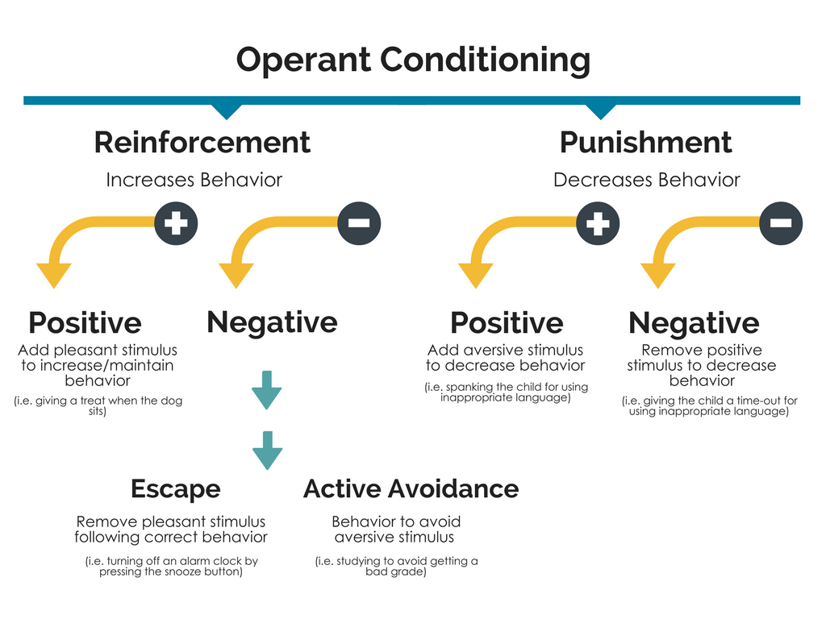

Slide 49
Assumptions of CBT
Main Assumption:
Substance problems arise/continue due to deficits in sober coping skills.
Patient is motivated to stop/reduce substance use-needs to acquire skills to do so.
Failure to engage in active coping when encountering precipitants to substance use contributes to relapse.
CBT is differentially effective in increasing active coping efforts when compared to alternative interventions
Because problems with coping are attributable to skills deficits, performance-based skill training techniques are necessary to remediate deficits
Notes:
https://pubs.niaaa.nih.gov/publications/arh23-2/078-85.pdf
Cognitive-Behavioral Therapy. This therapy is based on the principles of social learning theory and views drinking behavior as functionally related to major problems in the person’s life. It posits that addressing this broad spectrum of problems will prove more effective than focusing on drinking alone. Emphasis is placed on overcoming skill deficits and increasing the person’s ability to cope with high-risk situations that commonly precipitate relapse, including both interpersonal difficulties and intrapersonal discomfort, such as anger or depression. The program consists of 12 sessions with the goal of training the individual to use active behavioral or cognitive coping methods to deal with problems, rather than relying on alcohol as a maladaptive coping strategy. The skills also provide a means of obtaining social support critical to the maintenance of sobriety
The theory underlying CBT’s effectiveness hypothesizes three separate but interrelated assumptions – Morgenstein Longabaugh
1) Failure to engage in active coping when encountering precipitants to drinking contributes to relapse
2) CBT is differentially effective in increasing active coping efforts when compared to alternative interventions
3) Because problems with coping are attributable to skills deficits, performance-based skill training techniques are necessary to remediate these deficits

Slide 50
Cognitive Behavioral Therapy (CBT)
Some conclusions…
What are the clinical strategies involved in CBT? _ __________________
What is CBT and its assumptions?
How effective is CBT as an intervention for SUD?
Does it work the way we think it does?

Slide 51
Common Components of CBT
Establish good therapeutic relationship
Educate patients: model, disorder, therapy
Assess illness objectively, set goals
Use evidence to guide treatment decisions (collaborative empiricism)
Structure treatment sessions with agenda
Limit treatment length
Issue and review homework to generalize learning
Notes:
Course of Treatment
Assessment
Provide rationale
Training in self-monitoring
Behavioral strategies
Monitor relationship between situation/action and mood.
Applying new coping strategies to larger issues.
Identifying beliefs and biases
Evaluating and changing beliefs
Core beliefs and assumptions
Relapse prevention and termination
Rationale
Negative emotions are elicited by cognitive processes developed through influences of learning and temperament.
Adverse life events elicit automatic processing, which is viewed as the causal factor.
Cognitive triad: Negative automatic thoughts center around our understanding of:
Ourselves
Others (the world)
Future
Focus on examination of cognitive beliefs and developing rational responses to negative automatic thoughts.

Slide 52
Major Goals of CBT
Provide social-cognitive learning framework
  Substance use becomes predominant coping response to stress
Identify triggers (“functional analysis”)
  e.g., environmental, cognitive, affective
Teach Skills
  e.g., problem solving, environmental restructuring, social-interpersonal skills,
  cognitive restructuring, coping with craving/urges, relaxation
Consequence control – developing support systems
  Change positive expectancies about effects of use, access alternative reinforcers
  Develop social systems to support and reinforce abstinence
Reduce relapse risk (Abstinence Violation Effect)

Slide 53
Common Precursors to Relapse and How CBT might help
Cue Induced
Stress Induced
RELAPSE
Substance Induced
Social
Psych
Neuro-biology
CBT
Kelly JF, Yeterian, JD, (2013). In McCrady and Epstein. Comprehensive Textbook on Substance Abuse.
Notes:
Stress is one of the major precursors of relapse, along with cues, such as people, places, things, and moods, and priming doses of the substance, like one or two drinks, for example.
CBT could help mitigate this relapse risk is by mobilizing changes to biopsychosocial factors.
The most common triggers for relapse.
Just as addiction affects physical, emotional, social and spiritual aspects of an individual's life, the road to relapse may have signs that appear in all areas of one’s life.
Recovery is a biopsychosocial healing process and a commitment to change and growth.

Slide 54
Model for CBT Treatment (behavior chain): Functional analysis of substance use behavior
Trigger
Thoughts
Feelings
Behavior
Positive Consequences
Negative Consequences

Slide 55
Behavior Chain Modifying Worksheet
Example
Trigger
Thoughts
Feelings
Behavior
Positive Consequences
Negative Consequences
11:45 PM and in bed and not asleep
“I need alcohol to get to sleep"
Anxiety
Drink alcohol
Drowsy
Sleep
Wake up early;
jittery; worried
Notes:
The more positive or rewarding an experience you have as a consequence of a behavior, the more likely you are to repeat it.
The more rewarding trials you have with a behavior, the more likely it is to be repeated.
The time between the behavior and experience of its consequences is important (e.g., if you were to experience a hangover immediately after drinking instead of the next day)

Slide 56
Cognitive Behavioral Therapy (CBT)
Some conclusions…
What are the clinical strategies involved in CBT? _ __________________
What is CBT and its assumptions?
How effective is CBT as an intervention for SUD?
Does it work the way we think it does?

Slide 57
How effective is CBT as an intervention for SUD?
Main Treatment Effect
Small but statistically significant treatment effect (g = 0.154, p < .005)
Effects diminished over time: 6- to 9-months (g = 0.115, p < .005)
12 months (g = 0.096, p < .05)
Subgroup Moderators
Across substances, strongest among marijuana users (g = 0.513, p < .005)
CBT combined with additional psychosocial treatment (g = 0.305, p < .005; n = 19) had a larger effect size than CBT combined with pharmacological treatment (g = 0.208, p < .005; n =13) and CBT alone (g = 0.172, p < .05; n = 21)
Large effect size for CBT compared to no treatment (g = 0.796, p < .005; n = 6)
Regression Moderators
Women appeared to benefit more from CBT than men (b = .005, p < .05)
Benefit of shorter duration interventions: length of treatment had a negative association (b = -.008, p < .005) with effect size
No difference in effectiveness by format (group or individual)
Little evidence for its value as an adjunctive treatment particularly in combination with contingency management
Meta-analysis of 53 controlled trials (1982-2006) of CBT for adults with alcohol- or drug-use disorders.
Findings demonstrate utility of CBT across a large and diverse sample of studies and under rigorous conditions for establishing efficacy.
Magill M, & Ray, LA. (2009). Cognitive-behavioral treatment with adult alcohol and illicit drug users: a meta-analysis of randomized controlled trials. J Stud Alcohol Drugs, 70(4): 516-27
Notes:
Aims:
To provide a broad picture of CBT efficacy
Clarify potential design characteristics that may inflate or diminish effect size, and
Explore client or treatment factors as moderators of outcome
The mean sample size was 179 participants (range: 20-1,656). The treatment targets were: alcohol (n = 23), cocaine/stimulants (n = 11), polydrug (n = 11), marijuana (n = 6), and opiates (n = 2). The samples’ mean (SD) age was 38 (5.7) years. Studies included a moderate percentage of typically underrepresented groups such as women (mean = 29.2% [21.9%]) and ethnic or racial minorities (25.9% [27.8%]).
Current research demonstrates the overall effectiveness of CBT across adult alcohol- and other drug-use disorders.
This review also suggests that group CBT is as effective as CBT delivered as an individual treatment, and
Does not show that CBT is uniquely beneficial as aftercare or when delivered as an adjunctive treatment particularly in combination with contingency management
Meta-regression analyses indicated that the percentage of female participants was positively associated and the number of treatment sessions was negatively associated with effect size.
Findings demonstrate utility of CBT across a large and diverse sample of studies and under rigorous conditions for establishing efficacy.
CBT produced a small but statistically significant main treatment effect (g = 0.154, p < .005).
Treatment effects diminished over time: somewhat lower at 6- to 9-months (g = 0.115, p < .005) and markedly diminished at 12 months (g = 0.096, p < .05).
Subgroup moderators:
Across substances, effect was strongest among marijuana users (g = 0.513, p < .005)
CBT combined with additional psychosocial treatment (g = 0.305, p < .005; n = 19) had a larger effect size than CBT combined with pharmacological treatment (g = 0.208, p < .005; n =13) and CBT alone (g = 0.172, p < .05; n = 21).
Large effect size found for CBT in comparison to no treatment (g = 0.796, p < .005; n = 6)
Regression moderators:
Client Factors:
Women appeared to benefit more from CBT than men (b = .005, p < .05)
Treatment Factors:
No difference in effectiveness of CBT by format (group or individual)
Little evidence for its value as an adjunctive treatment particularly in combination with contingency management
Benefit of shorter duration interventions: length of treatment had a negative association (b = -.008, p < .005) with effect size

Slide 58
Cognitive Behavioral Therapy (CBT)
Some conclusions…
What are the clinical strategies involved in CBT? _ __________________
What is CBT and its assumptions?
How effective is CBT as an intervention for SUD?
How does it work?

Slide 59
Examining evidence of CBT’s hypothesized mechanisms of action
Coping Skills Mediator
Drinking-related outcome
CBT vs. Comparison
  Hypothesis: CBT for SUD works through increasing cognitive and behavioral coping skills
Review of 10 studies involving random assignment of participants to treatment condition (CBT and at least one comparison condition)
Four necessary conditions to establish support for coping skills mediation:
  CBT reduces substance use more than comparison
  CBT increases coping skill mediator more than comparison
  Substance outcome co-varies with coping skills mediator
  Entering mediator as a covariate reduces the treatment effect
Morgenstern, J. and Longabaugh, R. (2000). Cognitive–behavioral treatment for alcohol dependence: A review of evidence for its hypothesized mechanisms of action. Addiction, 95: 1475–1490. doi:10.1046/j.1360-0443.2000.951014753.x
Notes:
Cognitive-behavioral treatment for alcohol dependence: a review of evidence for its hypothesized mechanisms of action.
Morgenstern Longabaugh
Increase in self-efficacy
Acquisition of cognitive and behavioral coping skills
Use of these coping skills to handle stressful and/or alcohol-related situations
METHOD:
Ten studies involving random assignment (or near equivalent) of participants to treatment condition (CBT and at least one comparison condition)
RESULTS:
Although numerous analyses of the possible causal links have been conducted to evaluate whether CBT works through increasing coping, results indicate little support for the hypothesized mechanisms of action of CBT.
Overall, no reported positive findings; most common that none or only one step of the mediational chain were supported
CONCLUSIONS:
Research has not yet established why CBT is an effective treatment for alcohol dependence.
Explanations for negative findings:
Methodological flaws of prior studies may have obscured detection of effects
One or more underlying assumptions of CBT model may require revision
THEORY OF CBT EFFECTIVENESS HYPOTHESIZES THREE SEPARATE BUT INTERRELATED ASSUMPTIONS:
Failure to engage in active coping when encountering precipitants to drinking contributes to relapse
CBT treatment is differentially effective in increasing active coping efforts when compared to alternative interventions
Because problems with coping are attributable to skills deficits, performance-based skill training techniques are necessary to remediate these deficits
Empirical evidence only supports the first assumption
Studies have found that measures of coping are related to relapse (Chaney et al., 1978; Monti et al., 1990, 1993; Kadden et al., 1992).
SE consistent predictor of treatment outcome (Annis & Davis, 1988)
Failure to show that a mediator changed differentially in the CBT condition, and failure to demonstrate that is co-varied with the drinking outcome variable
CBT was demonstrated to increase coping behavior more than comparison, but relationship of coping behavior to drinking outcome was either not tested or found to be unrelated to the same drinking variable that CBT was shown to effect
Putative mediating coping behavior taught in CBT was reported to be related to drinking outcome, change in this coping behavior was not associated with CBT treatment

Slide 60
Examining evidence of CBT’s hypothesized mechanisms of action
Coping Skills Mediator
Drinking-related outcome
CBT vs. Comparison
Results indicate little support for the hypothesized mechanisms of action of CBT.
Overall no reported positive findings
Most common that none or only one step of the mediational chain supported
Research has not yet established why CBT is an effective treatment for SUD.
Possible explanations for negative findings:
Methodological flaws of prior studies may have obscured detection of effects
One or more underlying assumptions of CBT model may require revision
Morgenstern, J. and Longabaugh, R. (2000). Cognitive–behavioral treatment for alcohol dependence: A review of evidence for its hypothesized mechanisms of action. Addiction, 95: 1475–1490. doi:10.1046/j.1360-0443.2000.951014753.x
Notes:
Empirical evidence only supported assumption that failure to engage in active coping when faced with triggers will contribute to relapse.
Measures of coping are related to relapse (Chaney et al., 1978; Monti et al., 1990, 1993; Kadden et al., 1992).
SE was consistent predictor of treatment outcome (Annis & Davis, 1988)
Failure to show that a mediator changed differentially in CBT condition, and failure to demonstrate that is co-varied with the drinking outcome
CBT was demonstrated to increase coping behavior more than comparison, but relationship of coping behavior to drinking outcome was either not tested or found unrelated to the same drinking variable that CBT was shown to effect
Putative mediating coping behavior taught in CBT was reported to be related to drinking outcome, but change in this coping behavior was not associated with CBT treatment

Slide 61
Cognitive Behavioral Therapy (CBT)
Some conclusions…
What are the clinical strategies involved in CBT? _ __________________
What is CBT and its assumptions?
How effective is CBT as an intervention for SUD?
Does it work the way we think it does?

Slide 62
Summary
CBT represents therapeutic approach consisting of common set of strategies based in social-cognitive learning theory
Deconditioning-cognitive restructuring-skills building form basis of intervention usually anchored in functional analysis (behavior chain analysis)
CBTs for SUD are empirically supported but typically not clinically superior to other types of active interventions
Causal mechanisms of CBT’s effects on reducing alcohol/drug use not well-supported suggesting that, similar to other interventions, the common therapeutic encounter provides a context that activates and mobilizes dormant broad cognitive-behavioral strategies within patients that confers therapeutic benefits.

Slide 63


Slide 64
Self-Help
and Related Clinical Interventions
John F. Kelly, Ph.D.
www.recoveryanswers.org

Slide 65
Disclosures
Neither I nor my spouse/partner has a relevant financial relationship with a commercial interest to disclose.

Slide 66
Overview
Background and Rationale: Why “self-help” (“mutual-help”)?
Efficacy and Mechanisms: Do groups like AA confer real benefits? If so, how?
Clinical Interventions: What can we do clinically to enhance “self-help” participation and enhance outcomes?

Slide 67
Overview
Background and Rationale: Why “self-help” (“mutual-help”)?
Efficacy and Mechanisms: Do groups like AA confer real benefits? If so, how?
Clinical Interventions: What can we do clinically to enhance “self-help” participation and enhance outcomes?

Slide 68
1. Why “Self-help”?
Key Points
  Achieving stabilization and recovery is demanding
  Addiction is susceptible to relapse over the long-term
  MHOs like AA are widely available - provide adaptive long-term indigenous community recovery support for free

Slide 69
CBT
MI
TSF

Slide 70
The clinical course of addiction and achievement of stable recovery can take a long time …
Addiction Onset
Help Seeking
Full Sustained Remission (1 year abstinent)
Relapse Risk drops below 15%
4-5 years
8 years
5 years
Opportunity for earlier detection through screening in non-specialty settings like primary care/ED
Self-initiated cessation attempts
4-5 Treatment episodes/
mutual-help
Continuing care/
mutual-help
50-60% of individuals with addiction will achieve full sustained remission
Recovery Priming
Recovery Mentoring
Recovery Monitoring
Notes:
Wang, P. S., Berglund, P., Olfson, M., Pincus, H. A., Wells, K. B., & Kessler, R. C. (2005). Failure and delay in initial treatment contact after first onset of mental disorders in the National Comorbidity Survey Replication. Arch Gen Psychiatry, 62(6), 603-613. doi: 62/6/603 [pii]
10.1001/archpsyc.62.6.603
Dennis, M. L., Scott, C. K., Funk, R., & Foss, M. A. (2005). The duration and correlates of addiction and treatment careers. J Subst Abuse Treat, 28 Suppl 1, S51-62. doi: S0740-5472(04)00138-2 [pii] 10.1016/j.jsat.2004.10.013
De Soto, C.B., O’Donnell, W.E., & De Soto, J.L. (1989). Long-term recovery in alcoholics. Alcoholism: Clinical
and Experimental Research, 13, 693-697. Vaillant, G. E. (1996). A long-term follow-up of male alcohol abuse.
Archives of General Psychiatry, 53(3), 243-249. Nathan, P., & Skinstad, A. (1987). Outcomes of treatment for
alcohol problems: Current methods, problems and results. Journal of Consulting and Clinical Psychology, 55,
332-340. Dawson, D. A. (1996). Correlates of past-year status among treated and untreated persons with
former alcohol dependence: United States, 1992. Alcoholism: Clinical and Experimental Research, 20(4),
771-779. Jin, H., Rourke, S. B., Patterson, T. L., Taylor, M. J., & Grant, I. (1998). Predictors of relapse in
long-term abstinent alcoholics. Journal of Studies on Alcohol, 59, 640-646. Dennis, M. L., Foss, M. A., &
Scott, C. K. (2007). An eight-year perspective on the relationship between the duration of abstinence and other
aspects of recovery. Evaluation Review, 31(6), 585-612. Schutte, K., Byrne, F., Brennan, P., & Moos, R.
(2001). Successful remission of late-life drinking problems: A 10-year follow-up. Journal of Studies on
Alcohol 62, 322-334.

Slide 71

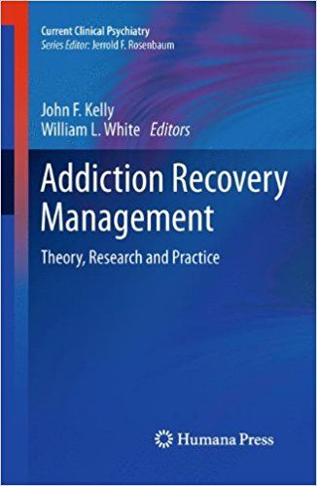

Slide 72
Potential Advantages of Community Mutual-help
Cost-effective -free; attend as intensively, as long as desired
Focused on addiction recovery over the long haul
Widely available, easily accessible, flexible
Access to fellowship/broad support network
Entry threshold (no paperwork, insurance); anonymous (stigma)
Adaptive community based system that is responsive to undulating relapse risk
Notes:
72

Slide 73
Substance Focused Mutual-help Groups
Name | Year of Origin | Number of groups in U.S. | Location of groups in U.S. | Evidence base* (0-3)
Alcoholics Anonymous (AA) | 1935 | 52,651 | all 50 States | 1, 2, 3
Narcotics Anonymous (NA) | 1940s | Approx. 15,000 | all 50 States | 1, 2
Cocaine Anonymous (CA) | 1982 | Approx. 2000 groups | most States; 6 online meetings at www.ca-online.org | 0
Methadone Anonymous (MA) | 1990s | Approx. 100 groups | 25 States; online meetings at http://methadone-anonymous.org/chat.html | 1, 2
Marijuana Anonymous (MA) | 1989 | Approx. 200 groups | 24 States; online meetings at www.ma-online.org | 0
Rational Recovery (RR) | 1988 | No group meetings or mutual helping; emphasis is on individual control and responsibility | ----------------------------------------------------- | 1, 2
Self-Management and Recovery Training (S.M.A.R.T. Recovery) | 1994 | Approx. 250 groups | 40 States; 19 online meetings at www.smartrecovery.org/meetings/olschedule.htm | 1, 3
Secular Organization for Sobriety, a.k.a. Save Ourselves (SOS) | 1986 | Approx. 480 groups | all 50 States; Online chat at www.sossobriety.org/sos/chat.htm | 1
Women for Sobriety (WFS) | 1976 | 150-300 groups | Online meetings at http://groups.msn.com/ WomenforSobriety | 1
Moderation Management (MM) | 1994 | Approx.16 face-to-face meetings | 12 States; Most meetings are online at www.angelfire.com/trek/mmchat/; | 1
*0= None 1=Descriptive studies only 2 = Observational (correlational, longitudinal) 3= Experimental (random assignment, controlled).
Source: Kelly & Yeterian, 2008

Slide 75
Overview
Background and Rationale: Why “self-help” (“mutual-help”)?
Efficacy and Mechanisms: Do groups like AA confer real benefits? If so, how?
Clinical Interventions: What can we do clinically to enhance “self-help” participation and enhance outcomes?

Slide 76
2. Do groups like AA actually confer real benefits? If so, how?
Key Points
  MHOs, like AA, confer benefits that are on par in magnitude with professional interventions
  Interventions that promote MHO participation (i.e., TSF) often produce superior outcomes and higher rates of FSR
  Participation in MHOs reduces reliance on professional care, reduces health costs and enhances remission
  TSF/MHOs produce these better outcomes because they mobilize mechanisms mobilized by formal treatment (e.g., coping skills/motivation/abstinence self-efficacy)

Slide 77




Notes:
Prior to 1990 AA research methodologically poor….

Slide 78
TSF Delivery Modes
TSF
OTH
  Stand alone
  Independent therapy
  Integrated into an existing therapy
  Component of a treatment package (e.g., an additional group)
As Modular appendage linkage component
In past 25 years, AA research has gone from contemporaneous correlational research to rigorous RCTs and …
Notes:
TSF implemented in various ways:

Slide 79
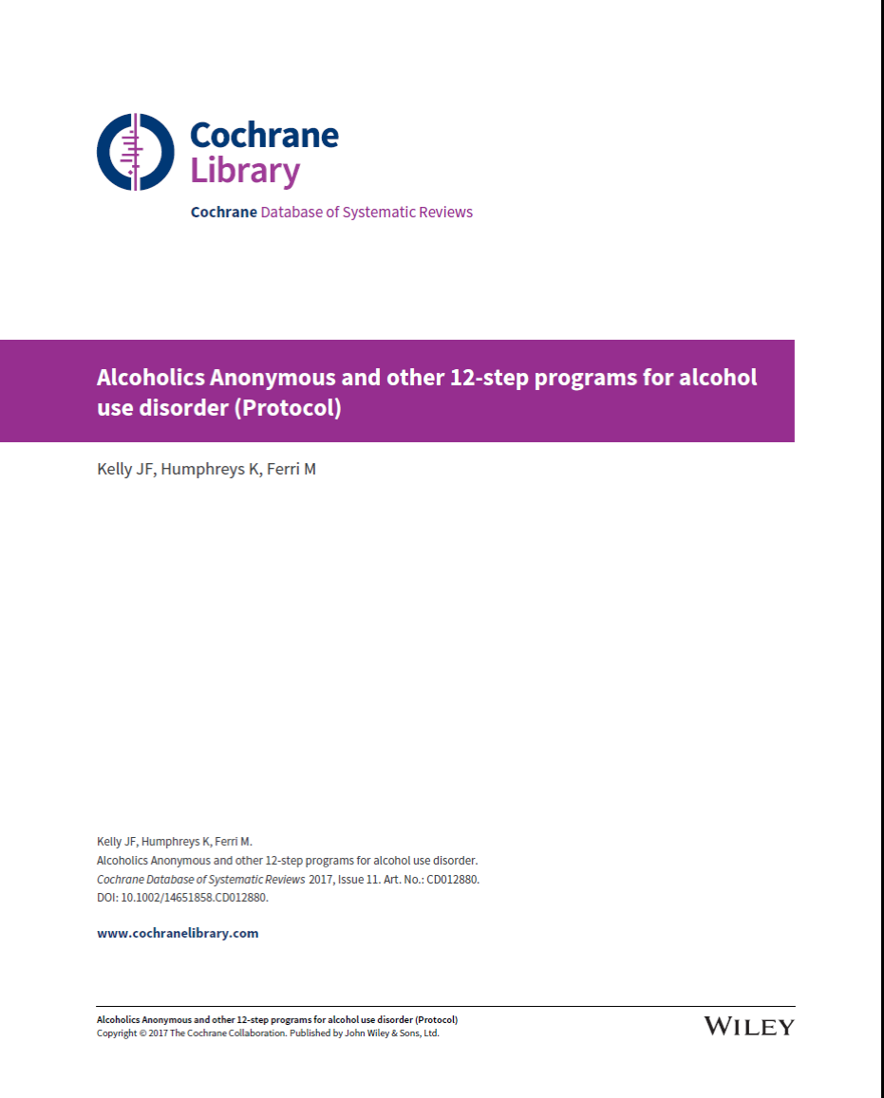

Slide 80
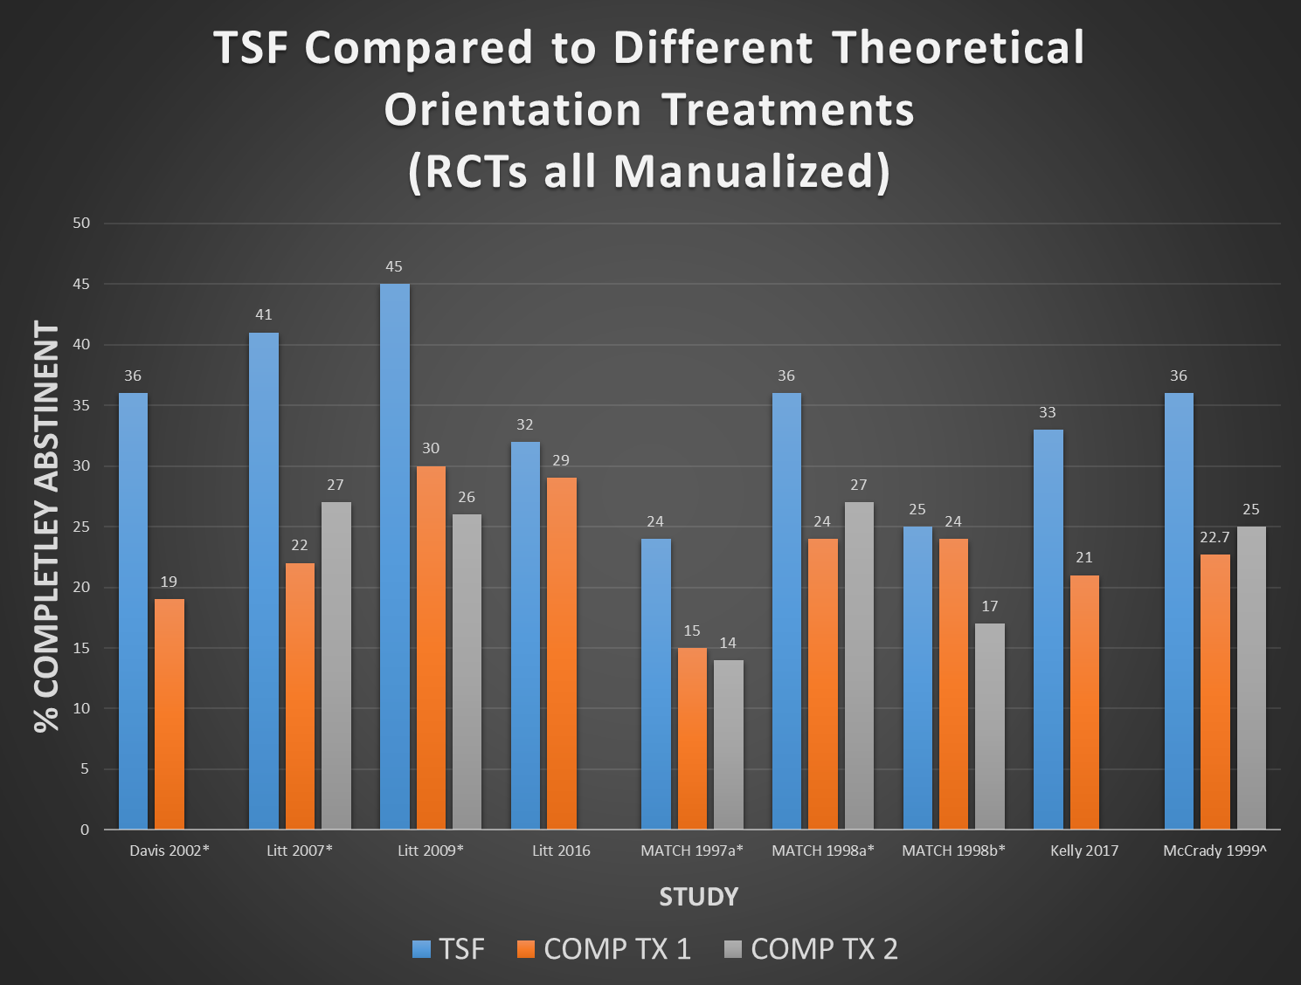

Slide 81
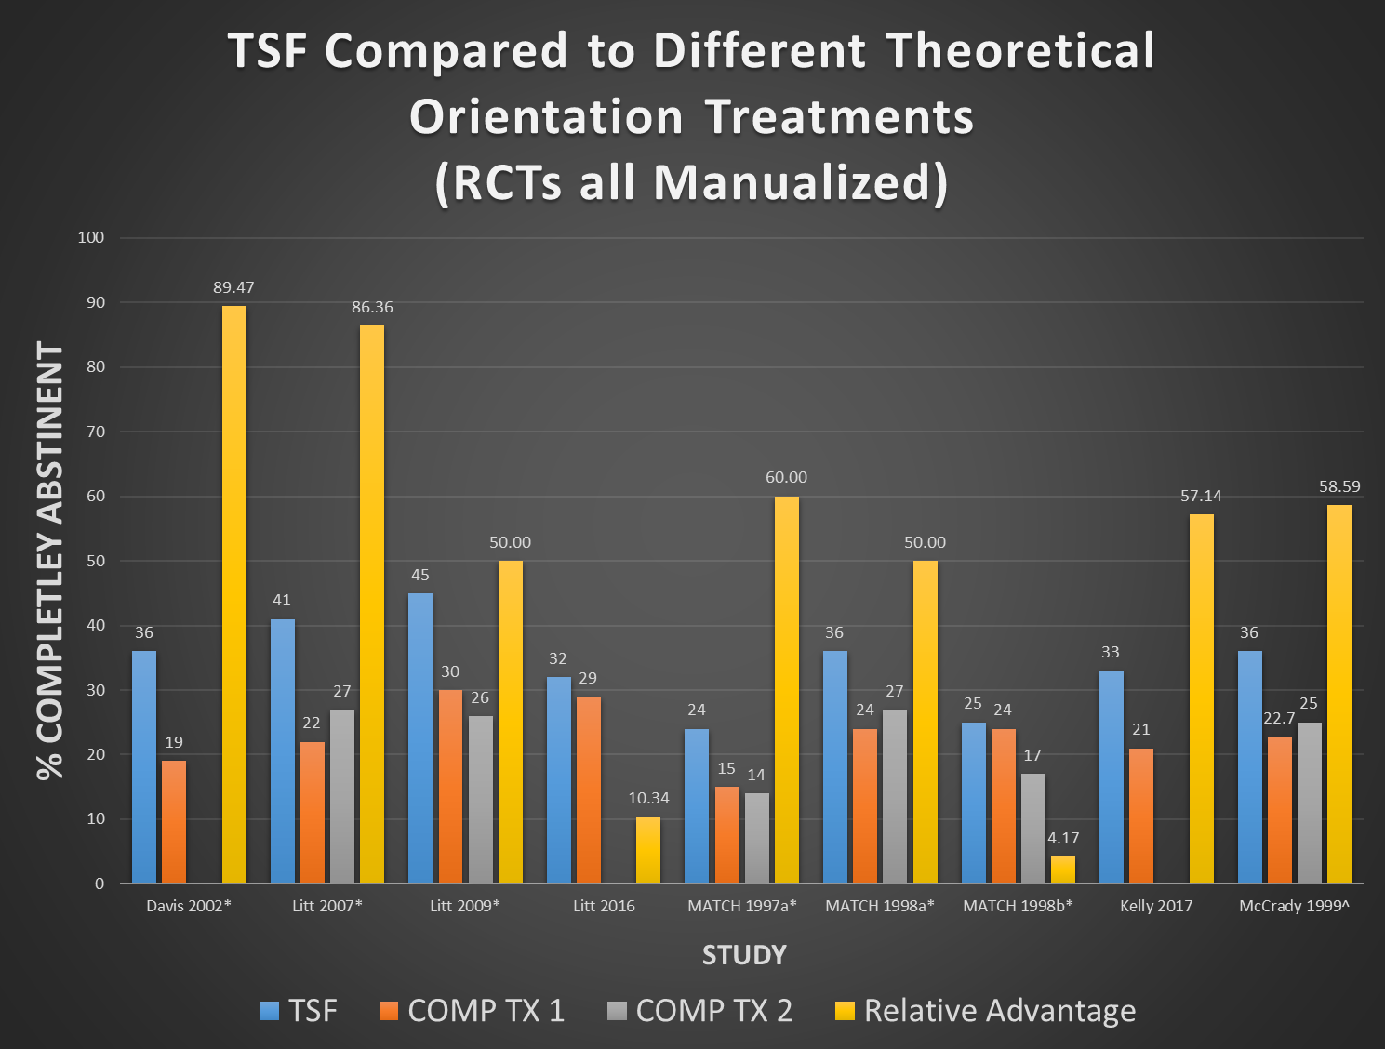

Slide 82
Health Care cost offset
CBT VS 12-STEP RESIDENTIAL TREATMENT
Compared to CBT-treated patients, 12-step treated patients more likely to be abstinent, at a $8,000 lower cost per pt over 2 yrs ($10M total savings)
Also, higher remission rates, means decreased disease and deaths, increased quality of life for sufferers and their families
Humphrey and Moos, 2001, 2007 ; ACER

Slide 83
Overview
Background and Rationale: Why “self-help” (“mutual-help”)?
Efficacy and Mechanisms: Do groups like AA confer real benefits? If so, how?
Clinical Interventions: What can we do clinically to enhance “self-help” participation and enhance outcomes?

Slide 84
Curative factors of group therapy and… of MHOs?
Universality
Altruism
Instillation of hope
Imparting information
Recapitulation of the primary family experience
Development of socializing techniques
Imitative behavior
Cohesiveness
Existential factors
Catharsis
Interpersonal learning
Self-understanding
(Yalom, 1995)

Slide 85
TSF often produces significantly better outcomes relative to active comparison conditions (e.g., CBT)
Although TSF is not “AA”, it’s beneficial effect is explained by AA involvement post-treatment.

Slide 86
TSF-AA-OUTCOME Causal chain supported…
TSF
AA
BETTER OUTCOME

Slide 87
What about support for causal chain of purported mobc of AA on outcomes?
MOBC?
TSF
AA
BETTER OUTCOME

Slide 88
Empirically-supported MOBCs through which AA confers benefit
Social network
Spirituality
Social Abstinence self-efficacy
AA participation in turn is explained by these factors which are similar to the mechanisms operating in formal treatment, and probably other MHOs as well….
Coping skills
Recovery motivation
Negative Affect Abstinence self-efficacy
Impulsivity
Craving
Notes:
So, if we apply these to models of common precursors to relapse…

Slide 89
Do more and less severely alcohol dependent individuals benefit from AA in the same or different ways?
effect of AA on alcohol use for AC was explained by social factors but also by S/R and through boosting NA ASE (DDD only)
Majority of effect of AA on alcohol use for OP was explained by social factors
Source: Kelly, Hoeppner, Stout, Pagano (2012) , Determining the relative importance of the mechanisms of behavior change within Alcoholics Anonymous:
A multiple mediator analysis. Addiction 107(2):289-99

Slide 90
Do men and women benefit from AA in the same ways?
NA ASE was a MOBC for women but not men - suggests that boosts in NA ASE were available in AA but men didn’t find this aspect relevant.
For men, AA was a way to help them find new sober friends and boost their social ASE much more than women
Source: Kelly and Hoeppner (2013) , Does Alcoholics Anonymous work differently for men and women? A moderated multiple-mediation analysis in a large clinical sample. Drug and Alcohol Dependence
Notes:
Men may use AA more than women to help them buffer socially-relevant relapse risks. Women appear to benefit in similar ways, but more work is needed to understand the additional ways women derive recovery benefit from AA. The pattern of findings underscores some gender-based differences that may have broader implications for the addiction treatment and recovery field. For women between the ages of 30 and 50, a focus on finding alternative ways to cope with negative affect may yield recovery benefits, while among men in the same life-stage, a relatively greater focus on coping with high risk social situations may yield recovery related benefits.

Slide 91
Do young Adults benefit as much and in the same ways as older adults
Young people (18-29yrs) benefitted as much as older adults, but these 6 MOBCs explained a much lower proportion of their benefit
The way AA helped young people differed also - mostly by helping them drop high risk social network members and boosting their social ASE; young people did not find new friends in AA (perhaps due to lack of sober same aged peers) and did not benefit via spirituality as much as older adults
Source: Hoeppner , Hoeppner, Kelly (2014) , Do young people benefit from AA as much, and in the same ways, as adult aged 30+? A moderated multiple mediation analysis. Drug and Alcohol Dependence.

Slide 92
Moderated-Mechanisms: AA effects Moderated by Severity, Gender, Age…
CONCLUSIONS
  6 mediators = about 50% of direct effect of AA on drinking (other 50%?)
  Proportion of direct effect explained even lower among young adults; more research needed on how young people benefit
  Of note, this MOBC research finds that the same entity/intervention (i.e., AA) produces benefits that differ in nature and magnitude between more severely alcohol involved/impaired and less severely alcohol involved/impaired; men and women; and, young adults and adults 30+
  Differences may reflect differing needs based on recovery challenges related to differing symptom profiles, degree of subjective suffering and perceived severity/threat, life-stage based recovery contexts, and gender-based social roles & drinking contexts

Slide 93
Similar to psychotherapy literature rather than thinking about how AA or similar interventions “work”, better to think how individuals use or make these interventions work for them – to meet most salient needs at any given phase of recovery

Slide 94


“Living Sober” vs. “Big Book”
MOBC research results suggest the way AA works has a closer fit with the pragmatic social, cognitive, and behavioral experiences of how its members stay sober documented in its later publications (Living Sober, 1975) than with the Big Book (1935; 2001), which was written in 1935 and based on relatively little accumulation of sober experience (i.e., less than one hundred members, most with short lengths of sobriety)

Slide 95

12-Step Alternatives
Main Findings
SMART RECOVERY RCT
One study found no difference between SR meetings only and SR meetings + an online SR intervention^{[23]}
PEER ALTERNATIVES COMPARATIVE EFFICACY STUDY
Adults with AUD who were members of WFS, LifeRing, SMART, or 12-step^{[24]}
  Overall, primary group affiliation and involvement did not predict substance use outcomes over the 1-year period
  SMART Recovery and LifeRing members were less likely than 12-step members to be abstinent at 1-year follow-up; however, these effects were negated when controlling for baseline abstinence goal
Alternatives to 12-step are likely to be as helpful as 12-step involvement at helping people manage SUDs. However, more research is needed on alternatives to 12-step, including research on facilitation to these groups.
Notes:
First bullet point:
In the single RCT of a non-12-step MHO (Campbell et al., 2016), SMART Recovery (SR) attendees were randomly assigned to participate in SR only or SR + Overcoming Addictions, a web-based intervention based on SR principles and techniques.
This null result suggests that there was no additive effect of the online intervention.

Slide 97
Overview
Background and Rationale: Why “self-help” (“mutual-help”)?
Efficacy and Mechanisms: Do groups like AA confer real benefits? If so, how?
Clinical Interventions: What can we do clinically to enhance “self-help” participation and enhance outcomes?

Slide 98
3. What can we do clinically to enhance “self-help” participation and thereby enhance clinical outcomes?
Key points
  Broach the topic of MHO participation
  Discuss what to expect (if patient never been)
  Actively prescribe participation
  Link with active members whenever possible
  Monitor attendance and reaction

Slide 99
TSF Delivery Modes
TSF
OTH
  Stand alone
  Independent therapy
  Integrated into an existing therapy
  Component of a treatment package (e.g., an additional group)
As Modular add-on linkage component
Notes:
TSF implemented in various ways:

Slide 100
Strategies for Facilitating Outpatient Attendance of AA (Wallitzer et al, 2008)
Approaches to assist in involvement in AA
169 adult alcoholic outpatients randomly assigned to one of three treatment conditions
All clients received treatment that included:
  12 sessions
  Focus on problem-solving, drink refusal, relaxation
  Recommendation to attend AA meetings

Slide 101
Strategies for Facilitating Outpatient Attendance of AA
Treatment varied between 3 conditions in terms of how the therapist discussed AA and how much information about AA was shared
  Condition 1: Directive approach
    - “I’d like you to attend 3 meetings this week and keep a diary of your experience….”
  Condition 2: motivational enhancement approach (more client centered)
    - “How do you think groups like AA might help you in your change attempts/recovery?”
  Condition 3: CBT treatment as usual, no special emphasis on AA
    - Throughout treatment, therapist briefly inquires about AA and encourages client to attend AA
Walitzer, Dermen & Barrick, 2009

Slide 102
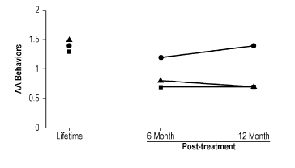
Strategies for Facilitating AA Attendance during Outpatient Treatment

Slide 103
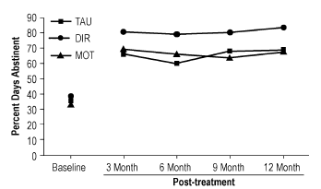
Strategies for Facilitating AA Attendance during Outpatient Treatment

Slide 104
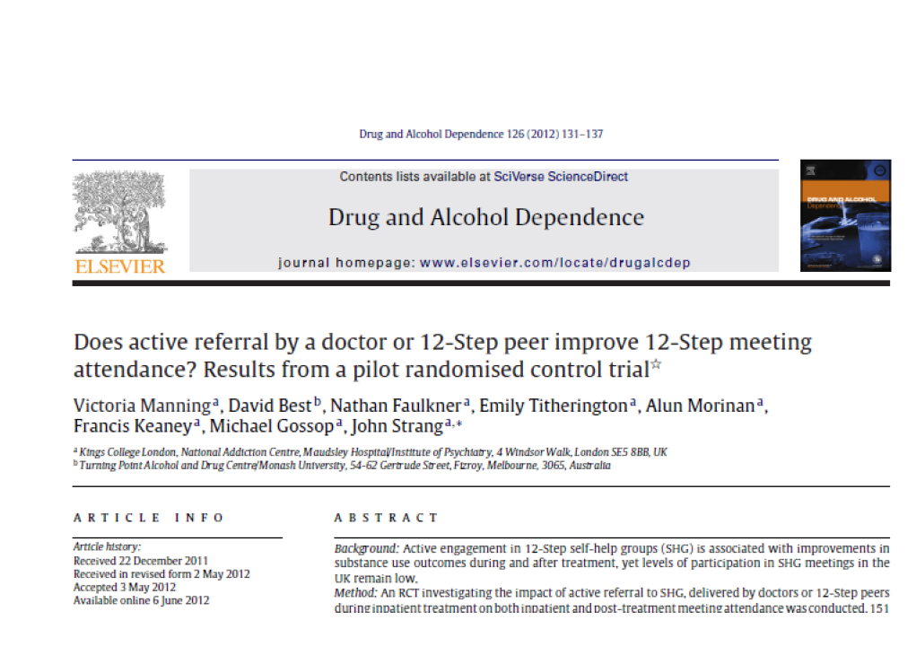

Slide 105
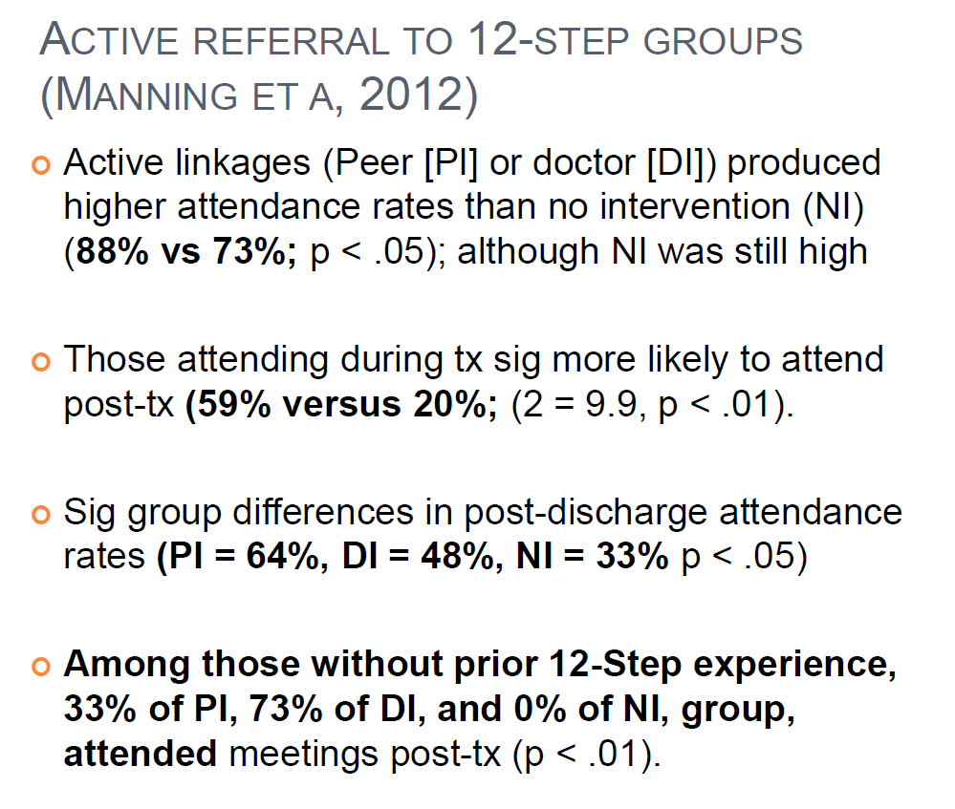

Slide 106
Summary
Mutual-help organizations, like AA, are effective public health resources helping to mitigate relapse risk, and reduce health care costs.
Research demonstrates AA works by mobilizing similar therapeutic mechanisms as those mobilized by professional interventions, but does so over the long-term for free in the communities in which people live.
A number of empirically-supported manualized interventions now exist that are shown to stimulate mutual-help participation during and following formal treatment and thereby improve outcomes and reduce health costs over the long-term.

