Slide 1
Parkside, Tulsa, OK November 2019 John F. Kelly, PhD, ABPP
From the “War on Drugs” to the “War on the War on Drugs”:
50 years of Drug Policy, Research, and Treatment
Notes:
Title: Recovery From Alcohol and Drugs Problems in a National Sample of U.S. Adults: Prevalence, Pathways, and Predictors
Talk Description: While much is known about the causes, clinical course, and treatment, of addiction, little is known about the prevalence, processes, pathways, and predictors of long-term remission and recovery.
This presentation reviews and discusses findings from the first nationally-representative study of U.S. adults who have resolved a significant alcohol or other drug problem, examines their varied pathways
to problem resolution, and describes the predictors of use of those pathways. Findings regarding changes in quality of life with time in recovery and smoking status and cessation will also be reviewed.
Learning Objectives
By the end of this presentation participants will be able to:
1. Describe recovery prevalence in the United States
2. Name the major pathways that people use to recover
3. Specify the changes in quality of life that occur with time in recovery

Slide 2
John F. Kelly, PhD ABPP Elizabeth R. Spallin Professor of Psychiatry in Addiction Medicine Harvard Medical School Director Recovery Research Institute Associate Director Center for Addiction Medicine Massachusetts General Hospital
No disclosures.
Content presented here represents the views of the presenter/author and do not necessarily represent the views of any other associated entity

Slide 4
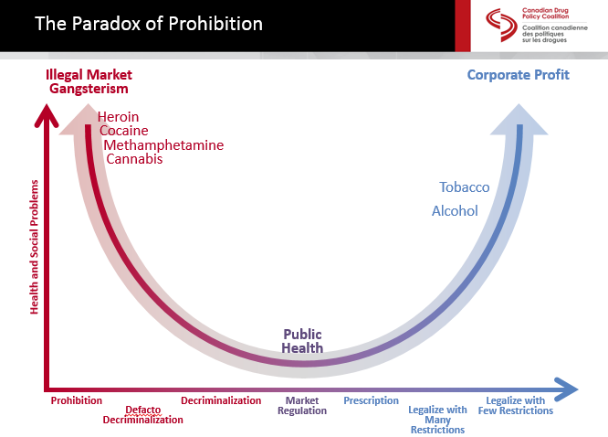
Different legal and commercial statuses of substances can affect consumption rates, patterns, and produce different types of harms…
Source: Canada Drug Policy Coalition, 2015
Notes:
Different policy position produe different harms…. The question is who will be the casualties? Are these casualties “acceptable”?

Slide 6
Source: Kelly, Hoeppner, Stout, Pagano (2012) , Determining the relative importance of the mechanisms of behavior change within Alcoholics Anonymous: A multiple mediator analysis. Addiction 107(2):289-99

Slide 7
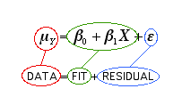

Slide 8
Translation of Standardized Effect Sizes to amount of variance explained (model fit)
Most clinical treatment effect
sizes explain about 1-4%
the variability in clinical
outcomes

Slide 9
…”More research is needed.”

Slide 10
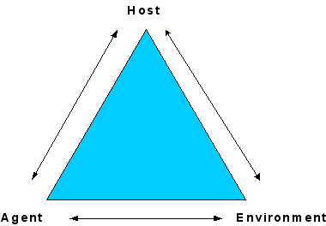
PUBLIC
HEALTH
MODEL
Notes:
Another “wrong” model, but a “useful” one!
Public health model
Individual/Host: age, attitudes toward drug use, genetics, dual diagnosis, etc.
Agent: Type and strength of drugs
Environment: treatment and recovery services, policy and laws, employment opportunities, drug availability, friends and family use

Slide 11
70,237 Overdose
deaths in the U.S.
In 2017

Slide 12
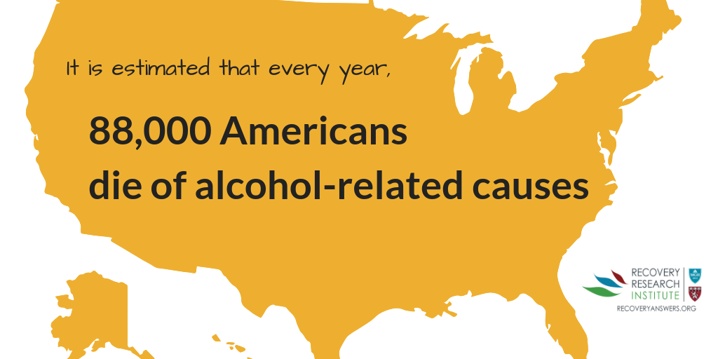

Slide 13
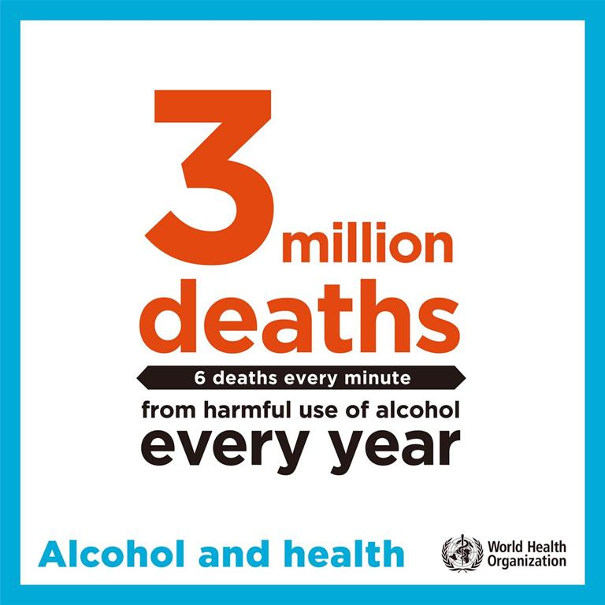

Slide 14
U.S. Economic burden
$600 Billion annually…
Lost productivity
Healthcare costs
Criminal justice

Slide 15
ADDICTION IS A COMPLEX DISORDER
RISK FACTORS
Biology/Genes
Environment
Genetics
Gender
Mental Health
Chaotic home and abuse
Parent’s use and attitudes
Peer influence
Community attitudes
Poor school achievement
Route of administration
Effect of drug itself
Drug
Early use
Availability
Cost
Brain Mechanisms
Addiction
Notes:
Most conditions and diseases have a genetic component. Some disorders, such as sickle cell disease and cystic fibrosis, are caused by mutations in a single gene. SUD and addiction, and mental health conditions, in contrast, are “complex” disorders caused by interactions among genes/biology, environment, and lifestyle….

Slide 16
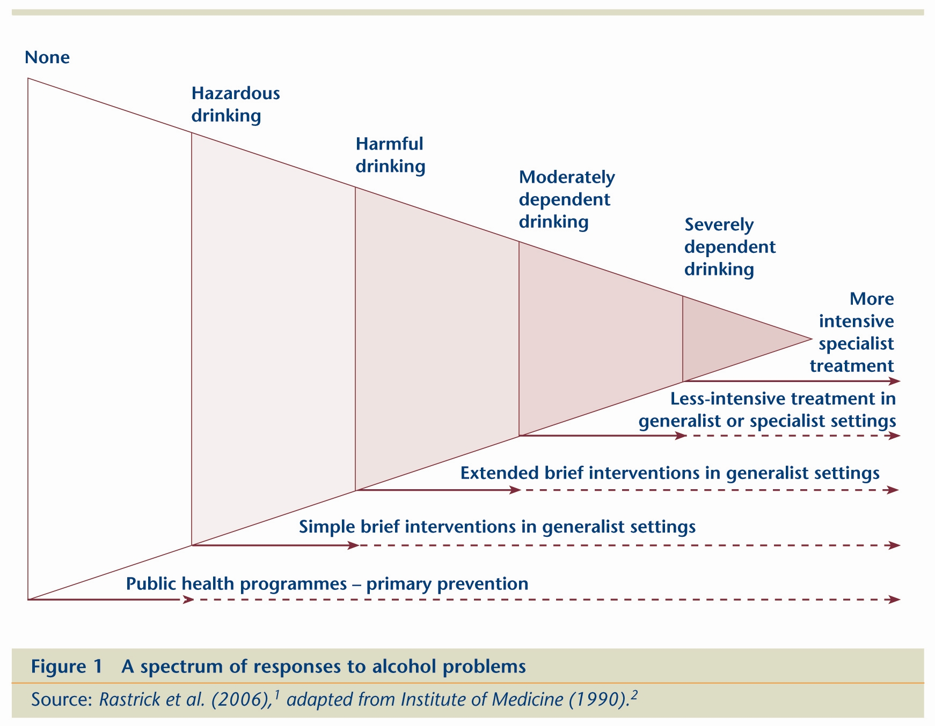
Spectrum of Alcohol and Drug Problems…

Slide 17
How do substances cause harm?
Mediators of substance-related harm:
Toxicity, Intoxication, and Substance use Disorder
Patterns of Use
Average volume
intoxication
Toxic Effects
Addiction
Chronic Disease
Accidents/injuries (acute disease)
Acute social problems
Chronic Social problems
(Adapted from: Babor et al, 2010)

Slide 18
How do substances cause harm?
Mediators of substance-related harm:
Toxicity, Intoxication, and Substance use Disorder
Patterns of Use
Average volume
intoxication
Liver disease
Cancer
Toxic Effects
Addiction
Chronic Disease
Accidents/injuries (acute disease)
Acute social problems
Chronic Social problems
(Adapted from: Babor et al, 2010)

Slide 19
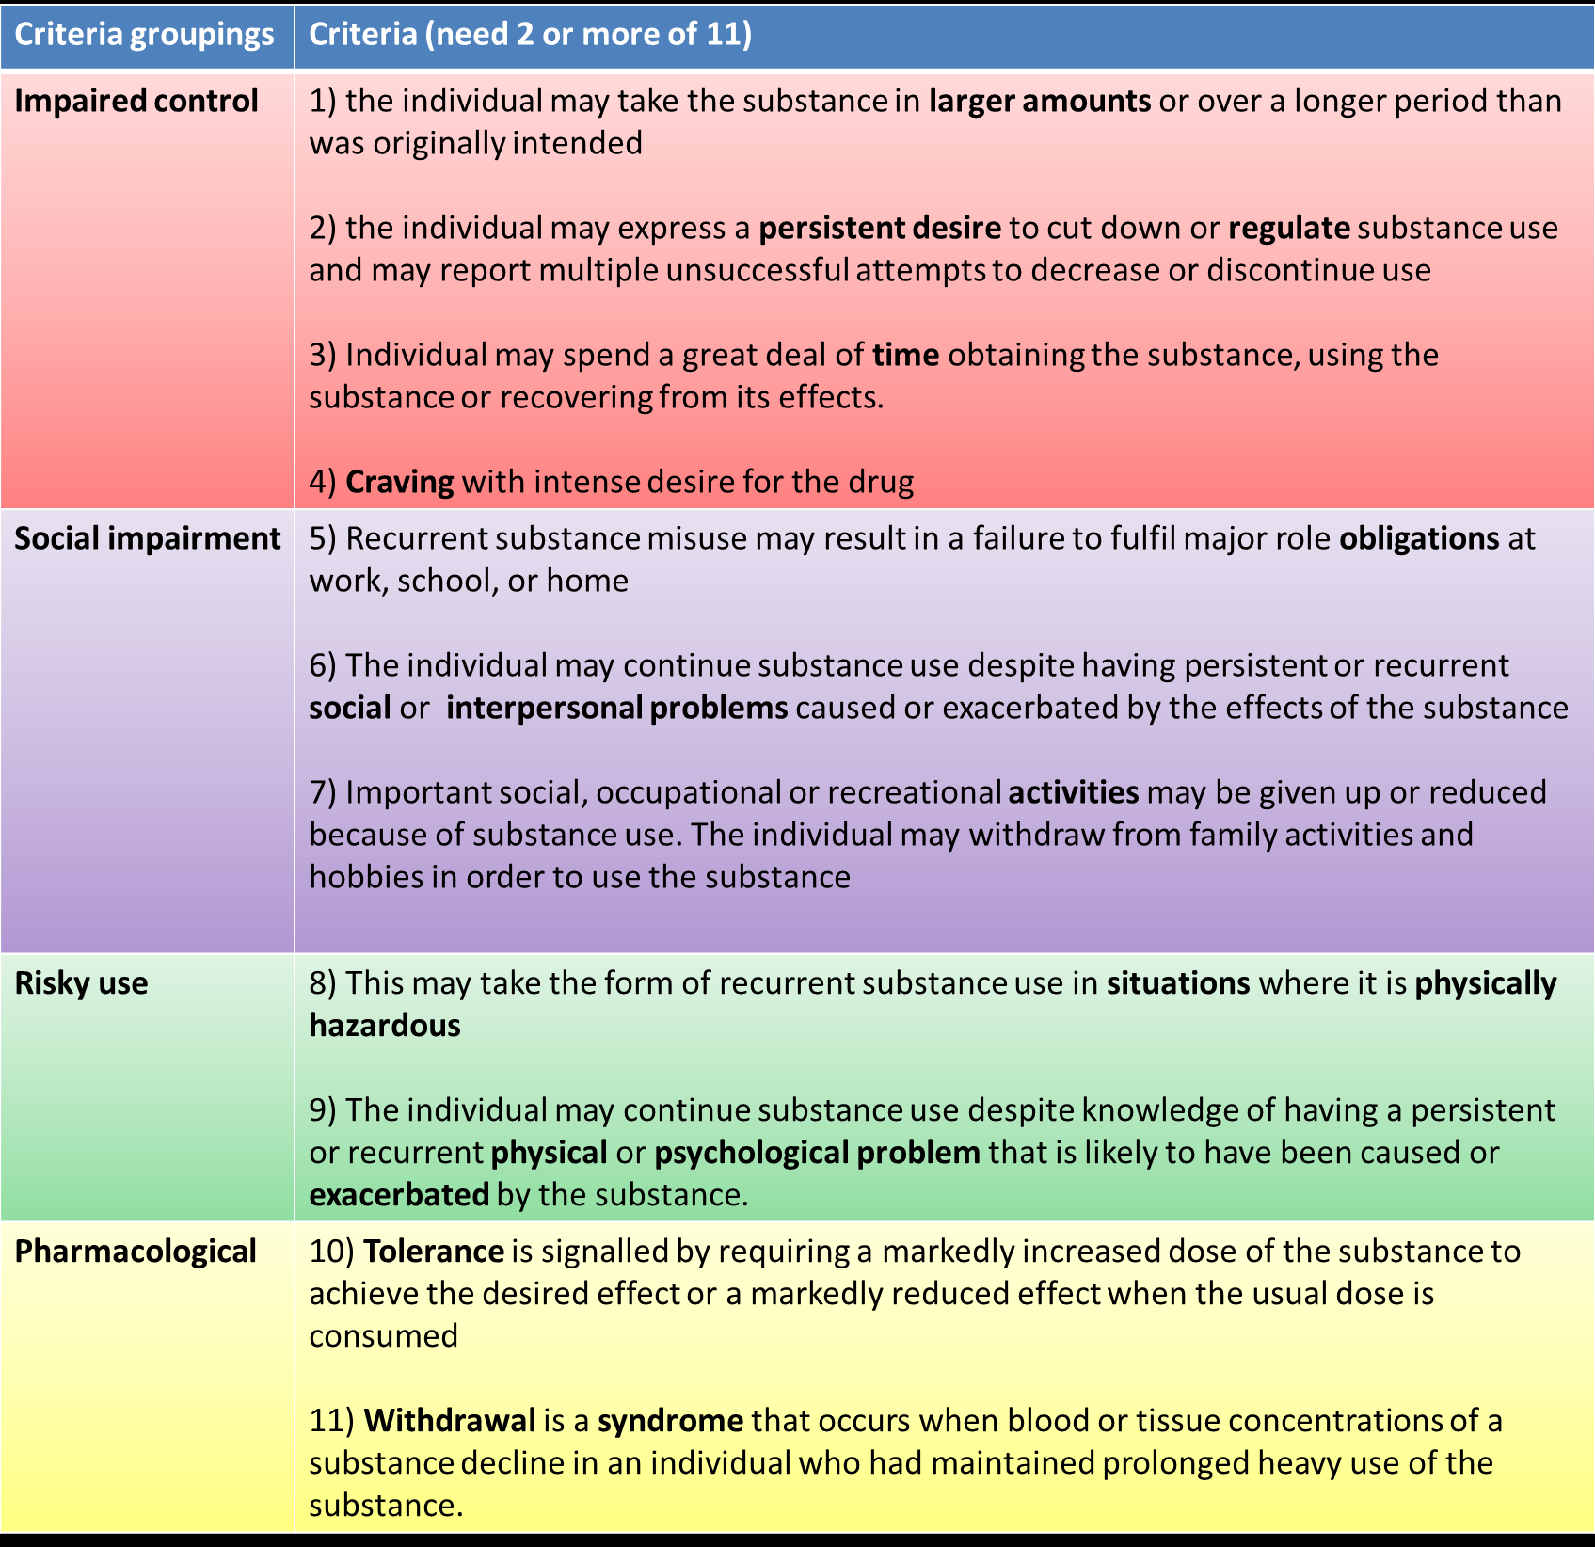
“THIS ONE GOES TO 11” DSM 5 SUD Criteria
Highly heterogeneous
Category…
Mild=2-3
Mod=4-5
Sev=6+

Slide 20
Substance-related problems: Top Public health Problem…
Pervasive and intransigent
Endemic and epidemic
Confer prodigious burden of disease, disability, premature mortality
Heavy economic burden, lost productivity, criminal justice, health care
Are highly heterogeneous

Slide 21
What have we done about it? What are we doing about it? How can we do better?

Slide 22
PUBLIC
HEALTH
MODEL
Notes:
Another “wrong” model, but a “useful” one!
Public health model
Individual/Host: age, attitudes toward drug use, genetics, dual diagnosis, etc.
Agent: Type and strength of drugs
Environment: treatment and recovery services, policy and laws, employment opportunities, drug availability, friends and family use

Slide 23
Major Policy Strategies
Supply Reduction
Demand Reduction
Harm Reduction

Slide 24
Different legal and commercial statuses of substances can affect consumption rates, patterns, and produce different types of harms…
Source: Canada Drug Policy Coalition, 2015
Notes:
Different policy position produe different harms…. The question is who will be the casualties? Are these casualties “acceptable”?

Slide 25
To sign up go to: https://www.recoveryanswers.org/

Slide 26
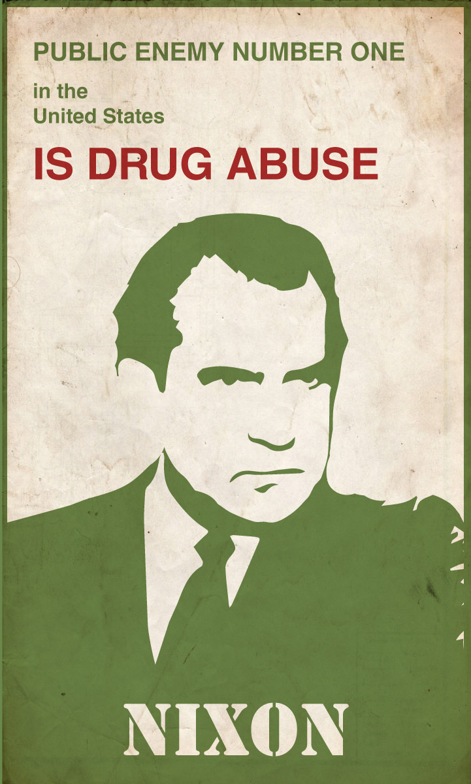
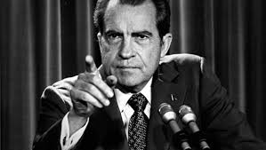
1970
1970
During the past 50 yrs since “War on Drugs” declared, we have moved from “Public Enemy No. 1” to “Public Health Problem No. 1”
Notes:
50 yrs since declaration of War on Drugs – rhetoric has changed as has language… moved from “public enemy No. 1” to “the top public health problem” – still the top but the language and approach has shifted….

Slide 27
Notes:
In fact, our laws over the past 50yrs reflect this shift… from more punitive to more public health oriented…

Slide 28
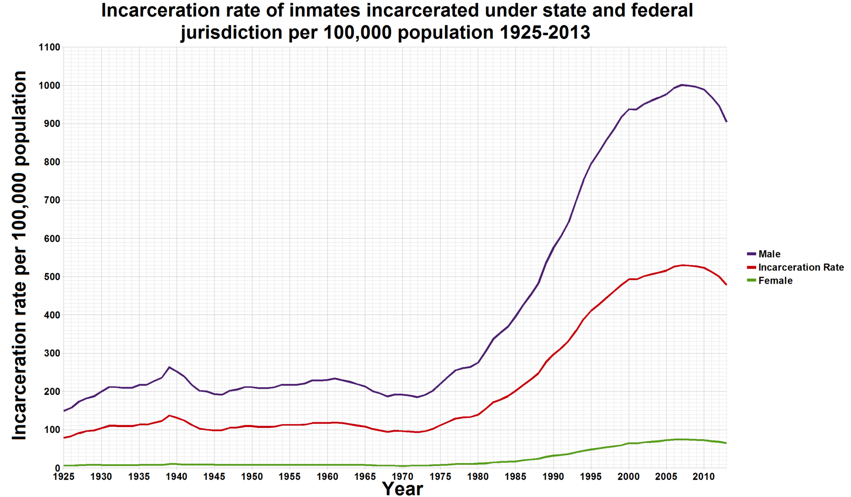
With 4% of the world’s pop, the US has 25% of its prisoners.
Avg US cost per prison inmate = (2010) = $31K (range 14K-60K); about $25 Billion ($2018) for the 500,000 drug-related prisoners (20% of all prisoners)

Slide 29
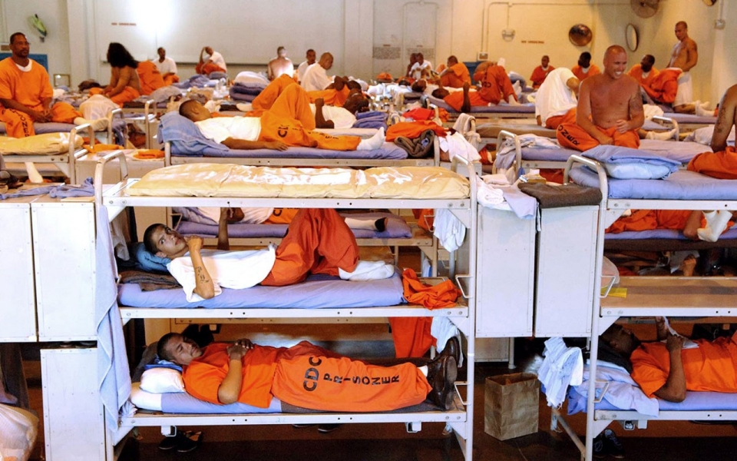
Prisons overcrowding: 20% (500,000) of US prisoners are in prison due to drug offences: 60-80% under the influence of alcohol/drugs at the time of the crime
$$$
Economic costs
of Corrections
approx. $100B/yr
Photo: California Department of Corrections

Slide 30
Laws passed in the past 50 yrs have moved from more punitive ones to public health oriented ones…. increasing availability, accessibility and affordability of treatment..

Slide 31
Major Policy Strategies
Supply Reduction
Demand Reduction
Harm Reduction

Slide 32
Major Policy Strategies
Supply Reduction
Demand Reduction
Harm Reduction
Greater emphasis on prevention,
treatment
and recovery support services

Slide 33
2013 ONDCP Director Kerlikowske declares move away from “war on drugs” toward broader public health approach
Notes:
Resulted in 1st ever drug policy reform summit held at White House Dec 9 2013…. Marked shift away from War on drugs toward broader public health model….

Slide 34
Criminal justice approaches have began to shift and embrace clinical and public health emphases….
Notes:
Resulted in 1st ever drug policy reform summit held at White House Dec 9 2013…. Marked shift away from War on drugs toward broader public health model….

Slide 35
Public Health Approahces to Addressing Drug-Related Crime: Drug Courts

Slide 36
Public Health Approaches to Law Enforcement
Chief Campanello
Angel Program
“Help not Handcuffs”

Slide 37
Past 50 yrs gone from…
War on drugs
War on the war on drugs
BUT… not just about interdiction, supply reduction, incarceration….
Also, a great deal carried out on the demand reduction side…

Slide 38
The “war on drugs” was part of a national concerted effort to reduce “supply” but also “demand” that created treatment and public health oriented federal agencies..
Notes:
Demand reduction

Slide 39
Paradigm Shifts

Slide 40
Genetics, Genomics, Pharmacogenetics

Slide 41
Neuroscience: Neural plasticity

Slide 42
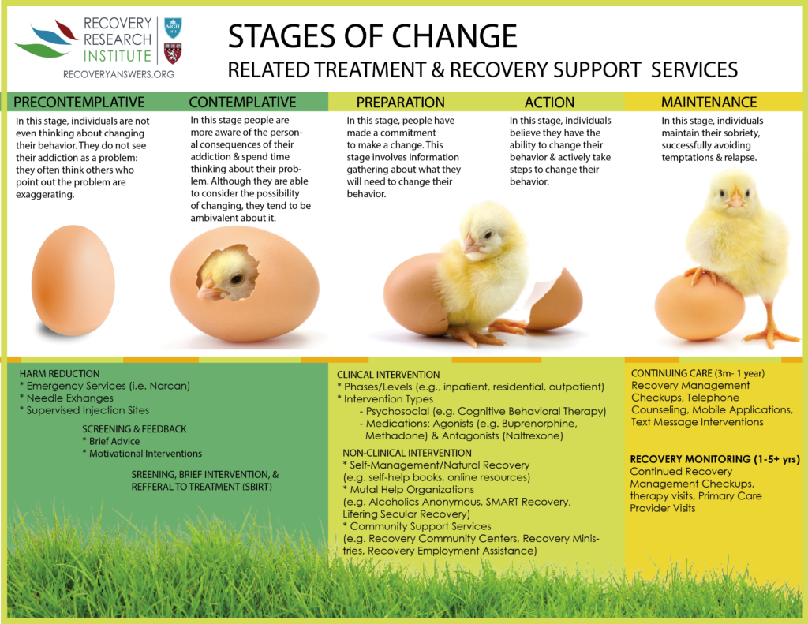

Slide 43
What people really need is a good listening to…

Slide 44
“Quitting smoking is easy, I’ve done it dozens of times” –Mark Twain

Slide 45
Swift, certain, modest, consequences shape behavioral choices…

Slide 46
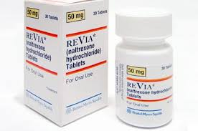
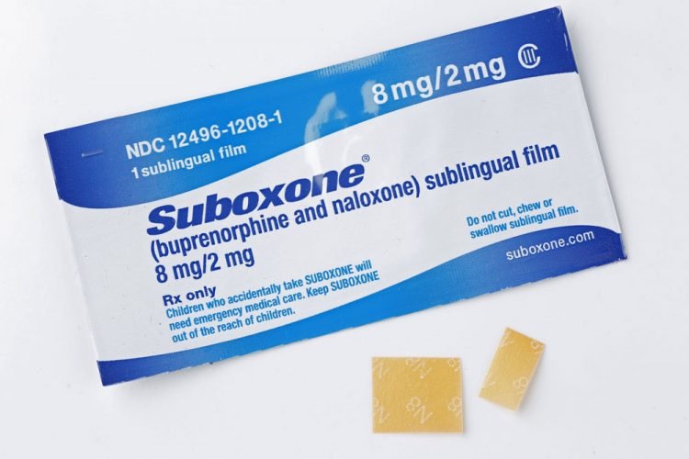
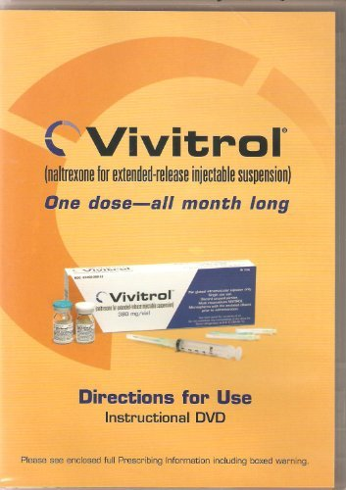
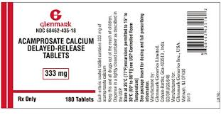
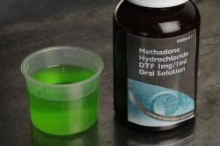
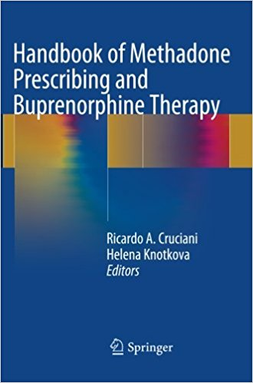
Effective Medications

Slide 47
Harm Reduction Strategies
Anti-craving/anti-relapse medications (“MAT”)
Overdose reversal medications (Narcan)
Needle exchange programs
Heroin prescribing
Overdose prevention facilities (safe Injection facilities)

Slide 49
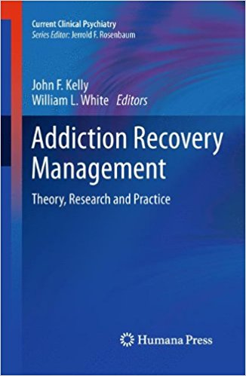

Slide 50
The clinical course of addiction and achievement of stable recovery can take a long time …
Addiction Onset
Help Seeking
Full Sustained Remission (1 year abstinent)
Relapse Risk drops below 15%
4-5 years
8 years
5 years
Self-initiated cessation attempts
4-5 Treatment episodes/
mutual-help
Continuing care/
mutual-help
Recovery Priming
Recovery Mentoring
Recovery Monitoring
Notes:
We know a lot about the first half of this figure… much less about full remission, very little about the first 5yrs or recovery and beyond…. What happens to funx/QOL?
Wang, P. S., Berglund, P., Olfson, M., Pincus, H. A., Wells, K. B., & Kessler, R. C. (2005). Failure and delay in initial treatment contact after first onset of mental disorders in the National Comorbidity Survey Replication. Arch Gen Psychiatry, 62(6), 603-613. doi: 62/6/603 [pii]
10.1001/archpsyc.62.6.603
Dennis, M. L., Scott, C. K., Funk, R., & Foss, M. A. (2005). The duration and correlates of addiction and treatment careers. J Subst Abuse Treat, 28 Suppl 1, S51-62. doi: S0740-5472(04)00138-2 [pii] 10.1016/j.jsat.2004.10.013
De Soto, C.B., O’Donnell, W.E., & De Soto, J.L. (1989). Long-term recovery in alcoholics. Alcoholism: Clinical
and Experimental Research, 13, 693-697. Vaillant, G. E. (1996). A long-term follow-up of male alcohol abuse.
Archives of General Psychiatry, 53(3), 243-249. Nathan, P., & Skinstad, A. (1987). Outcomes of treatment for
alcohol problems: Current methods, problems and results. Journal of Consulting and Clinical Psychology, 55,
332-340. Dawson, D. A. (1996). Correlates of past-year status among treated and untreated persons with
former alcohol dependence: United States, 1992. Alcoholism: Clinical and Experimental Research, 20(4),
771-779. Jin, H., Rourke, S. B., Patterson, T. L., Taylor, M. J., & Grant, I. (1998). Predictors of relapse in
long-term abstinent alcoholics. Journal of Studies on Alcohol, 59, 640-646. Dennis, M. L., Foss, M. A., &
Scott, C. K. (2007). An eight-year perspective on the relationship between the duration of abstinence and other
aspects of recovery. Evaluation Review, 31(6), 585-612. Schutte, K., Byrne, F., Brennan, P., & Moos, R.
(2001). Successful remission of late-life drinking problems: A 10-year follow-up. Journal of Studies on
Alcohol 62, 322-334.

Slide 51
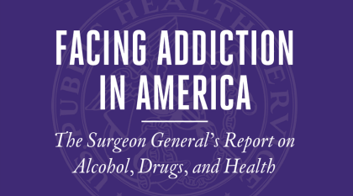
1st Surgeon General’s Report on Alcohol, Drugs, and Health 2016

Slide 52
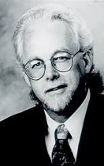
Focus on long-term stable remission and recovery
Bill White for decades has talked about understanding more about recovery from the tens of millions already in recovery-untapped resource.
Whole libraries/volumes written about etiology, epidemiology, and treatment, but little about recovery…
A lot might be learned from the millions of people already successfully in long-term recovery; how they did it; what helped, made the difference.

