Slide 1



John F. Kelly, PhD ABPP
Elizabeth R. Spallin Professor of Psychiatry in Addiction Medicine
Harvard Medical School
Director Recovery Research Institute
Associate Director Center for Addiction Medicine
Massachusetts General Hospital
No disclosures.
Content presented here represents the views of the presenter/author and do not necessarily represent the views of any other associated entity

Slide 2
Outline
Alcohol/drugs – top public health problem
Policy Approaches and conceptualizations
The role of stigma/discrimination
Ways to address stigma/discrimination

Slide 3
Outline
Alcohol/drugs – top public health problem
Policy Approaches and conceptualizations
The role of stigma/discrimination
Ways to address stigma/discrimination

Slide 4
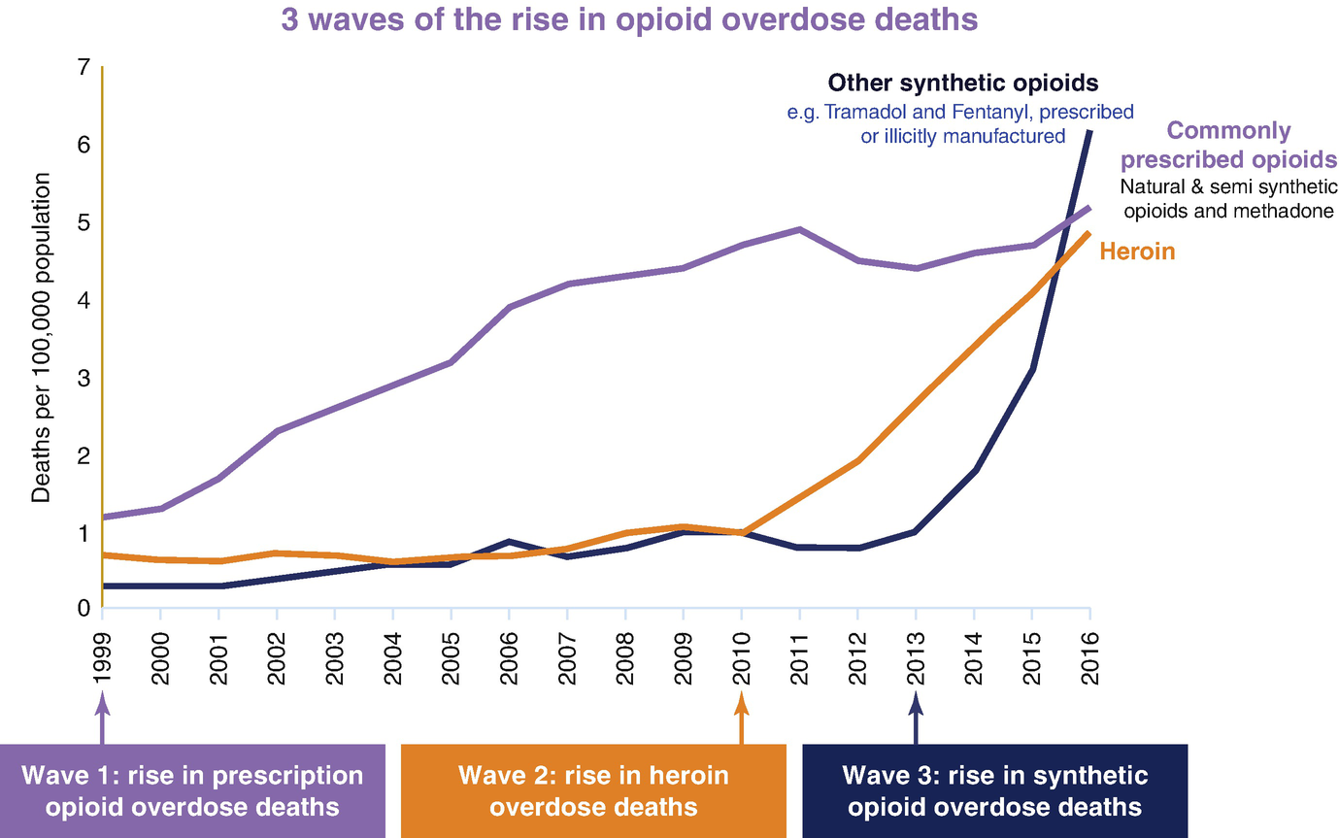
70,237 Overdose
deaths in the U.S.
In 2017

Slide 5
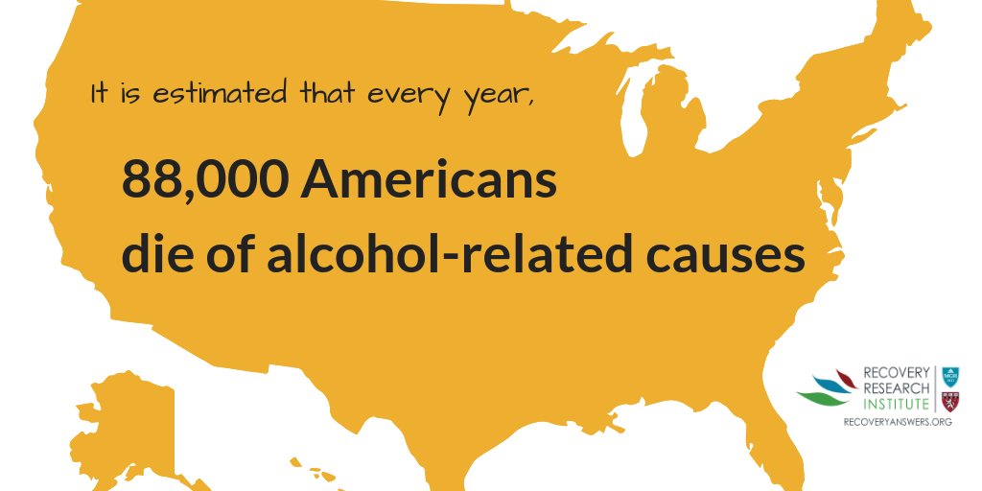

Slide 6
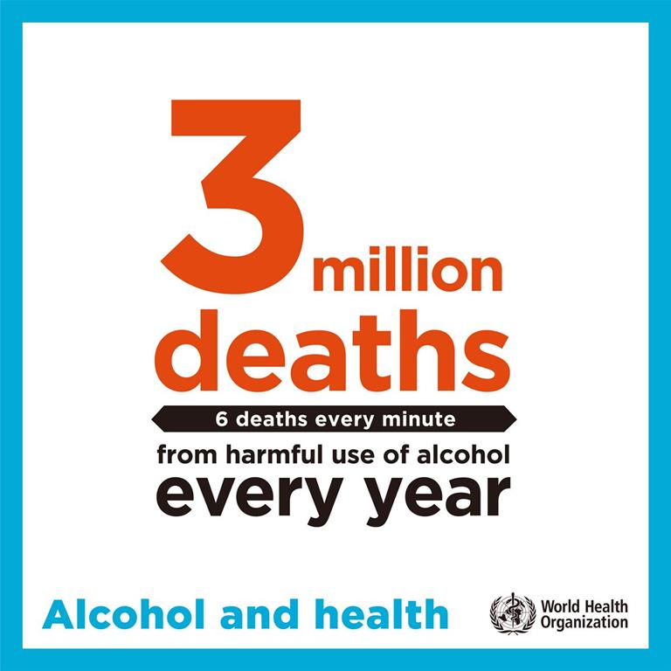

Slide 7

U.S. Economic burden
$600 Billion annually…
  Lost productivity
  Healthcare costs
  Criminal justice

Slide 8
Outline
Alcohol/drugs – top public health problem
Stats on magnitude of alcohol/drug problem emphasizing top problem
Policy Approaches and conceptualizations
How do we best approach?
Rhetoric of different approaches
The role of stigma/discrimination
SUD most stigmatized among all social conditions
Ways to address stigma/discrimination

Slide 9
What Is Stigma?
An attribute, behavior, or condition, that is socially discrediting
Notes:
So, addiction is highly stigmatized, but what is stigma? And why is addiction so stigmatized compared to other health and mental health conditions? It has to do with the way view it and whether people are to “blame” for it and can “control” it as well as how unpredictable and unsafe they may be….

Slide 10
What Is discrimination?
The unfair treatment of individuals with the stigmatized condition/problem
Notes:
So, addiction is highly stigmatized, but what is stigma? And why is addiction so stigmatized compared to other health and mental health conditions? It has to do with the way view it and whether people are to “blame” for it and can “control” it as well as how unpredictable and unsafe they may be….

Slide 11
Stigma Consequences: Public and Personal
Public:
  Public stigma can lead to:
    Differential public and political support for treatment policies
    Differential public and political support for criminal justice preferences
    Barriers to employment/education/training
    Reduced housing and social support
    Increased social distance (social isolation)
Personal:
  Internalization of public stigma can lead to:
    Shame/guilt
    Lowered self-esteem
    Rationalization/minimization; lack of problem acknowledgment
    Delays in help-seeking
    Less treatment engagement/retention; lowered chance of remission/recovery

Slide 12
Stigma may involve several elements:
(1) labeling (e.g., “drug abuser” “junkie”)
(2) negative stereotypes (e.g., “addicts are dangerous”)
(3) othering (e.g., “addicts are not normal people”);
(4) unequal health and social outcomes (e.g., high rates of HIV, incarceration, unemployed);
(5) poor access to economic or political power (e.g., frequently denied employment based on their history).
Link BG, Phelan J. Social conditions as fundamental causes of disease. J Health Soc Behav. 1995;35:80-94

Slide 13
Commonly Studied Dimensions of Stigma
Blame – are they responsible for causing their problem/disorder?
Prognostic pessimism/optimism – will they ever recover “be normal”, “trustworthy”?
Social distance – would I have them marry into my family, share an apartment with them, have them as a babysitter?
Dangerousness – are they unpredictably volatile, a threat to my/others’ safety?

Slide 14
Addiction may be most stigmatized condition in the US and around the world:
Cross-cultural views on stigma
Across 14 countries and 18 of the most stigmatized conditions…
Illicit drug addiction ranked 1st
Alcohol addiction ranked 4th
Stigma, social inequality and alcohol and drug use
ROBIN ROOM
Centre for Social Research on Alcohol and Drugs, Stockholm University, Stockholm, Sweden
Sample: Informants from 14 countries
Design: Cross-sectional survey
Outcome: Reaction to people with different health conditions
Notes:
Across 14 countries and 18 of the most stigmatized conditions drug addiction was 1st and alcohol addiction 4th…
Originally in chapter “Cross-cultural views on stigma, valuation, parity and societal values towards disability”

Slide 15
Studies have shown that…
Compared to other psychiatric disorders, SUD is more stigmatized
Compared to other psychiatric disorders, people with SUD are perceived as more to blame for their disorder
Describing SUD as treatable helps
Patients themselves who hold more stigmatizing beliefs about SUD less likely to seek treatment; discontinue sooner
Physicians/clinicians shown to hold stigmatizing biases against those with SUD; view SUD patients as unmotivated, manipulative, dishonest; SUD-specific education/training helps

Slide 16
So, why is addiction so stigmatized compared to other social problems and health conditions, and other mental illnesses?
Notes:
So, addiction is highly stigmatized, but what is stigma? And why is addiction so stigmatized compared to other health and mental health conditions? It has to do with the way view it and whether people are to “blame” for it and can “control” it as well as how unpredictable and unsafe they may be….

Slide 17
What Factors Influence Stigma?
Cause | Controllability | Stigma
“It’s not their fault” | “They can’t help it” | Decreases
“It is their fault” | “They really can help it” | Increases
Notes:
There are two major factors which influence stigma: cause and controllability
We tend to have more compassion toward indidiuals if we can say “It’s not their fault” (cause) and “They can’t help it” (controllability)

Slide 18
Relation between Cause and Controllability in producing Stigma
Extent of Stigma
Controllability
“Can’t help it” “Can help it”
“NOT their own fault” “IS their own fault”
Cause
Notes:
This graph shows that as the perception that someone actually CAN help themselves from engaging in the behavior and it IS their fault stigmatizing attitudes increase…. .

Slide 19
Outline
Alcohol/drugs – top public health problem
Policy Approaches and conceptualizations
The role of stigma/discrimination
Ways to address stigma/discrimination

Slide 20
What can we do about stigma and discrimination in addiction?
Education about essential nature of these conditions
Personal witness (putting a face and voice on recovery)
Change our language/terminology to be consistent with the nature of the condition and the policies we wish to implement to address it

Slide 21
What can we do about stigma and discrimination in addiction?
Education about essential nature of these conditions
Personal witness (putting a face and voice on recovery)
Change our language/terminology to be consistent with the nature of the condition and the policies we wish to implement to address it

Slide 22
might greater biomedical emphasis AND explanations (e.g., biogenetic and/OR neurobiological) help reduce stigma?

Slide 23
Relation between Cause and Controllability in producing Stigma
Extent of Stigma
Controllability
“Can’t help it” “Can help it”
“NOT their own fault” “IS their own fault”
Cause
Notes:
This graph shows that as the perception that someone actually CAN help themselves from engaging in the behavior and it IS their fault stigmatizing attitudes increase…. .

Slide 24

If Drugs Are so Pleasurable, Why Aren’t We All Addicted?
In terms of cause…
Genetically mediated response, metabolism, reward sensitivity…
Genetics substantially influence addiction risk
Genetic differences affect subjective preference and degree of reward from different substances/activities
Notes:
Now, regarding cause, the question may not be so much as to why do some people become addicted, but rather how come we are not ALL addicted when so many of us are exposed to powerfully rewarding/relieving substances, such as alcohol, during our lives? The answer has to do in part with our genetic make-up. In fact, we know that between 40-60% of the risk for addiction is conferred by genetics. These genes affect the degree or reward experienced by people as well the speed at which they metabolize drugs which can lead vulnerable individuals to increase their dose to get the same effect….

Slide 25
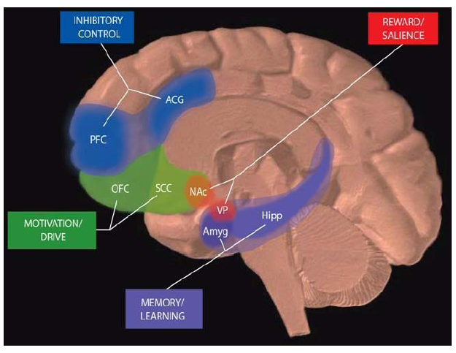
Neural Circuits Involved in Substance Use Disorders
In terms of controllability…
…all of these brain regions must be considered in developing strategies to effectively treat addiction
Notes:
Despite, this we have learned during the past 25yrs of neuroscience that chronic substance use exposure produces radical changes in the neurocircuitry of reward, memory, motivation, impulse control, and judgement which are represented by these brain areas here: this process of exposure severely impairs individuals'’ ability to consistently self-regulate the impulse to use substances helping to explain what we see clinically and as observers more generally.

Slide 26
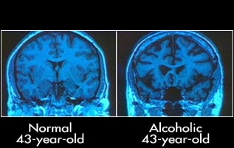
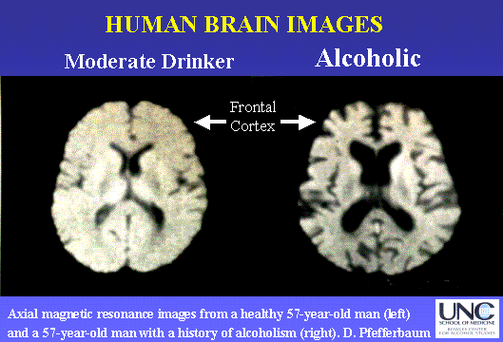
Notes:
Also, structurally, the brain is radically changed as a function of chronic exposure to neurotoxicants…. You don’t have to look long or hard to see this… it is not subtle. A human organism that mother nature had endowed with a rough lifespan of approx. 80yrs self-destructs, poisons itself to death, roughly 30 yrs prior to the intended expiration date. This suggests a biological anomaly; a medical malfunction in the brain; this is why it is a psychiatric illness; this is why it is housed within our psychiatric diagnostic classification….

Slide 27
Biogenetic explanations as ways to reduce stigma…
Meta-analysis of 28 experimental studies found biogenetic explanations:
Reduced blame, but increased…
Social distance
Dangerousness
Prognostic Pessimism

Slide 28
Neurobiological explanations as ways to reduce stigma…
Neurobiological explanation studies found they increased:
Social distance
Dangerousness
Prognostic pessimism
had no effect on reducing blame

Slide 29
Such findings may explain mixed public attitudes across different dimensions of stigma …
Representative study of Scottish public
Strong sympathy for those with addiction history, but…
50% of respondents said they would not want someone with a drug addiction history as a neighbor
46% said residents were correct to be worried about having an addiction treatment program in their neighborhood
38% disagreed that people with addiction history could be trusted as a babysitter
Source: Scottish Government (2016) 2016 Public Attitudes Toward People with Drug Dependence and People in Recovery

Slide 30
Pardoxical findings on biological explanations of stigmatized disorders
Reviews of the research suggest that biogenetic and neurobiologic explanations, while reducing attributions of blame - increase perceived dangerousness, social distance, and prognostic pessimism.
Meta-analytic review with 28 experimental studies found that biogenetic explanations reduce blame (Hedges g=-0.324) but induce pessimism (Hedges g=0.263). Also found biogenetic explanations increase endorsement of the stereotype that people with psychological problems are dangerous (Hedges g=0.198)
biogenetic explanations do not typically affect social distance.
Promoting biogenetic or neurobiologic explanations to alleviate blame may induce pessimism and set the stage for self-fulfilling prophecies that could hamper recovery.
Highlights need to emphasize most people recover, lead normal productive lives, but it can take time…

Slide 31
What can we do about stigma and discrimination in addiction?
Education about essential nature of these conditions
Personal witness (putting a face and voice on recovery)
Change our language/terminology to be consistent with the nature of the condition and the policies we wish to implement to address it

Slide 32
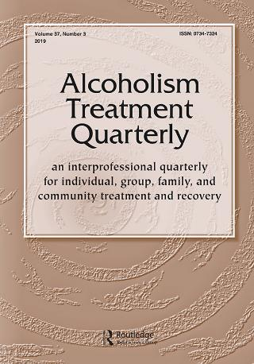
2004

Slide 33
Confusing array of terms Describing the Construct and Spectrum of
Substance-Related Problems
Addiction
Dependence
Abuse
Misuse
Harmful Use
Alcoholism
Hazardous use
Substance Use Disorder
Substance Use
Problem Use

Slide 34
Array of Terms Describing the Person using or suffering from compulsive substance use
Addict
Substance Abuser
Crackhead
Junkie
Drunk
Substance Misuser
Alcoholic
Problem User
Smackhead
Alkie

Slide 35
Does it matter?
Much ado about nothing?
“Political correctness”?
Mere “semantics”?
Notes:
Words don’t have innate meaning; rather, what we come to ascribe to them…

Slide 36
Yes… in two main ways
Precision and Accuracy in Communication
  Clinicians and others use the same different terms to mean different things; sometimes used in the technical sense, other times in a general sense (e.g., “addiction” “abuse” “abuser” “addict”)
Certain terms may induce explicit and/or implicit biases

Slide 37

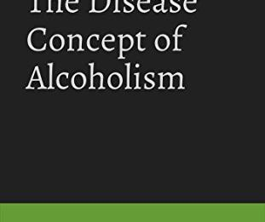
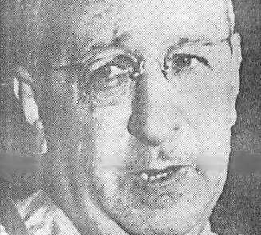
Terminology:
Does it matter?
“….there are more definitions of ‘definition’ than there are alcoholism. … may be consolation for students of alcoholism who complain about the plethora of …so-called definitions in their field. On the other hand it should impress them that definition is nothing sacred and unalterable. One cannot question whether definitions are right or wrong, unless they go against the rules of the defining process, but one may debate their utility.”
Source: Disease Concept of Alcoholism: Jellinek, 1960, pg 33
Notes:
The issues of “clinical utility” is paramount when it comes to real world practice. We must have something that is reliable and valid of course, but also something that can be used! The ultimate question for stigmatized conditions, is does it help us or hinder us? Is it better to describe “addiction” as a “disorder of choice”? Or as an illness, disorder, or “brain disease” ?

Slide 38
Why It Matters How We Conceptualize It,
What We Call It, People with It
Conceptualizations and related terminology implicitly reflect and influence how we think about and approach SUD
When we think about what language is… it is a standardized collection of sounds and symbols that trigger networks of cognitive scripts, activating chains of thoughts; influences appraisal, attitudes, actions
Language changes over time; from “lunatic asylums” “drunkards/dipsomaniacs” to “psych hospital” “AUD patients”
Policy approaches to “drug problem” possess own rhetoric - shift from “War on drugs” (punishment) to public health (prevention/treatment)…
Notes:
FB note: I condensed the text in the bullet points. Here’s the complete text:
Conceptualizations/related terminology implicitly reflect and influence how we think about and approach SUD
Language = standardized collection of sounds and symbols that tacitly trigger networks of cognitive scripts, activating serial chains of thoughts; influence appraisal, attitudes, actions
Language changes over time; from “lunatic asylums” “drunkards/dipsomaniacs” to “psych hospital” “AUD patients”
Policy approaches to “drug problem” possess own rhetoric - recent shift from “War on drugs” (punishment) to public health (prevention/treatment)…

Slide 39
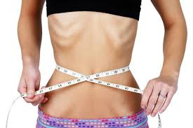
Question…
People with eating-related conditions are always referred to as “having an eating disorder”, never as “food abusers”.
So why are people with substance-related conditions referred to as “substance abusers” and not as “having a substance use disorder”?

Slide 40
Relation between Cause and Controllability in producing Stigma
Extent of Stigma
Controllability
“Can’t help it” “Can help it”
“NOT their own fault” “IS their own fault”
Cause

Slide 41
Two Commonly Used Terms…
Referring to someone as…
      “a substance abuser” – implies willful misconduct (it is their fault and they can help it)
      “having a substance use disorder” – implies a medical malfunction (it’s not their fault and they cannot help it)
      But, does it really matter how we refer to people with these (highly stigmatized) conditions?
      Can’t we just dismiss this as a well-meaning point, but merely “semantics” and “political correctness”?

Slide 42
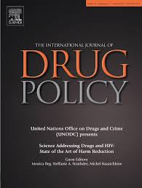
Does it matter how we refer to individuals with substance-related conditions? A randomized study of two commonly used terms
John F. Kelly, Cassandra M. Westerhoff
International Journal of Drug Policy
How we talk and write about these conditions and individuals suffering them does matter

Slide 43
“Substance Abuser”
Mr. Williams is a substance abuser and is attending a treatment program through the court. As part of the program Mr. Williams is required to remain abstinent from alcohol and other drugs…
“Substance Use Disorder”
Mr. Williams is a substance abuser and is attending a treatment program through the court. As part of the program Mr. Williams is required to remain abstinent from alcohol and other drugs…
Compared to those in “substance use disorder condition”, those in “substance abuser” condition agreed more with idea that individual was personally culpable, needed punishment

Slide 44
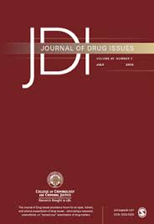
© 2010 by the Journal of Drug Issues
Does Our Choice of Substance-Related Terms Influence Perceptions of Treatment Need?
An Empircal Investigation with Two Commonly Used Terms
John F. Kelly, Sarah J. Dow, Cara Westerhoff
Substance-related terminology is often a contentious topic because terms may convey meanings that have stigmatizing consequences and present a barrier to treatment. Chief among these are the labels, “abuse” and “abuser.”
Notes:
We replicated that first study in a general population study…. Found even bigger differences with even greater stigmatizing attitudes held by general public when exposed to the “abuser” label compared to the “substance use disorder” label…..

Slide 45
Notes:
This slide shows how when members of the general public are exposed to the term “substance abuser” vs. “a person with a substance use disorder” they are less likely to view treatment as necessary, more likely to view punishment as warranted, that the person is a greater social threat, that they are more to blame for their behavior, and that they can really control their behavior (and therefore are more to blame).

Slide 46
Implications
Even well-trained clinicians judged same individual differently and more punitively depending on which term exposed to
Use of “abuser” term may activate implicit cognitive bias perpetuating stigmatizing attitudes–could have broad effects (e.g., treatment/funding)
Let’s learn from allied disorders: people with “eating-related conditions” uniformly described as “having an eating disorder” NEVER as “food abusers”
Referring to individuals as having “substance use disorder” may reduce stigma, may enhance treatment and recovery

Slide 47

EDITORIAL
Avoid “dirty,” “clean,” “abuser” language
Negative urine test for drugs
Kelly JF, Wakeman SE, Saitz R. Stop talking 'dirty': clinicians, language, and quality of care for the leading cause of preventable death in the United States. Am J Med. 2015 Jan;128(1):8-9. doi: 10.1016/j.amjmed.2014.07.043. Epub 2014 Sep 3.
http://www.amjmed.com/article/S0002-9343(14)00770-0/abstract
Notes:
Another stigmatizing term is descxribing people as “dirty” or “clean” depending on whether they are or are not using substances. We do not use this type of language in any other areas of medicine… we should instead describe people as abstinent vs not, or “in remission” or not, or with urine toxicology test results as “negative” or “positive” instead of “clean” or “dirty”…

Slide 48
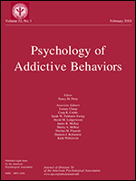

Slide 49


Proportion self-identify as being “in recovery”
46%
Odds of self-identifying in this manner associated with greater indices of greater severity (earlier age of onset, psychiatric comorbidities, greater treatment and recovery support services use)

Slide 50
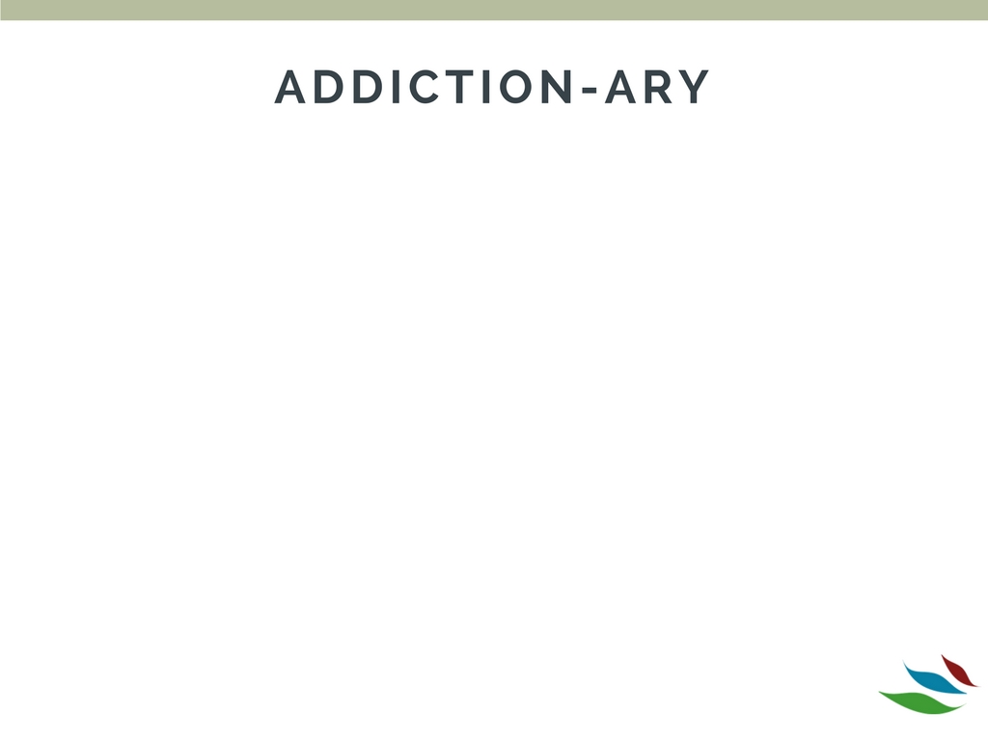
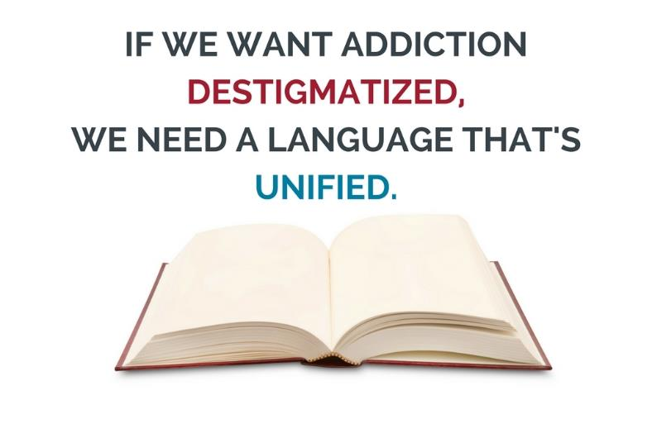

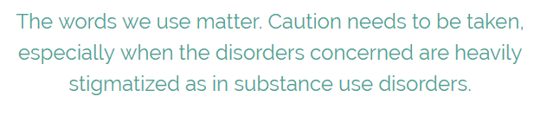
www.recoveryanswers.org

Slide 51

International Addiction Terminology Statement
Sept 2015…
International Society of Addiction Journal Editors
National Addiction Center
4 Windsor Walk
London
SES 8A, UK
Addiction Terminology Statement
ISAJE editors adopted consensus statement advocating against use of stigmatizing language like “abuse” “abuser” “dirty,” “clean” in addiction science in 2015
http://www.parint.org/isajewebsite/terminology.htm
Notes:
The International society of addiction journal editors have now adopted a statement to drop this kind of lanague from addiction clinical science…. In order to improve accuracy in clinical communication and reduce stigma….

Slide 52

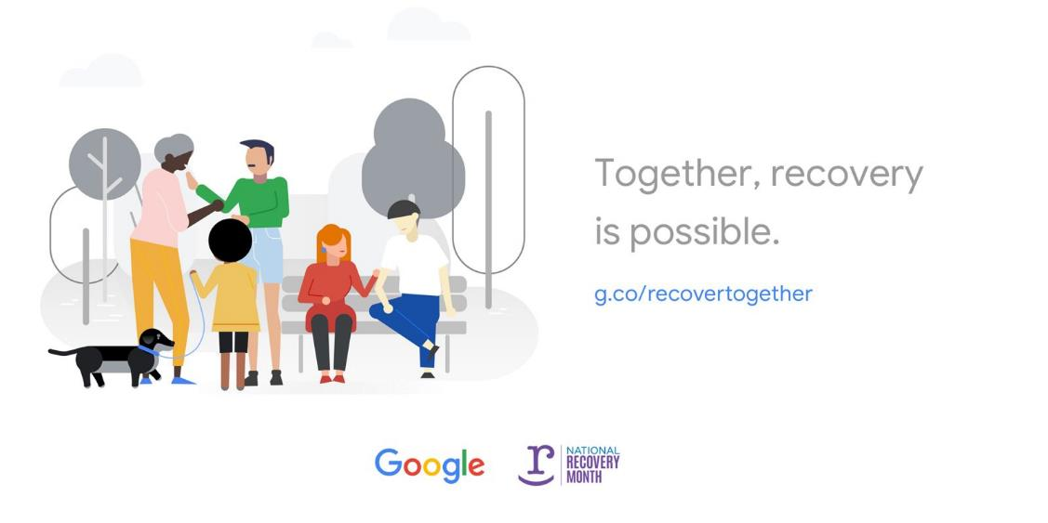

Slide 53
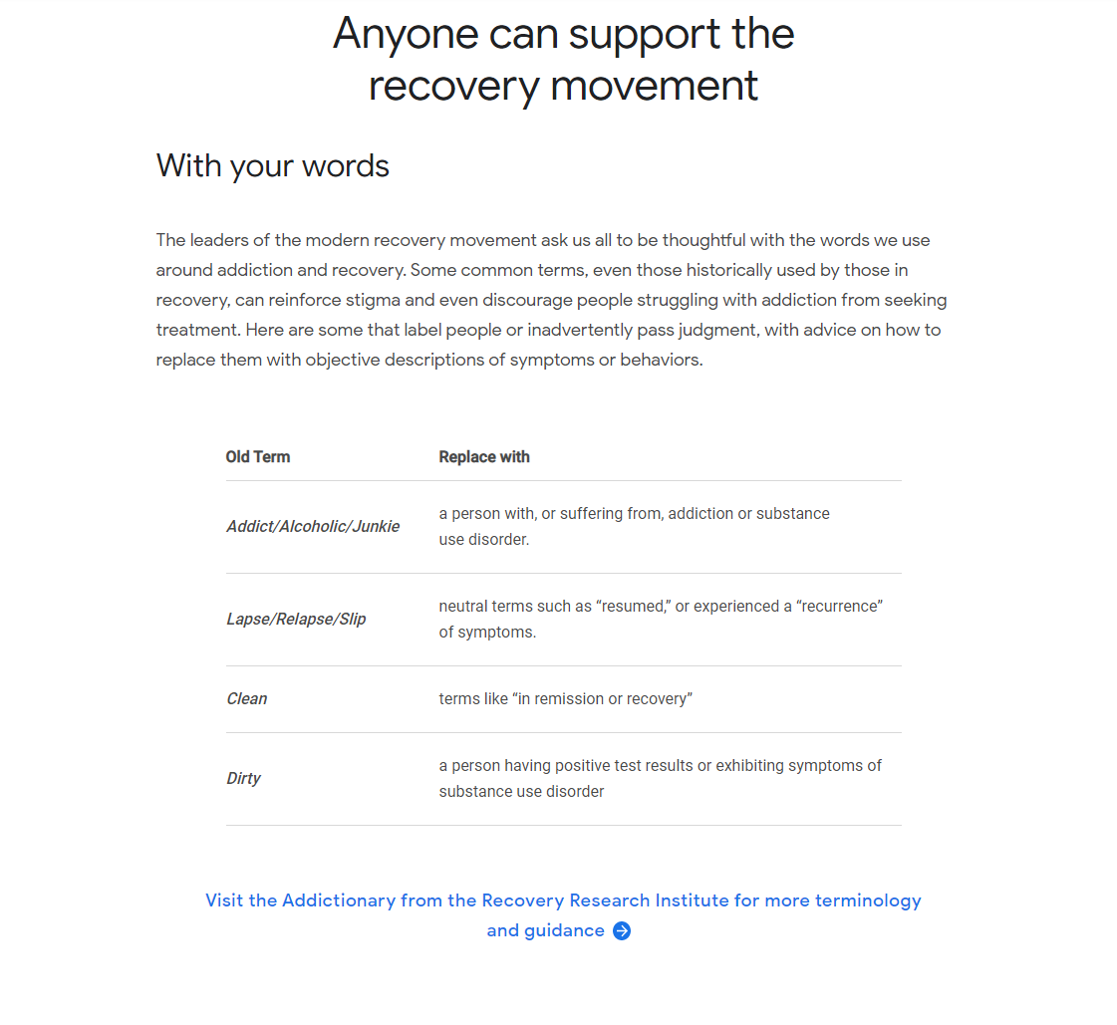



Slide 54
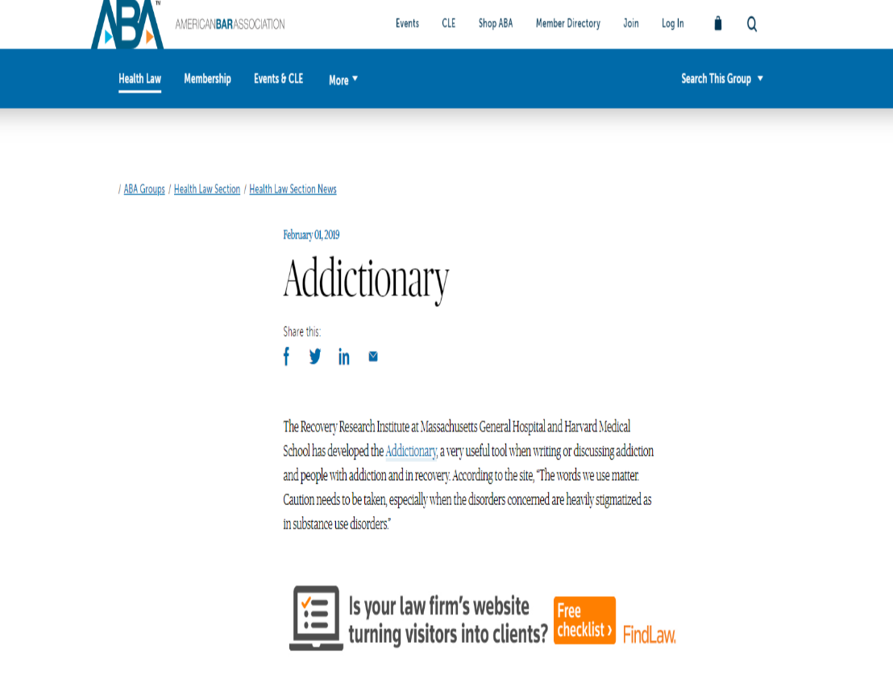
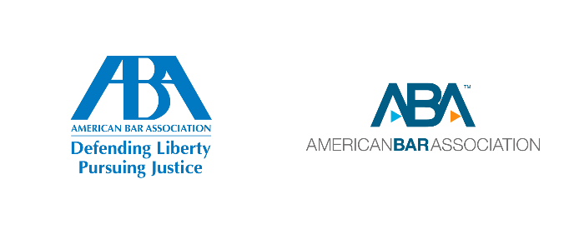

Slide 55

Impact around the U.S. and world…
ONDCP –White House Office of National Drug Control Policy - efforts to change SUD terminology to reduce stigma
NIH, SAMHSA, website/literature changes; SGR (2016)
U.S. Associated Press (AP) style guide update on SUD
World Federation for the Treatment of Opioid Dependence
The European Pain Federation EFIC
International Association for Hospice and Palliative Care
International Doctors for Healthier Drug Policies
Swiss Romany College for Addiction Medicine
Swiss Society of Addiction Medicine
… Also, called on medical journals to ensure that authors always use terminology that is neutral, precise, and respectful in relation to the use of psychoactive substances.

Slide 56
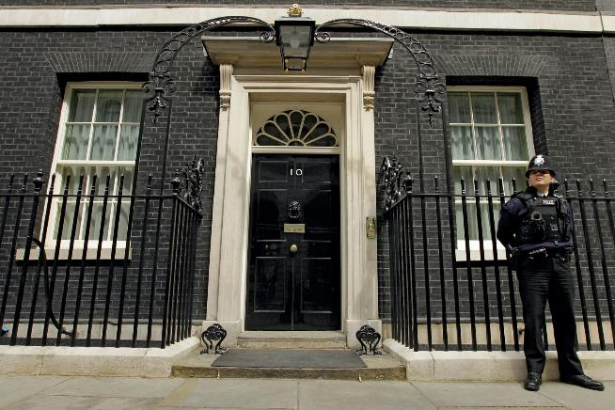





Slide 57



Slide 58
Recommended language examples…
Don’t say…
Instead, say…
“drug abuser”
“Person/individual/patient with a substance use disorder”
“alcoholic”
“Person/individual/patient with an alcohol use disorder”
“dirty urine”
“the urine was positive for….”
“heroin addict”
“Person/individual/patient with an opioid use disorder”

Slide 59
Implications for Practice
Enhanced practitioner understanding that SUD is a biomedical disorder maybe helpful in reducing patients/others blame but this may also need to be accompanied by acknowledgement that SUD is treatable, and most people recover
Practitioners might reduce degree of internalized stigma often held by patients by communicating these facts to patients and family members they treat
Avoiding the use of certain terms and phrases in clinical practice (e.g.,. “abuse” “abuser” addict” “dirty urine”) and using neutral language that is consistent with a medical and public health approach may help diminish stigma; more respectful
In sum, clear communication of the medical nature of SUD coupled with the likelihood of treatment benefits and recovery using appropriate terminology may increase treatment engagement and clinical response

Slide 60
Name Change Could Be Game Change
Language - prominent in the names of federal institutes addressing alcohol/drug concerns - is outdated, is at odds with clinical understanding of SUD, and contains terms that have been shown to increase stigmatizing attitudes; may conflict with and undermine efforts to destigmatize and move toward public health approaches
Eliminating “abuse”/“abuser” may help reduce implicit bias; lack of precision in “abuse”, means its non-use unlikely to affect communication accuracy
Name changes nationally (e.g., National Institute on Drug “Abuse”, National Institute on Alcohol “Abuse” and “Alcoholism”; Substance “Abuse” and Mental Health Services Admin.), would send message, set example, help reflect and affect shift in our approaches
Changing names of NIHs takes an act of congress; there is never “a good time” to change these names; let’s do it now.

Slide 61

Thank you for your attention!

Slide 62

“The words we use
to describe drug/ alcohol disorders contribute to the stigma around the conditions, psychologist John F. Kelly told attendees at a recent White House conference on Drug Policy Reform”

Slide 63


substance use disorder: Understanding Stigma and Bias
John F. Kelly, Ph.D.
Elizabeth R. Spallin Associate Professor of Psychiatry in Addiction Medicine, Harvard Medical School
Director, Massachusetts General Hospital Recovery Research Institute (RRI)
Director, Massachusetts General Hospital Addiction Recovery Management Service (ARMS)
Associate Director , Massachusetts General Hospital Center for Addiction Medicine

Slide 64

Language and Terminology Considerations in Addiction
“Political correctness”?
Public stigma/discrimination
Policy approaches to addressing addiction
Clinical attitudes and behavior in treatment
Scientific and clinical accuracy in communication

Slide 65
Key points
Burden related to addiction/substance-related conditions is prodigious and growing
Research on stigma reveals addiction/substance-related conditions highly stigmatized; understanding of biomedical aspects of addiction increasing but stigmatizing attitudes are not decreasing
Stigma and discrimination are major barriers to acknowledging the presence of a problem, in accessing help, and staying in recovery
Definitions and conceptualizations of addiction matter- affect stigma and our societal approach and accuracy in scientific communication
Stigma is influenced by perceptions about cause and controllability
Language/terminology of addiction influence these perceptions and may affect policy and clinical care
What to do about stigma: education, personal witness, shift language/terminology

Slide 66
Burden of disease attributable to alcohol and other drug–related conditions
Worldwide, alcohol kills 3.3 million each year; 350,000 die due to illicit drugs (WHO, 2015). Major contributor to DALYs – alcohol third leading risk factor for disease burden
Alcohol and other drug-related conditions number 1 public health concern in US; unintentional overdose leading cause of accidental death (CASA, 2011; Warner, Chen, Makuc, Anderson, & Minino, 2011).
23 million individuals with substance use disorder in the US
Economic cost attributable to substance use from lost productivity, health care expenditures, and criminal justice involvement, = $600 billion annually.
Despite presence of about 14,000 treatment facilities and 100,000 recovery mutual-aid support chapters meeting weekly in US, only 10% receive some form of help
A main barrier to seeking and receiving help is stigma…

Slide 67
What is stigma?
An attribute, behavior, or condition, that is socially discrediting
Notes:
So, addiction is highly stigmatized, but what is stigma? And why is addiction so stigmatized compared to other health and mental health conditions? It has to do with the way view it and whether people are to “blame” for it and can “control” it as well as how unpredictable and unsafe they may be….

Slide 68
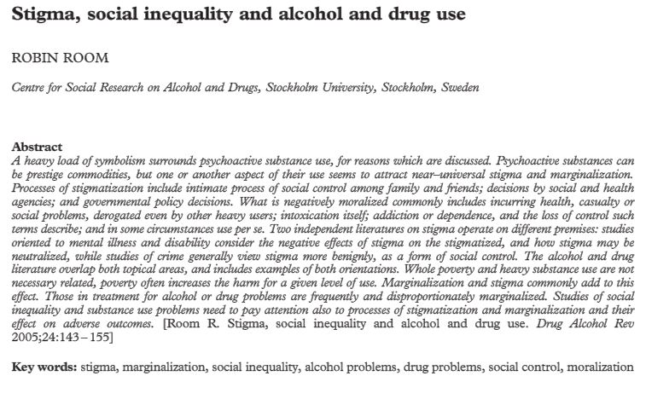
Addiction may be the most stigmatized condition in the US and around the world: Cross-cultural views on stigma
Sample: Informants from 14 countries
Design: Cross-sectional survey
Outcome: Reaction to people with different health conditions
Notes:
Across 18 countries and 14 of the most stigmatized conditions drug addiction was 1st and alcohol addiction 4th…
Originally in chapter “Cross-cultural views on stigma, valuation, parity and societal values towards disability”

Slide 69
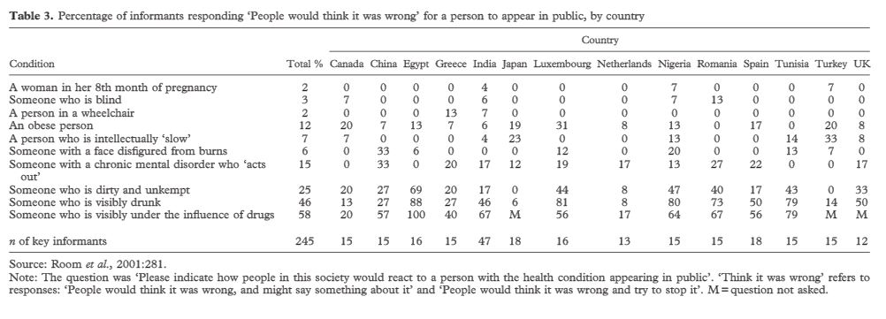
When asked “Please indicate how people in society would react to a person with the health condition appearing in public”, the most marginalized conditions were “someone who is visibly drunk” and “someone who is visibly under the influence of drugs”

Slide 70
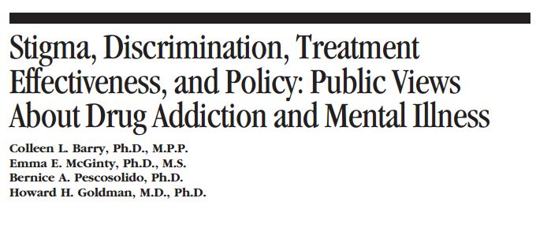
Addiction more stigmatized than other mental illness:
Sample: 709 respondents to an online survey
Design: Randomized experiment (online survey)
Comparison conditions: Participants were randomly assigned to receive questions about mental illness or the same questions in reference to drug addiction
Outcome: Public attitudes (i.e. willing to let a person with this addiction marry into your family)
People hold more negative attitudes towards persons with drug addiction than mental illness

Slide 71
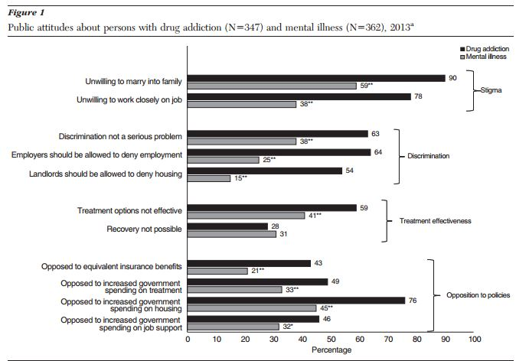
More individuals were unwilling to have a person with drug addiction (90%) (versus mental illness 59%) marry into their family or work closely with them on a job (78% versus 38%)
In terms of discrimination, people thought employers should be able to deny employment more for addicted (64%) than those with mental illness 25%) and landlords deny housing (54% addicted vs. 15% mental illness)
Treatment options perceived to be less effective for addiction (59%) than mental illness (41%)
Also, big differences in opposition to insurance benefits, government paying for housing, increased spending on treatment etc.
Notes:
authors reported that 43% of respondents were opposed to equivalent insurance benefits for individuals with drug addiction compared to 21% for individuals with mental illness. Additionally, 49% reported being opposed to increased government spending on treatment for persons with drug addiction compared to 33% for increased government spending on treatment for persons with mental illness. When questioned about opposing increased government spending on housing, 76% reported being opposed when it pertained to individuals with drug addiction compared to 45% being opposed to increased spending for housing for individuals with mental illness. Lastly, 46% of respondents reported being opposed to increased government spending on job support for individuals with drug addiction compared to only 32% being opposed to increased spending on job support for individuals with mental illness.

Slide 72
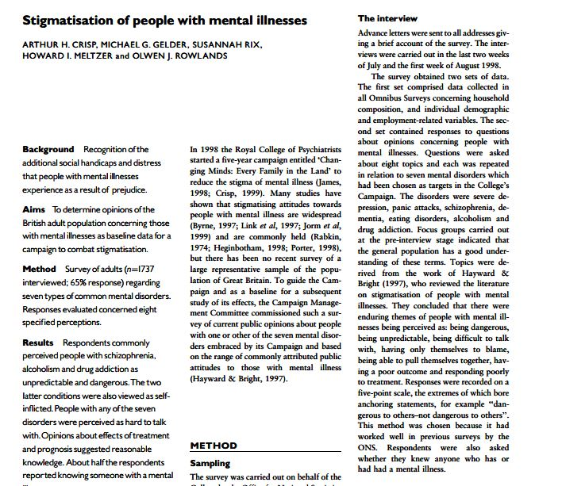
Attitudes toward different mental illness: Addicted individuals “more to blame”…
Sample: 1737 adults in the UK
Design: Cross-sectional survey
Outcome: Questions about perceptions of common mental disorders:
  Severe depression
  Panic attacks
  Schizophrenia
  Dementia
  Eating disorder
  Alcohol addiction
  Drug addiction
1737 adults in the UK participated in an interview about perceptions regarding common mental disorders

Slide 73
Of all types of mental illness, schizophrenia, alcohol addiction, and drug addiction had the most negative opinions
  70% of respondents rated these conditions as dangerous to others
  80% rated them as unpredictable
People with alcohol or other drug addiction were viewed as having themselves to blame for their disorder
  Only 7% of respondents rated people with schizophrenia in this manner
Notes:
Respondents were regarded as having an “negative opinion” if they endorsed either of the two points on the five-point scale on the “negative” side of its mid-point

Slide 74
Commonly Studied Dimensions of Stigma
Blame – are they responsible for causing their problem/disorder?
Prognostic pessimism/optimism – will they ever recover “be normal”?
Social distance – would I have them marry into my family, share an apartment with them, have them as a babysitter?
Dangerousness – are they unpredictably volatile, a threat to my/others’ safety?

Slide 75
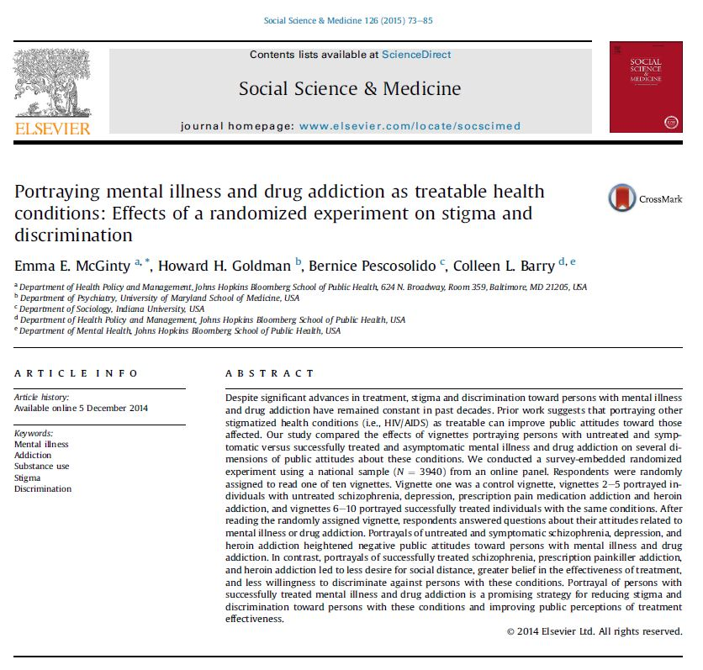
Addiction still more stigmatized than mental illnesses but portraying it as treatable helps…
Sample: 3940 respondents to a nationally representative online survey
Design: Randomized vignette-based experiment
Comparison conditions: Participants were randomized to read one of ten vignettes with different portrayals (e.g., having untreated or treated mental illness or drug addiction) of a white college-educated woman.
Outcomes: desirability of social distance, perceptions about treatment effectiveness, willingness to discriminate, support for policies that benefit persons with mental health or substance use disorders

Slide 76
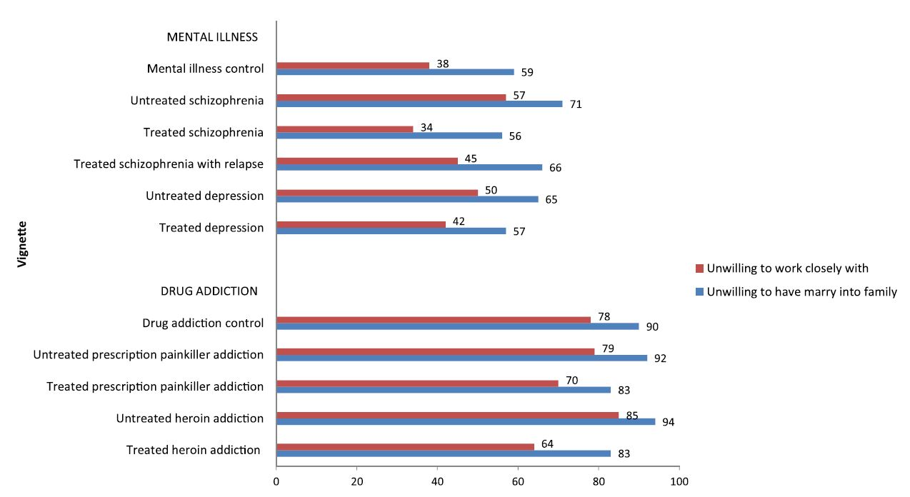
Longer bars = worse stigma
Drug addiction vignettes had more stigmatizing responses than seen with mental illness vignettes
Treated individuals less stigmatized…

Slide 77
SELF Stigma and treatment
Addicted individuals:
Less likely to seek help/treatment perceived stigma high
Report high discrimination, feeling feared, abandoned
More likely to dropout of treatment due to stigma
Health Care Professionals:
Hold patients with SUD in poor regard relative to other patients
View them as poorly motivated, violent, manipulative
May avoid these patients, shorten visits, leading to suboptimal care

Slide 78
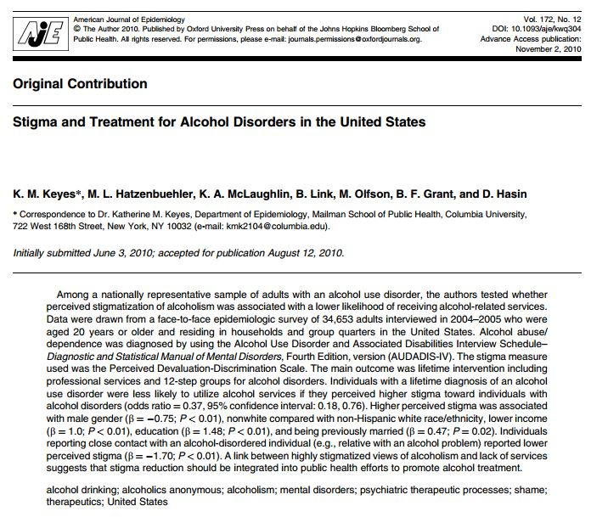
Stigmatization of alcoholism: impact on treatment seeking
Sample: Nationally representative sample of 34,653 adults with alcohol use disorder
Design: Cross-sectional survey
Outcomes: Perceived stigma of alcoholism and receipt of services
Notes:
Data are drawn from the 2004–2005 National Epidemiologic Survey of Alcohol and Related Conditions (NESARC)

Slide 79
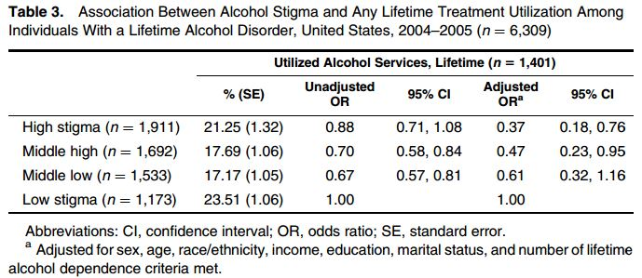
Treatment utilization - highest in the lowest stigma group
Individuals with lifetime alcohol use disorder (AUD) less likely to use services if had higher perception of stigma towards individuals with AUD
Odds of treatment/self-help decreased with each increase in alcohol stigma quartile
Notes:
The scale measures the extent to which respondents believe that a person with a mental disorder will be stigmatized if their disorder were known

Slide 80
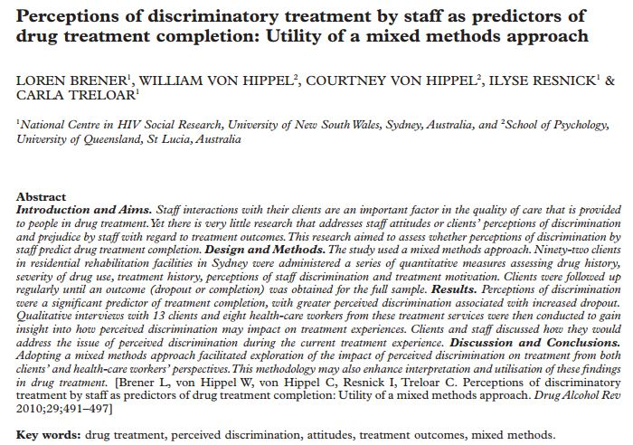
Does stigma affect treatment completion?
Sample: 92 patients who used heroin in residential treatment in Sydney, Australia
Design: Cross-sectional survey
Outcomes: Perceptions of staff discrimination and treatment motivation

Slide 81
Patients in the study…
Experienced discrimination: 60% believed people treated them unfairly because they knew about their substance use
Felt Feared: 46% felt others were afraid of them when they found out about their substance use
Felt Abandoned: 45% felt some of their family gave up on them after finding out about their substance use

Slide 82
Perceptions of discrimination was a significant predictor of treatment completion
  Greater perceived discrimination was associated with increased dropout
From qualitative interviews with 13 participants:
  All reported they experienced discrimination in the past in treatment or at other health facilities

Slide 83
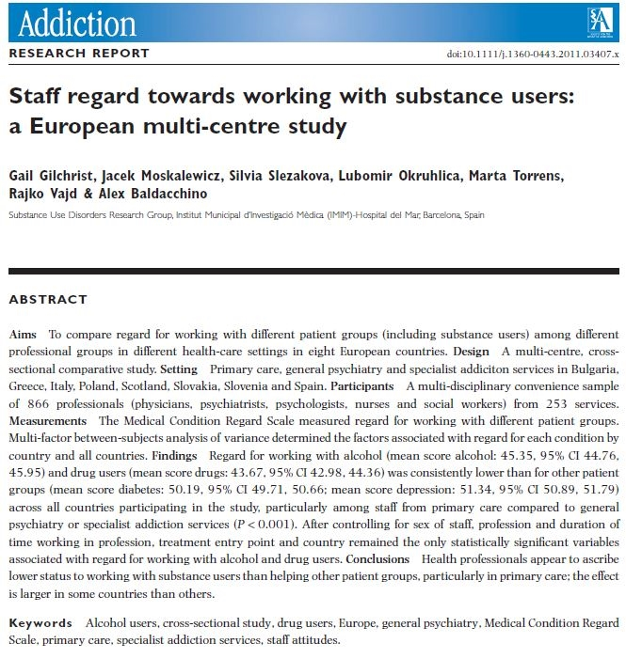
Clinician attitudes toward patients who use substances: differences by specialty
Sample: 866 health service professionals (physicians, psychiatrists, psychologist, nurses, and social workers) from a variety of service settings in 7 European countries
Design: Cross-sectional survey
Outcomes: Regard toward working with patients with problems related to alcohol or drugs, with depression, and with diabetes

Slide 84
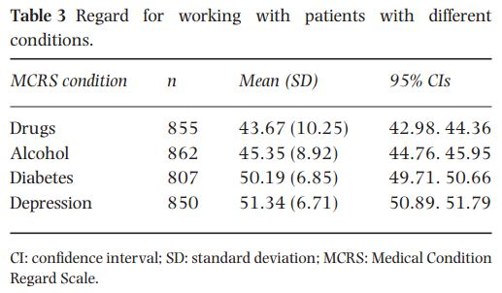
Over all clinicians, regard for working with alcohol and drug users consistently lower than other patients with diabetes or depression
Primary care physicians showed lower regard for drinkers and drug users than other professionals

Slide 85
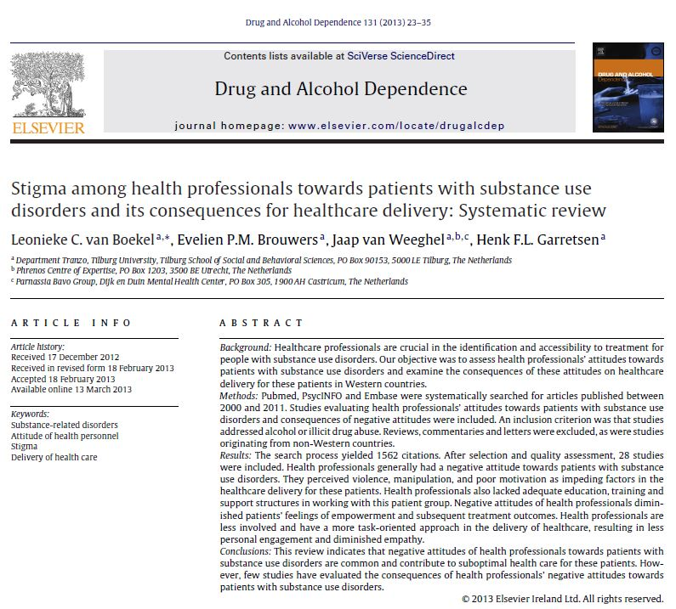
Stigma among health professionals: impact on care delivery
Sample: 28 studies with health personnel who work with patients with substance use problems
Design: Systematic review
Outcomes: Attitudes of health personnel, healthcare delivery, (social) stigma

Slide 86
In general, health professionals had a negative attitude toward patients with substance use disorders
Perceived factors impeding healthcare for these patients:
  Violence
  Manipulation
  Poor motivation
  Health professionals did not have adequate training in regards to working with this patient group
Health professionals may have an avoidant approach to delivery of care with substance use disorder patients compared to other patient groups
  may result in shorter visits, expression of less empathy, and less patient engagement and retention

Slide 87
Brief Recap
Addiction appears to be among the top (if not the top) most stigmatized conditions across different societies
Compared to other mental illnesses, people have more stigmatizing and discriminatory views toward those with addiction disorders
Perceived stigma is a major barrier to seeking help/earlier
Perceived stigma predicts earlier treatment discontinuation
Clinicians, generally, hold negative views toward addicted individuals, particularly those with less specific training/exposure in addiction

Slide 88
So, why is addiction so stigmatized compared to other social problems and health conditions, and other mental illnesses?
Notes:
So, addiction is highly stigmatized, but what is stigma? And why is addiction so stigmatized compared to other health and mental health conditions? It has to do with the way view it and whether people are to “blame” for it and can “control” it as well as how unpredictable and unsafe they may be….

Slide 89
What factors influence stigma?
Cause | Controllability | Stigma
“It’s not their fault” | “They can’t help it” | Decreases
“It is their fault” | “They really can help it” | Increases

Slide 90
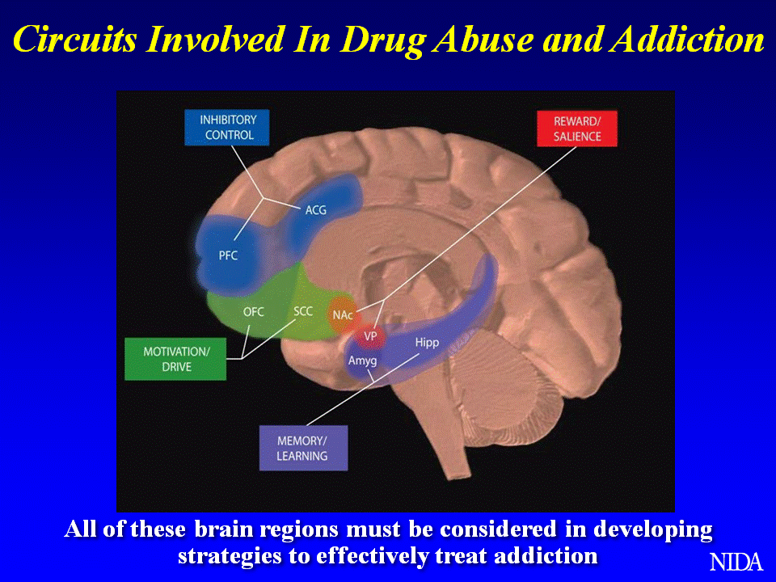
Key:
PFC – prefrontal cortex;
ACG – anterior cingulate gyrus;
OFC – orbitofrontal cortex;
SCC – subcallosal cortex;
NAc – nucleus accumbens;
VP – ventral pallidum;
Hipp – hippocampus;
Amyg – amygdala.
Notes:
Key:
PFC – prefrontal cortex;
ACG – anterior cingulate gyrus;
OFC – orbitofrontal cortex;
SCC – subcallosal cortex;
NAc – nucleus accumbens;
VP – ventral pallidum;
Hipp – hippocampus;
Amyg – amygdala.

Slide 91
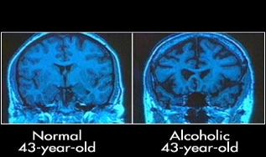

Slide 92

If drugs are so pleasurable, Why aren’t we all addicted? Genetically mediated response, metabolism, reward sensitivity…
Approx. 50% of the risk for addiction
is genetic
Genetic differences affect the
subjective preference and degree of reward people experience
from different substances/activities

Slide 93
What is “addiction”?
Contemporary definitions
A genetically influenced disease of the brain characterized by impairments in the neurocircuitary of reward, motivation, memory, impulse control, and judgment
Impaired control over a reward-seeking behavior from which harm ensues
A disease of the brain
….Why important to describe as a disease of the brain? In part, to help destigmatize addiction, take it out of the realm of moralization, and place it in the medical/treatment realm…

Slide 94
Caution: Potential paradoxical outcome of biomedical “chronically relapsing brain disease” definition’s intent to destigmatize -may actually increase at least some aspects of stigma of addiction
While a genetic and biological and brain disease view is popular and describes the nature of addiction at that level, it is important to also communicate that addiction is treatable, and actually a good prognosis psychiatric disorder from which most people recover.

Slide 95
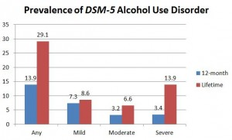
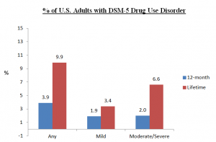
52% remission
rate for AUD
61% remission
Rate for DUD

Slide 96
Why it matters how we conceptualize it and what we call it and people with it
Our conceptual formulations and related language and terminology implicitly reflect and influence how we think about and approach these conditions
Language is a standardized collection of sounds and symbols that tacitly trigger networks of cognitive scripts that activate a serial chain of connected thoughts that influence appraisal, attitudes, decisions, and actions
Language changes over time (“lunatic asylums” “drunkards/dipsomaniacs” replaced with psych hospitals/ alcohol/AUD patients).
National policy approaches to “drug problem” possesses own terms/rhetoric - recent shift from a “war on drugs” (punishment) to a broader public health approach (prevention/treatment)…

Slide 97
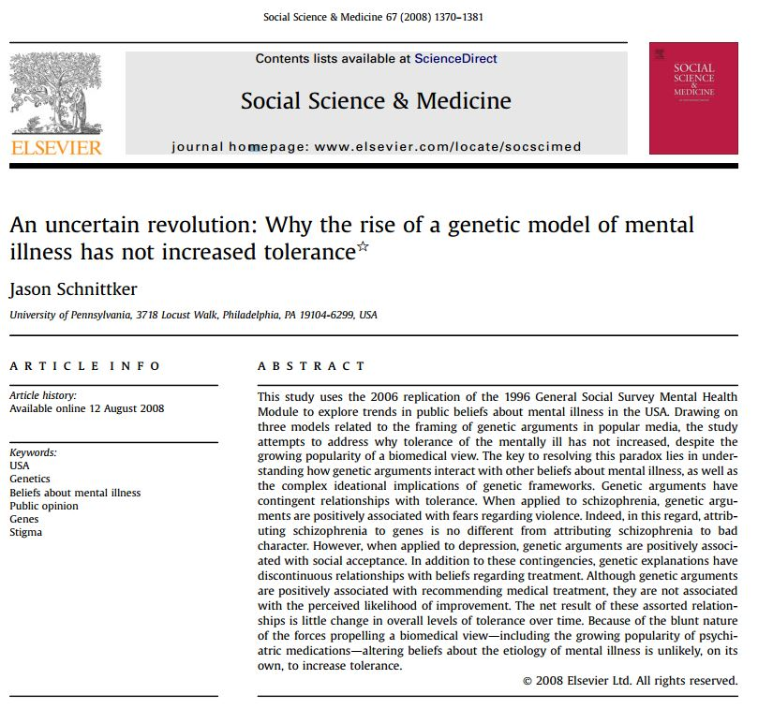
The paradox of a biomedical view
Sample: Respondents completing the General Social Survey (nationally representative survey of U.S. adults) mental health module in 1996 and 2006
Design: Vignette-based randomized design
Comparison conditions: Respondents were randomized to vignettes depicting a person with one of three psychiatric conditions
Outcomes: Questions about the person portrayed in the vignette

Slide 98
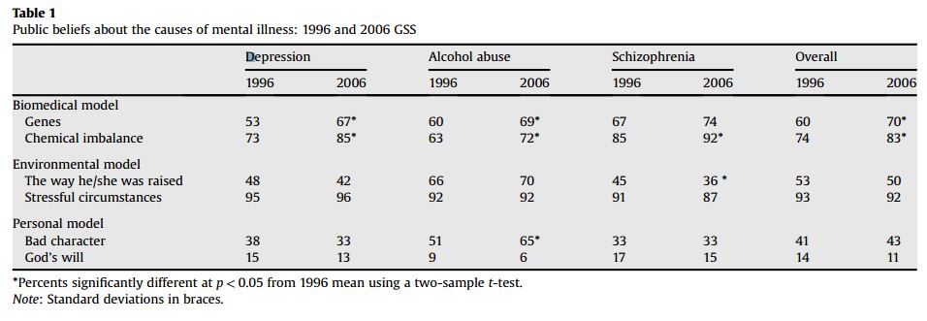
Endorsement of the biomedical model increased over time
  Between 1996 and 2006 people viewed “alcohol abuse” as more “genetic” and due to a “chemical imbalance” but also viewed it significantly more as due to “bad character”

Slide 99
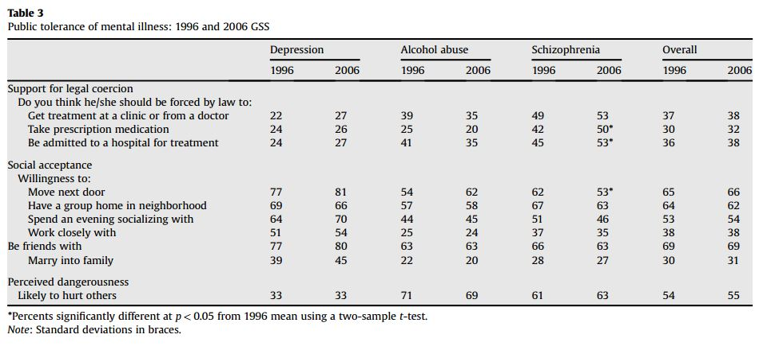
Despite the increase in support for a biomedical model, no improvements to public tolerance between 1996 and 2006…

Slide 100
What can we do about stigma and discrimination in addiction?
Education about essential nature of these conditions; but also stress that treatment and recovery supports help sustain remission, and a majority of people make full recoveries and have productive lives
Personal witness (putting a face and voice on recovery)
Change our language/terminology to be consistent with the nature of the condition and the policies we wish to implement to address it

Slide 101


Slide 102
Factors that influence stigma have language that is associated with them…
Cause | Controllability | Stigma
“It’s not their fault” | “They can’t help it” | Decreases
“It is their fault” | “They really can help it” | Increases

Slide 103
Two commonly used terms…
Major policy approaches (“war on drugs” vs. public health approaches) has corresponding rhetoric.
Referring to someone as…
  “a substance abuser” – implies willful misconduct (it is their fault and they can help it)
  “having a substance use disorder” – implies a medical malfunction (it’s not their fault and they cannot help it)
  But, does it really matter how we refer to people with these (highly stigmatized)conditions?
  Can’t we just dismiss this as a well-meaning point, but merely “semantics” and “political correctness”?

Slide 104

How we talk and write about these conditions and
individuals suffering them does matter

Slide 105
Study conceptual model
Causal Attribution (is it their own fault?)
Substance-Related Term
Punishment/ Treatment
Self-Regulation (can they control it?)
Social Distance/ Social Danger (are they dangerous?)
3 Subscales: 1. Perpetrator- Punishment
2. Social threat
3.Victim-treatment

Slide 106
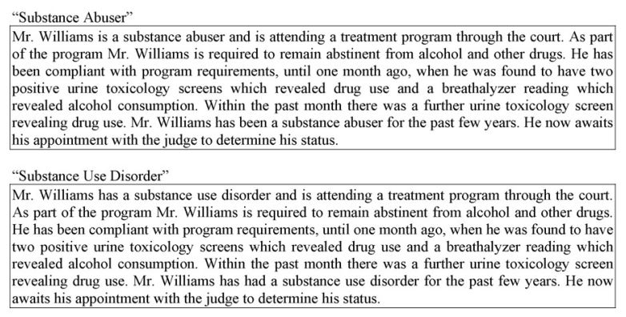
Compared to those in the “substance use disorder condition”, those in the “substance abuse” condition agreed with the idea that the individual was personally culpable and more in need of punishment

Slide 107
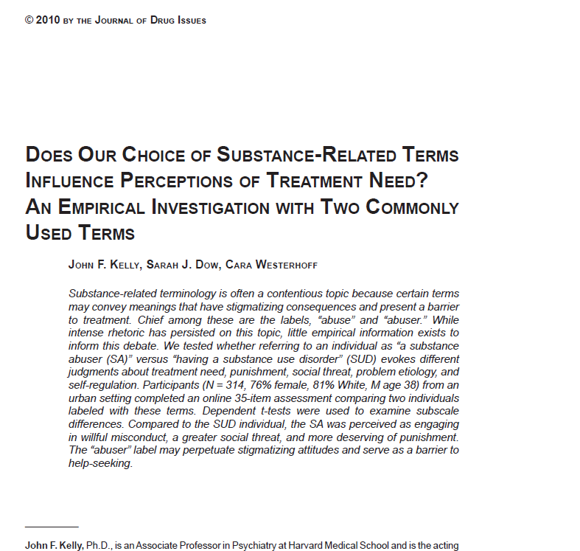

Slide 108
Figure 1. Subscales comparing the “substance abuser” and “substance use disorder” descriptive labels
Kelly, JF, Dow, SJ, Westerhoff, C. Does our choice of substance-related terms influence perceptions of treatment need? An empirical investigation with two commonly used terms (2010) Journal of Drug Issues

Slide 109
Implications
Even well-trained doctoral clinicians judged same individual differently and more punitively depending on to which term they were exposed
Use of the “abuser” term may activate an implicit cognitive bias that perpetuates stigmatizing attitudes – these could have broad stroke societal ramifications for treatment/funding
Let’s learn from our colleagues treating allied disorders: Individuals with “eating-related conditions” are uniformly described as “having an eating disorder” NEVER as “food abusers”
Referring to individuals as suffering from “substance use disorders” is likely to diminish stigma and may enhance treatment and recovery
Kelly JF, Westerhoff C. Does it matter how we refer to individuals with substance-related problems? A randomized study with two commonly used terms. Int J Drug Policy, 21 (2010), pp. 202–207
Kelly JF, Dow SJ, Westerhoff C. Does our choice of substance-related terms influence perceptions of treatment need? An empirical investigation with two commonly used terms J Drug Issues, 40 (2010), pp. 805–818

Slide 110
Stop talking dirty
Avoid “dirty,” “clean,” “abuser”
  Negative urine test for drugs
Kelly JF, Wakeman SE, Saitz R. Stop talking 'dirty': clinicians, language, and quality of care for the leading cause of preventable death in the United States. Am J Med. 2015 Jan;128(1):8-9. doi: 10.1016/j.amjmed.2014.07.043. Epub 2014 Sep 3.

Slide 111
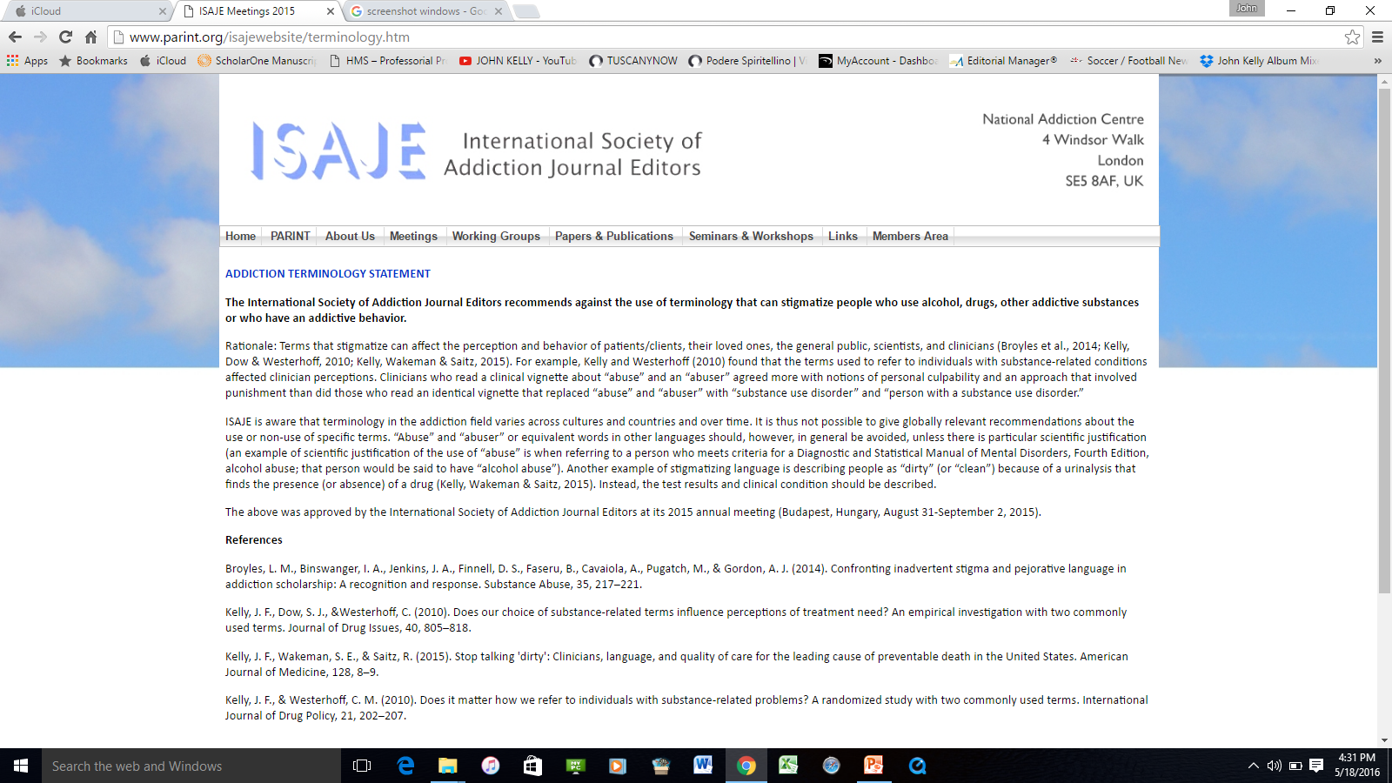
International Society of Addiction Journal Editors Budapest Consensus Statement adopted Sept 2015…

Slide 112
Name change could be game change
Despite increases in public understanding as addiction as a biomedical/genetic phenomenon from 1996 to 2006, attitudes that it is a character weakness has similarly increased and stigmatizing attitudes have not changed
One potential contributing factor is that our language is at odds with our new understanding of addiction as a disease that affects the structure and function of the brain
Removing from our lexicon terms like “abuse” and “abuser” could potentially reduce the likelihood of inducing implicit cognitive biases; also, given the lack of precision of the term “abuse” its non-use is unlikely to result in any loss of scientific precision in communication
Updating and changing our lexicon at the federal level NIH (National Institute of Drug Abuse and National Institute of Alcohol Abuse and Alcoholism) as well as SAMHSA, could go a long way to setting an example that would shift our national dialogue and related approaches to addressing endemic alcohol/drug problems

Slide 113
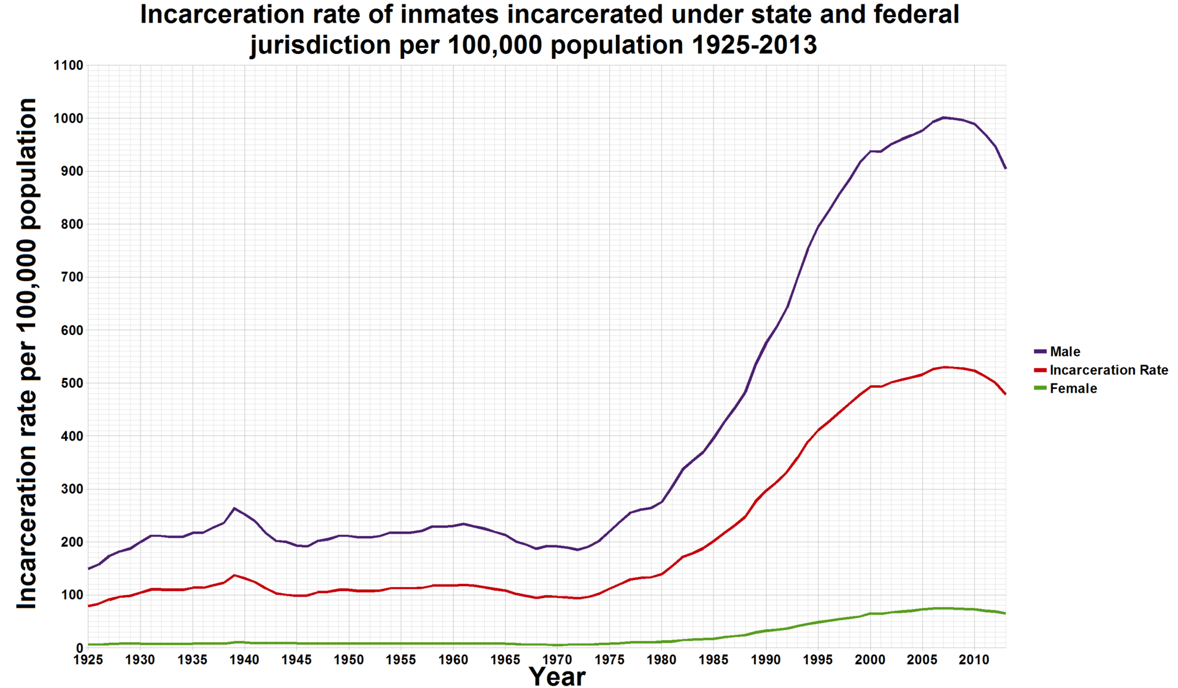
The War on Drugs
With 5% of the world’s pop, the US has 25% of its prisoners.
Avg US cost per prison inmate = (2010) = $31K (range 14K-60K); about $16 Billion for the 500,000 drug-related prisoners (20% of all prisoners)
Anti Drug Abuse Act

Slide 114
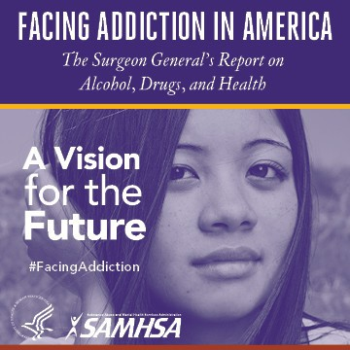
More recently, the first ever U.S. Surgeon General’s Report on Alcohol, Drugs, and Health was published in 2016 describing the nature of addiction, treatment, and recovery based on 50 yrs of research and policy …

Slide 115
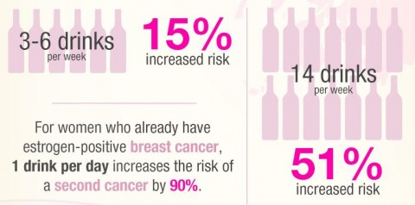
Did you know Alcohol is a level I carcinogen?

Slide 116
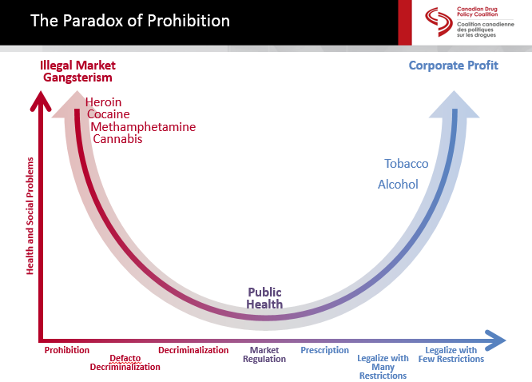
Different legal and commercial statuses of substances can affect consumption rates, patterns, and produce different types of harms…
Source: Canada Drug Policy Coalition, 2015

Slide 117
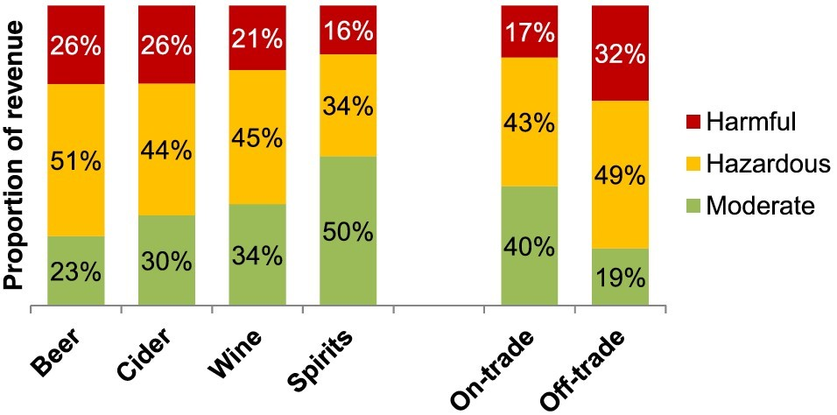
70% of annual alcohol industry revenue comes from hazardous and harmful drinkers
Source: Bhattacharya et al., 2018, Addiction

Slide 118
Meanings…
  Addiction: typically refers to compulsive, chronic, severe form of substance use disorder (i.e., DSM 5 “moderate” and “severe”)
  Dependence: older DSM IV term for addiction/severe substance use disorder; BUT can also refer to physiological dependence on a substance (“tolerance”) in the absence of compulsive drug use/drug-seeking behavior
  Abuse: older DSM IV term for less severe pattern of use that causes clinically significant impairment and/or distress in the absence of dependence/addiction; BUT sometimes also used to signify generic “drug problem”, also shown to be stigmatizing
  Alcoholism: an outdated term used to describe addiction specifically to the drug alcohol
  Misuse: a generic term used to describe a general pattern of problem substance use
  Hazardous/harmful use: use of a substance that places that person or other people in danger (e.g., driving while intoxicated)/produces direct ill health effects (e.g., alcoholic liver disease).
  Substance use disorder: the new DSM 5 term for a pattern of substance use that causes clinically significant impairment and/or distress as defined by 11 criteria

Slide 119
What are we talking about?
  Construct itself
    What is “it”?
    Phenomena at play- range of problem use
    How should we refer to these various phenomena?
    Implications (e.g., clinical, public health, criminal justice “ownership”

Slide 120
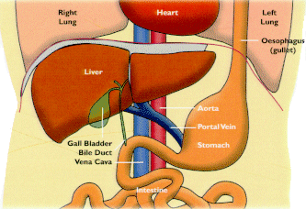
Toxicity-related effects independent of ADDICTION
Wodak and his colleagues obtained SADQ ratings on 193 patients with alcoholic liver disease.
Of these subjects:
  63% showed no or minimal dependence (SADQ<15),
  20% moderate dependence (SADQ 15-30)
  17% severe dependence SADQ < 30)
Suggesting results support hypothesis that patients who escape florid (i.e., fully manifest) symptoms of alcohol dependence are at greater risk of developing liver damage because they are able to sustain a continual consumption of alcohol for many years (beta)
Ref: WODAK, A. D., SAUNDERS, J. B., EWUSI-MENSAH, I.,DAVIES, M. & WILLIAMS, R. (1983) Severity of alcohol dependence in patients with alcoholic liver disease, British Medical Journal, 287, pp. 1140-1143.

Slide 122
Construct definition
Category
Dimension

Slide 123
Construct definition
Category that gives rise to the dimension…

Slide 124




Dimensional to categorical…

Slide 125
Notes:
Also, structurally, the brain is radically changed as a function of chronic exposure to neurotoxicants….

Slide 126
Outline
Burden of disease related to substance-related conditions large and growing
Research reveals addiction highly stigmatized; understanding of biomedical aspects increasing but addiction stigma not decreasing
Stigma major barrier to acknowledging problem, accessing help, and staying in recovery
Conceptualizations of addiction matter- influenced by cause and controllability
What to do about stigma: education, personal witness, shift language/terminology

Slide 127
But, what are talking about exactly?
Alcohol/drug problems are highly heterogeneous in their…
Etiology
Clinical course
Phenomenology
Influence and impact
Resolution, Remission, and recovery

Slide 128


What is it?
“Disease”? “Disorder”?
“Choice”?

Slide 129


Slide 130

Addiction is developmental learning disorder

Slide 131
Different legal and commercial statuses of substances can affect consumption rates, patterns, and produce different types of harms…
Source: Canada Drug Policy Coalition, 2015

Slide 132

MULTIPLE PATHWAYS TO RECOVERY
Acknowledges myriad ways in which individuals can recover:
Clinical pathways (provided by a clinician or other medical professional – both medication and psychosocial interventions)
Non-clinical pathways (services not involving clinicians like AA)
Self-management pathways (recovery change processes that involve no formal services, sometimes referred to as “natural recovery”).

Slide 133
We have learned a lot in the past 50 years as a result of these concerted national efforts…
We are moving away from…
A “moral issue ” a genetically influenced disorder of the brain
A few treatment options many evidence-based pharmacological and psychosocial treatment options
A rapid detox and “30 day rehab” ongoing recovery management
Believing few people recover to understanding that most people recover, but it can take time
Uncoordinated and segregated addiction care health systems treating this as a top clinical and public health problem
How conceptualize it and refer to it changing

Slide 134
Dimensional to categorical…

Slide 135
Caution: Paradox of a biomedical view
Sample: Respondents completing the General Social Survey (nationally representative survey of U.S. adults) mental health module in 1996 and 2006
Design: Vignette-based randomized design
Comparison conditions: Respondents were randomized to vignettes depicting a person with one of three psychiatric conditions
Outcomes: Questions about the person portrayed in the vignette
An uncertain revolution: why the rise of a genetic model of mental illness has not increased tolerance.
SCHNITTKER J
Social Science and Medicine Journal
Notes:
While our understanding of addiction as a biobehavioral disorder has increased substantially in recent decades, and this is reflected in population surveys, it is important to note also, that stigmatizing attitudes have also increased. How come? This study examined this pheneomenon in a large population study….

Slide 136

Despite increased agreement that alcohol addiction is biomedical, more viewed it also as due to “bad character”
Thus, while emphasizing biomedical, need to talk about addiction as treatable disorder, recovery is likely…
Pescosolido, B. A., Martin, J. K., Long, J. S., Medina, T. R., Phelan, J. C., & Link, B. G. (2010). “A Disease Like Any Other”? A Decade of Change in Public Reactions to Schizophrenia, Depression, and Alcohol Dependence. American Journal of Psychiatry, 167(11), 1321-1330. doi:doi:10.1176/appi.ajp.2010.09121743
Notes:
Greater public embrace of a neurobiological understanding of mental illness across nearly all indicators and vignette conditions
Social or moral conceptions decreased across most indicators
Socio-moral conceptions of alcohol dependence were largely unchanged or for attributions of bad character significant INCREASED.
Thus while describing addiction as a “chronically relapsing brain disease” may decrease stigmatizing attributions regarding cause and controllability it may be that we need to also add that most people actually do remit from the disorder and achieve long-term recovery. This is because people often do not believe people can recovery from a “chronically relapsing brain disease”.

Slide 137


Slide 138
Why the fuss about language?
  Two major reasons:
    Stigma and Discrimination
    Communication Precision

Slide 139
Language and Terminology Considerations in Addiction
The language we use influences and
reflects our policies and approaches
to addiction
Different terms convey different meanings and can affect perceptions cause and controllability, punishment or treatment
Goes beyond mere “political correctness”
Can implicitly affect judgment that can perpetuate stigma/discrimination against addicted individuals

Slide 140
Addiction more stigmatized than other mental illness:
People hold more negative attitudes towards persons with drug addiction than mental illness
Stigma, Discrimination, Treatment Effectiveness, and Policy: Public Views About Drug Addiction and Mental Illness
BARRY CL, MCGINTY EE, PESCOSOLIDO BA, GLODMAN HH.
Psychiatric Services Journal
Sample: 709 respondents to an online survey
Design: Randomized experiment (online survey)
Comparison conditions: Participants were randomly assigned to receive questions about mental illness or the same questions in reference to drug addiction
Outcome: Public attitudes (i.e. willing to let a person with this addiction marry into your family)
Notes:
People hold more negative attitudes towards persons with drug addiction than mental illness
This was a large randomized study conducted online using case vignettes

Slide 141

Public attitudes about persons with drug addiction (N=347) and mental illness (N=362), 2013
Drug addiction
Mental Illness
Unwilling to marry into family
Unwilling to work closely on job
Compared to those with mental illness, people less willing to have drug addicted person marry into family (90% vs 59%) or be co-worker (78% vs 38%)
Employers should deny employment for addicted more than mentally ill (64% vs 25%); landlords should deny housing (54% vs 15%)
Treatment perceived less effective for addiction than mental illness (59% vs 41%)
More opposition to insurance benefit, govt. housing, spending on treatment for addicted
https://www.ncbi.nlm.nih.gov/pubmed/25270497
Notes:
authors reported that 43% of respondents were opposed to equivalent insurance benefits for individuals with drug addiction compared to 21% for individuals with mental illness. Additionally, 49% reported being opposed to increased government spending on treatment for persons with drug addiction compared to 33% for increased government spending on treatment for persons with mental illness. When questioned about opposing increased government spending on housing, 76% reported being opposed when it pertained to individuals with drug addiction compared to 45% being opposed to increased spending for housing for individuals with mental illness. Lastly, 46% of respondents reported being opposed to increased government spending on job support for individuals with drug addiction compared to only 32% being opposed to increased spending on job support for individuals with mental illness.

Slide 142
Attitudes toward different mental illness: Addicted individuals “more to blame”…
People with addiction viewed as having themselves to blame for their disorder…
Only 7% rated people with schizophrenia in this way
Stigmatization of People with Mental Illness
ARTHUR H. CRISP, MICHAEL G. GELDER, SUSANNAH RIX, HOWARD I MELTZER and OLWEN J. ROWLANDS
British Journal of Psychiatry
Sample: 1737 adults in the UK
Design: Cross-sectional survey
Outcome: Questions about perceptions of common mental disorders:
Severe depression
Panic attacks
Schizophrenia
Dementia
Eating disorder
Alcohol addiction
Drug addiction
Notes:
People with addiction were viewed as having themselves to blame for their disorder…
But only 7% rated people with schizophrenia in this way

Slide 143
Addiction still more stigmatized than mental illnesses, but portraying it as treatable helps…
Sample: N=3940; nationally representative online survey
Design: Randomized vignette-based experiment
Comparison conditions: Participants were randomized to read one of ten vignettes with different portrayals (e.g., having untreated or treated mental illness or addiction) of white college-educated woman.
Outcomes: desirability of social distance, perceptions of treatment effectiveness, willingness to discriminate, support for policies that benefit persons with mental health or addiction
Portraying mental illness and drug addiction as treatable health conditions: Effects of a randomized experiment on stigma and discrimination
MCGINTY E, GOLDMAN H H, PESCOSOLIDO B, BARRY C L
Journal of Social Science & Medicine
Notes:
In this large nationally representative study, addiction was still more stigmatized than mental illnesses, but portraying it as treatable helps…

Slide 144
Addiction still more stigmatized than mental illnesses, but portraying it as treatable helps…
Overall, study found whether treated or untreated, people less likely to have addicted vs mentally ill be co-worker, marry into family
BUT, depicting as treatable helped: e.g., 85% unwilling to have heroin addicted person as co-worker, but 64% unwilling to have treated heroin addicted person as co-worker
Notes:
Overall, study found whether treated or untreated, people less likely to have addicted vs mentally ill be co-worker, marry into family
But, depicting as treatable helped: e.g., 85% unwilling to have heroin addicted person as co-worker, but just 64% unwilling to have treated heroin addicted person as co-worker

Slide 145
Stigmatization of AUD: impact on treatment seeking
What is the impact of stigma on treatment seeking in the US?
Stigma and Treatment for Alcohol Disorders in the United States
KEYES K M, HATZENBUEHLER M L, MCLAUGHLIN K A, LINK B, OLFSON M, GRANT B F, HASIN D
American Journal of Epidemiology
Sample: Nationally representative sample of 34,653 adults with alcohol use disorder
Design: Cross-sectional survey
Outcomes: Perceived stigma of alcoholism and receipt of services
Notes:
Data are drawn from the 2004–2005 National Epidemiologic Survey of Alcohol and Related Conditions (NESARC)

Slide 146
Treatment utilization - highest in lowest stigma group
Individuals with lifetime alcohol use disorder (AUD) less likely to use services if had higher perception of stigma towards individuals with AUD (independent of their own AUD severity)
Notes:
The scale measures the extent to which respondents believe that a person with a mental disorder will be stigmatized if their disorder were known
Treatment utilization – was highest in lowest stigma group
Individuals with lifetime alcohol use disorder (AUD) less likely to use services if they reported a higher perception of stigma towards individuals with AUD

Slide 147
Does stigma affect treatment completion?
Perceptions of discriminatory treatment by staff as predictors of drug treatment completion: utility of a mixed methods approach.
BRENER L, VON HIPPEL W, VON HIPPEL C, RESNICK I, TRELOAR C
Drug and Alcohol Review
Sample: 92 patients who used heroin in residential treatment in Sydney, Australia
Design: Cross-sectional survey
Outcomes: Perceptions of staff discrimination and treatment motivation

Slide 148

Patients in Study…
Experienced discrimination: 60% believed people treated them unfairly because knew of their substance use
Felt feared: 46% felt others afraid of them when found out about their substance use
Felt abandoned: 45% felt some family gave up on them after finding out about their substance use
Greater perceived discrimination associated with increased dropout
Notes:
Experienced discrimination: 60% believed people treated them unfairly because knew of their substance use
Felt feared: 46% felt others afraid of them when found out about their substance use
Felt abandoned: 45% felt some family gave up on them after finding out about their substance use
Greater perceived discrimination associated with increased dropout

Slide 149
Clinician attitudes toward SUD patients differ by specialty…
Overall, clinicians’ regard for pts using alcohol/drug consistently lower than other patients with diabetes/depression
Primary care physicians showed lower regard for pts using alcohol/drugs than other professionals
Staff regard towards working with substance users: a European multi-centre study.
GILCHRIST G, MOSKALEWICZ J, SLEZAKOVA S, OKRUHLICA L, TORRENS M, VAJD R, BALDACCHINO A
Addiction Research Report
Sample: 866 health service professionals (physicians, psychiatrists, psychologist, nurses, and social workers) from a variety of service settings in 7 European countries
Design: Cross-sectional survey
Outcomes: Regard toward working with patients with problems related to alcohol or drugs, with depression, and with diabetes
Notes:
Overall, clinicians’ regard for pts using alcohol/drug consistently lower than other patients with diabetes/depression
Primary care physicians showed lower regard for pts using alcohol/drugs than other professionals

Slide 150
Stigma among health professionals: impact on care delivery from 28 studies
Health professionals found to have…
negative attitudes toward pts with SUD
(e.g., more violent, manipulative, less motivated)
inadequate training in SUD care
be more avoidant regards SUD care- may result in shorter visits, less empathy, less engagement
Stigma among health professionals towards patients with substance use disorders and its consequences for healthcare delivery: systematic review.
VAN BOEKEL LC, BROUWERS EP, VAN WEEGHEL J, GARRETSEN HF
Drug and Alcohol Dependence Journal
Sample: 28 studies with health personnel who work with patients with substance use problems
Design: Systematic review
Outcomes: Attitudes of health personnel, healthcare delivery, (social) stigma
Notes:
Overall across all of these studies health professionals were found to have…
negative attitudes toward pts with SUD
(e.g., viewed them as more violent, manipulative, less motivated)
inadequate training in SUD care
be more avoidant regards SUD care- may result in shorter visits, less empathy, less engagement

