Slide 1

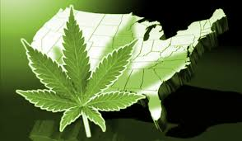
Medicine or menace: Will new Cannabis policies reduce harm or produce harm?”
John F. Kelly, PhD
Parkside, Tulsa OK November 2019

Slide 2
The Drug problem … “For every complex problem there is a solution that is clear, simple, and wrong” –Henry L. Mencken

Slide 3
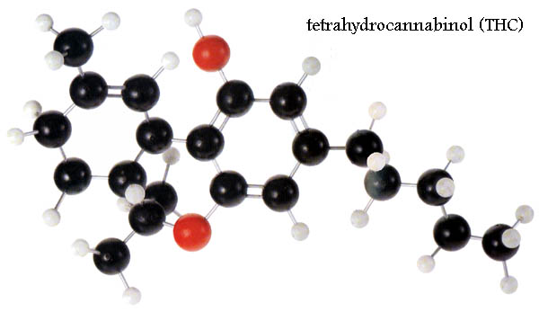
What is MJ?
common name for cannabis sativa plant -contains Psychoactive effects through variety of cannabinols, notably Delta-9 THC, and cannabidiol
commonly inhaled producing mild euphoria, mood enhancement, relaxation; higher/regular use produces intoxication, slowed cognition/memory impairment(Short-term memory/working memory) increased anxiety/paranoia/psychosis, hallucinations, addiction
Can increase the likelihood of accidents/MJ-related deaths but Unlikely to produce od related mortality directly
May be neurotoxic in higher doses; developing teen brain appears more susceptible to negative impacts than older adult users

Slide 4
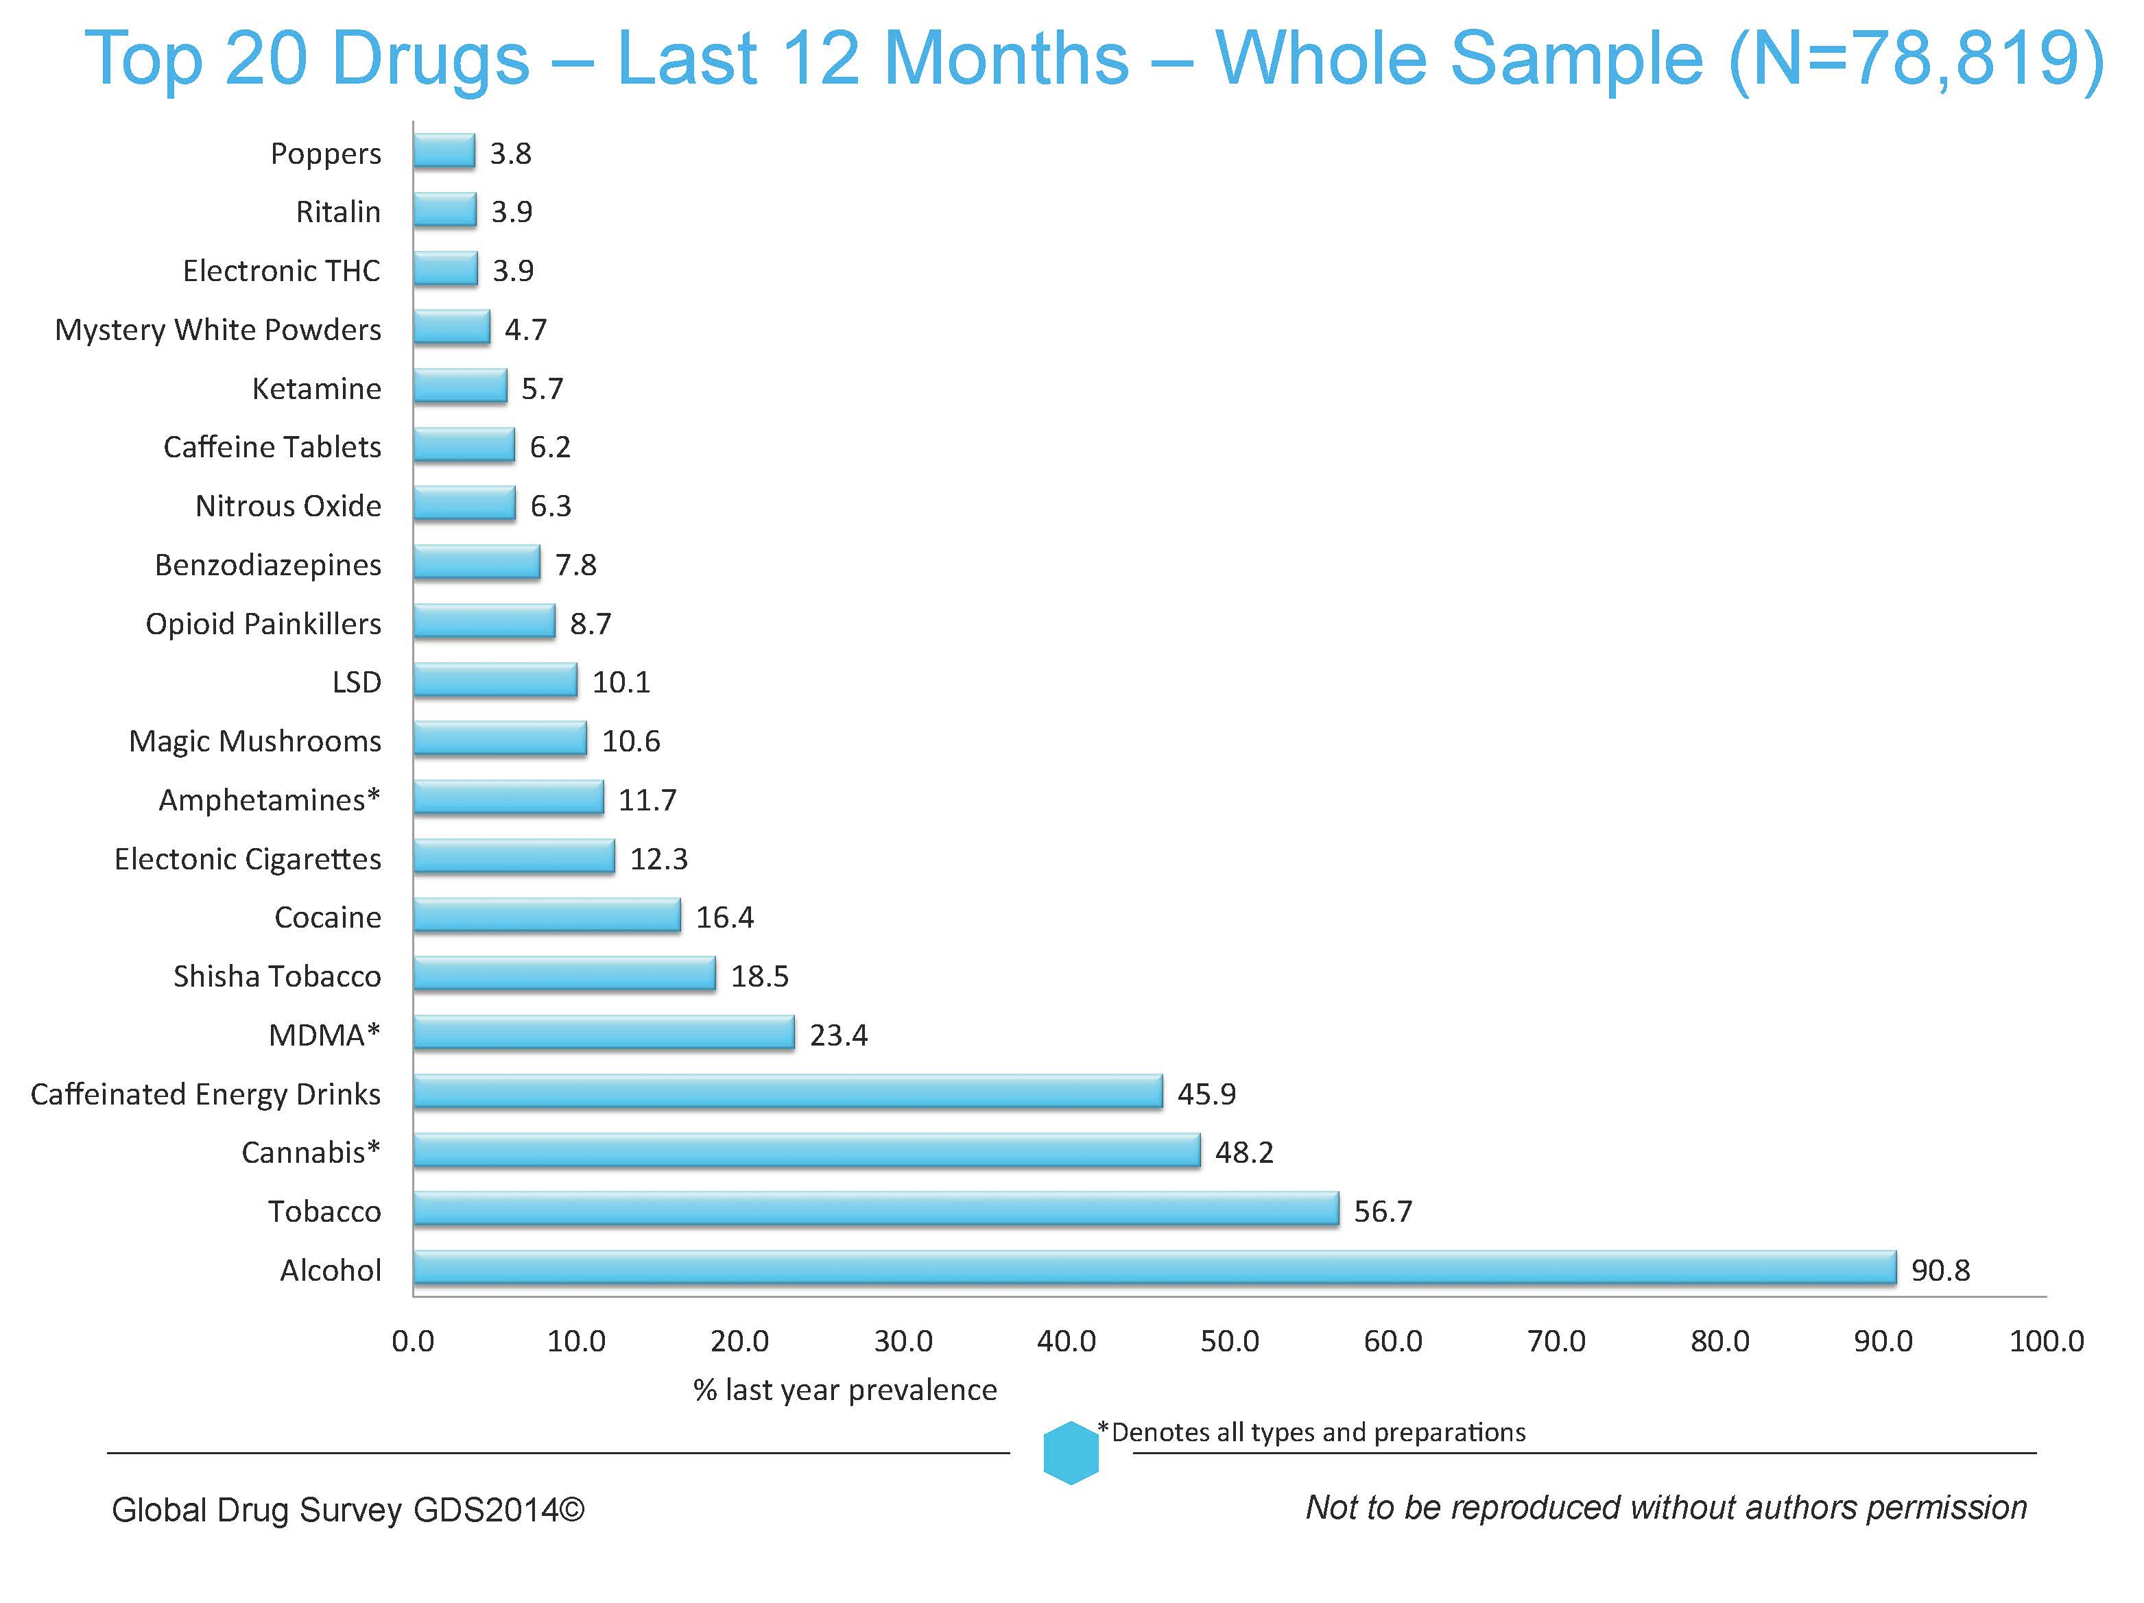
MJ is popular around the world
…

Slide 5
…and in the USA Second only to alcohol…

Slide 6
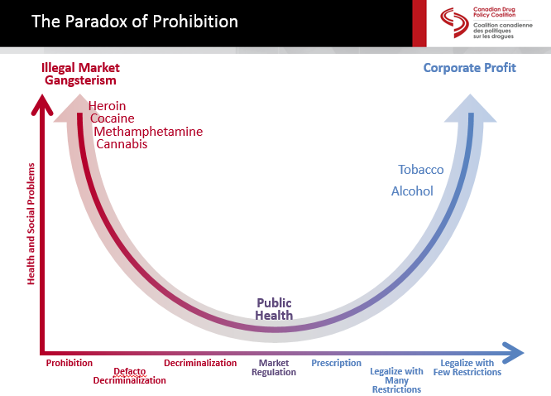
Degree of Problems Associated with Various Policy Approaches to Addressing the Drug Problem
Source: Canada Drug Policy Coalition, 2015

Slide 7
Policy Positions 101
PROHIBITION
In most countries and the US, prohibition generally pertains to illegality in terms of manufacture, sale, or distribution (Can also mean possession as in the us)
remains primary policy position for psychoactive drugs that have the potential to be misused, cause intoxication, addiction, and induce harms (other than alcohol, nicotine)

Slide 8
Policy Positions 101 Decriminalization
often confused with legalization but very different.
1
Decriminalization means if you are caught in possession of small amounts for personal use, you do not incur criminal penalty.
2
It is still illegal to use the drug.
3
The penalty, however, is typically nothing more than a modest fine, such as $100.
4
Multiple states have now passed laws decriminalizing the possession and use of marijuana.
5

Slide 9
Policy Positions 101
DE FACTO DECRIMINALIZATION
Often prior to passing decriminalization legislation, many states go through a period of “de facto decriminalization,” whereby no actual decriminalization law has been officially passed, but the existing criminal law prohibiting use is no longer enforced.
It is an implicit recognition that decriminalization might be a potentially useful policy position, even if sufficient social and political will to enact it is currently absent.

Slide 10
Policy Positions 101
MARKET REGULATION
A medium for the exchange of goods or services over which a government body exerts a level of control.
may require market participants to comply with environmental standards, product-safety specifications, information disclosure requirements etc. market for both prescription and over-the-counter drugs is an example of regulated market.
FDA controls what drugs may be sold on the market, how advertised, for what conditions they may be prescribed ETC.

Slide 11
Policy Positions 101
MEDICALIZATION
Medicalization is a policy position taken for some psychoactive drugs. Notably, in the case of marijuana, its use for medical purposes has now become law in the majority of US states.
Medicalization of marijuana is unusual in this regard because it is medically “recommended” rather than actually “prescribed,” due to limited availability of empirical evidence on health benefits. If properly regulated and supported by clinical science for specific medical conditions, medicalization of a drug can destigmatize use, decrease pain and suffering related to those specific conditions.
Because of safety concerns (e.g., in utero effects in pregnancy, drug-drug interactions, other medical contraindications), medicalization typically requires extensive testing to ensure users of the prescribed medication are not harmed by its use, and side-effects are minimized.

Slide 12
Policy Positions 101
LEGALIZATION (IN ITS MANY FORMS)
While you might think legalization is simply a yes or no dichotomy, important to recognize are several forms that legalization can take, each accompanied by own set of pros/cons.

Slide 13
Policy Positions 101
LEGALIZATION WITHOUT COMMERCIALIZATION
allows production, distribution, and sale, forbids commercialization. bans branding and advertising designed to increase sales.
alternative is have local, state, or federal control over production, sale; still makes drug legal, available, and accessible, and retains better control of quality and labeling of the drug’s psychoactive potency and ingredients.
plus side- people who want to use it recreationally can without fear of recrimination; eradicates criminality, incarceration, black markets - lessens stigmatization of addicted users, lessening barrier to treatment.
downside, because drugs cause acute impairments, as well as addiction (about 10% of users meet criteria for addiction), increased accessibility, de-stigmatization, and decreased prices that comes with legalization, results in more users and more potential hazards and harms in population (e.g., drugged driving) as well as addiction cases.

Slide 14
Policy Positions 101
LEGALIZATION WITH LIMITS ON COMMERCIALIZATION
legalization but allows at least some commercialization. E.g., restrictions placed on how much and to whom products are advertised. drug could be made legal for recreational use, but commercial advertising in certain venues at certain times (e.g., when children/adolescents likely to be exposed to advertisements) is restricted.
Other restrictions could include minimum age (e.g. age 21), ensuring quality control, listing of ingredients including nature and potency of psychoactive content; limiting licensed outlets; still prohibiting use under certain conditions (e.g., driving); having minimum price per unit at which the drug sold (Many such restrictions are placed on the sale of alcohol, for example).
Note, just because laws in place to limit potential public health and safety harms from uptick in use, does not mean necessarily that such laws will be adequately enforced once drug legalized.

Slide 15
Policy Positions 101
LEGALIZATION WITH FULL COMMERCIALIZATION
other end of spectrum from prohibition, and at far end of legalization continuum, free market commercialization. allows free reign for industry to brand and advertise and sales with few, if any, restrictions.
advertising and branding valuable – imagine cigarettes sold in a plain white box with nothing on the outside; or wine, beer, liquor, sold in ordinary transparent glass containers with just a simple white label on the outside stating, “Wine” or “Vodka.”
Industry goes to great expense to attractively shape, tint, color, emboss glass, create gilt-edged high-color labels, gold foil wrappings, and launch multi-million-dollar professional advertising campaigns in an attempt to create an image that attracts, seduces, and increases sales and profits.
Increasing sales increases population exposure; may increase harms/hazards to the extent that drug can cause such harms

Slide 16
Degree of Problems Associated with Various Policy Approaches to Addressing the Drug Problem
Source: Canada Drug Policy Coalition, 2015

Slide 17

Legalization? How did we get here?

Slide 18

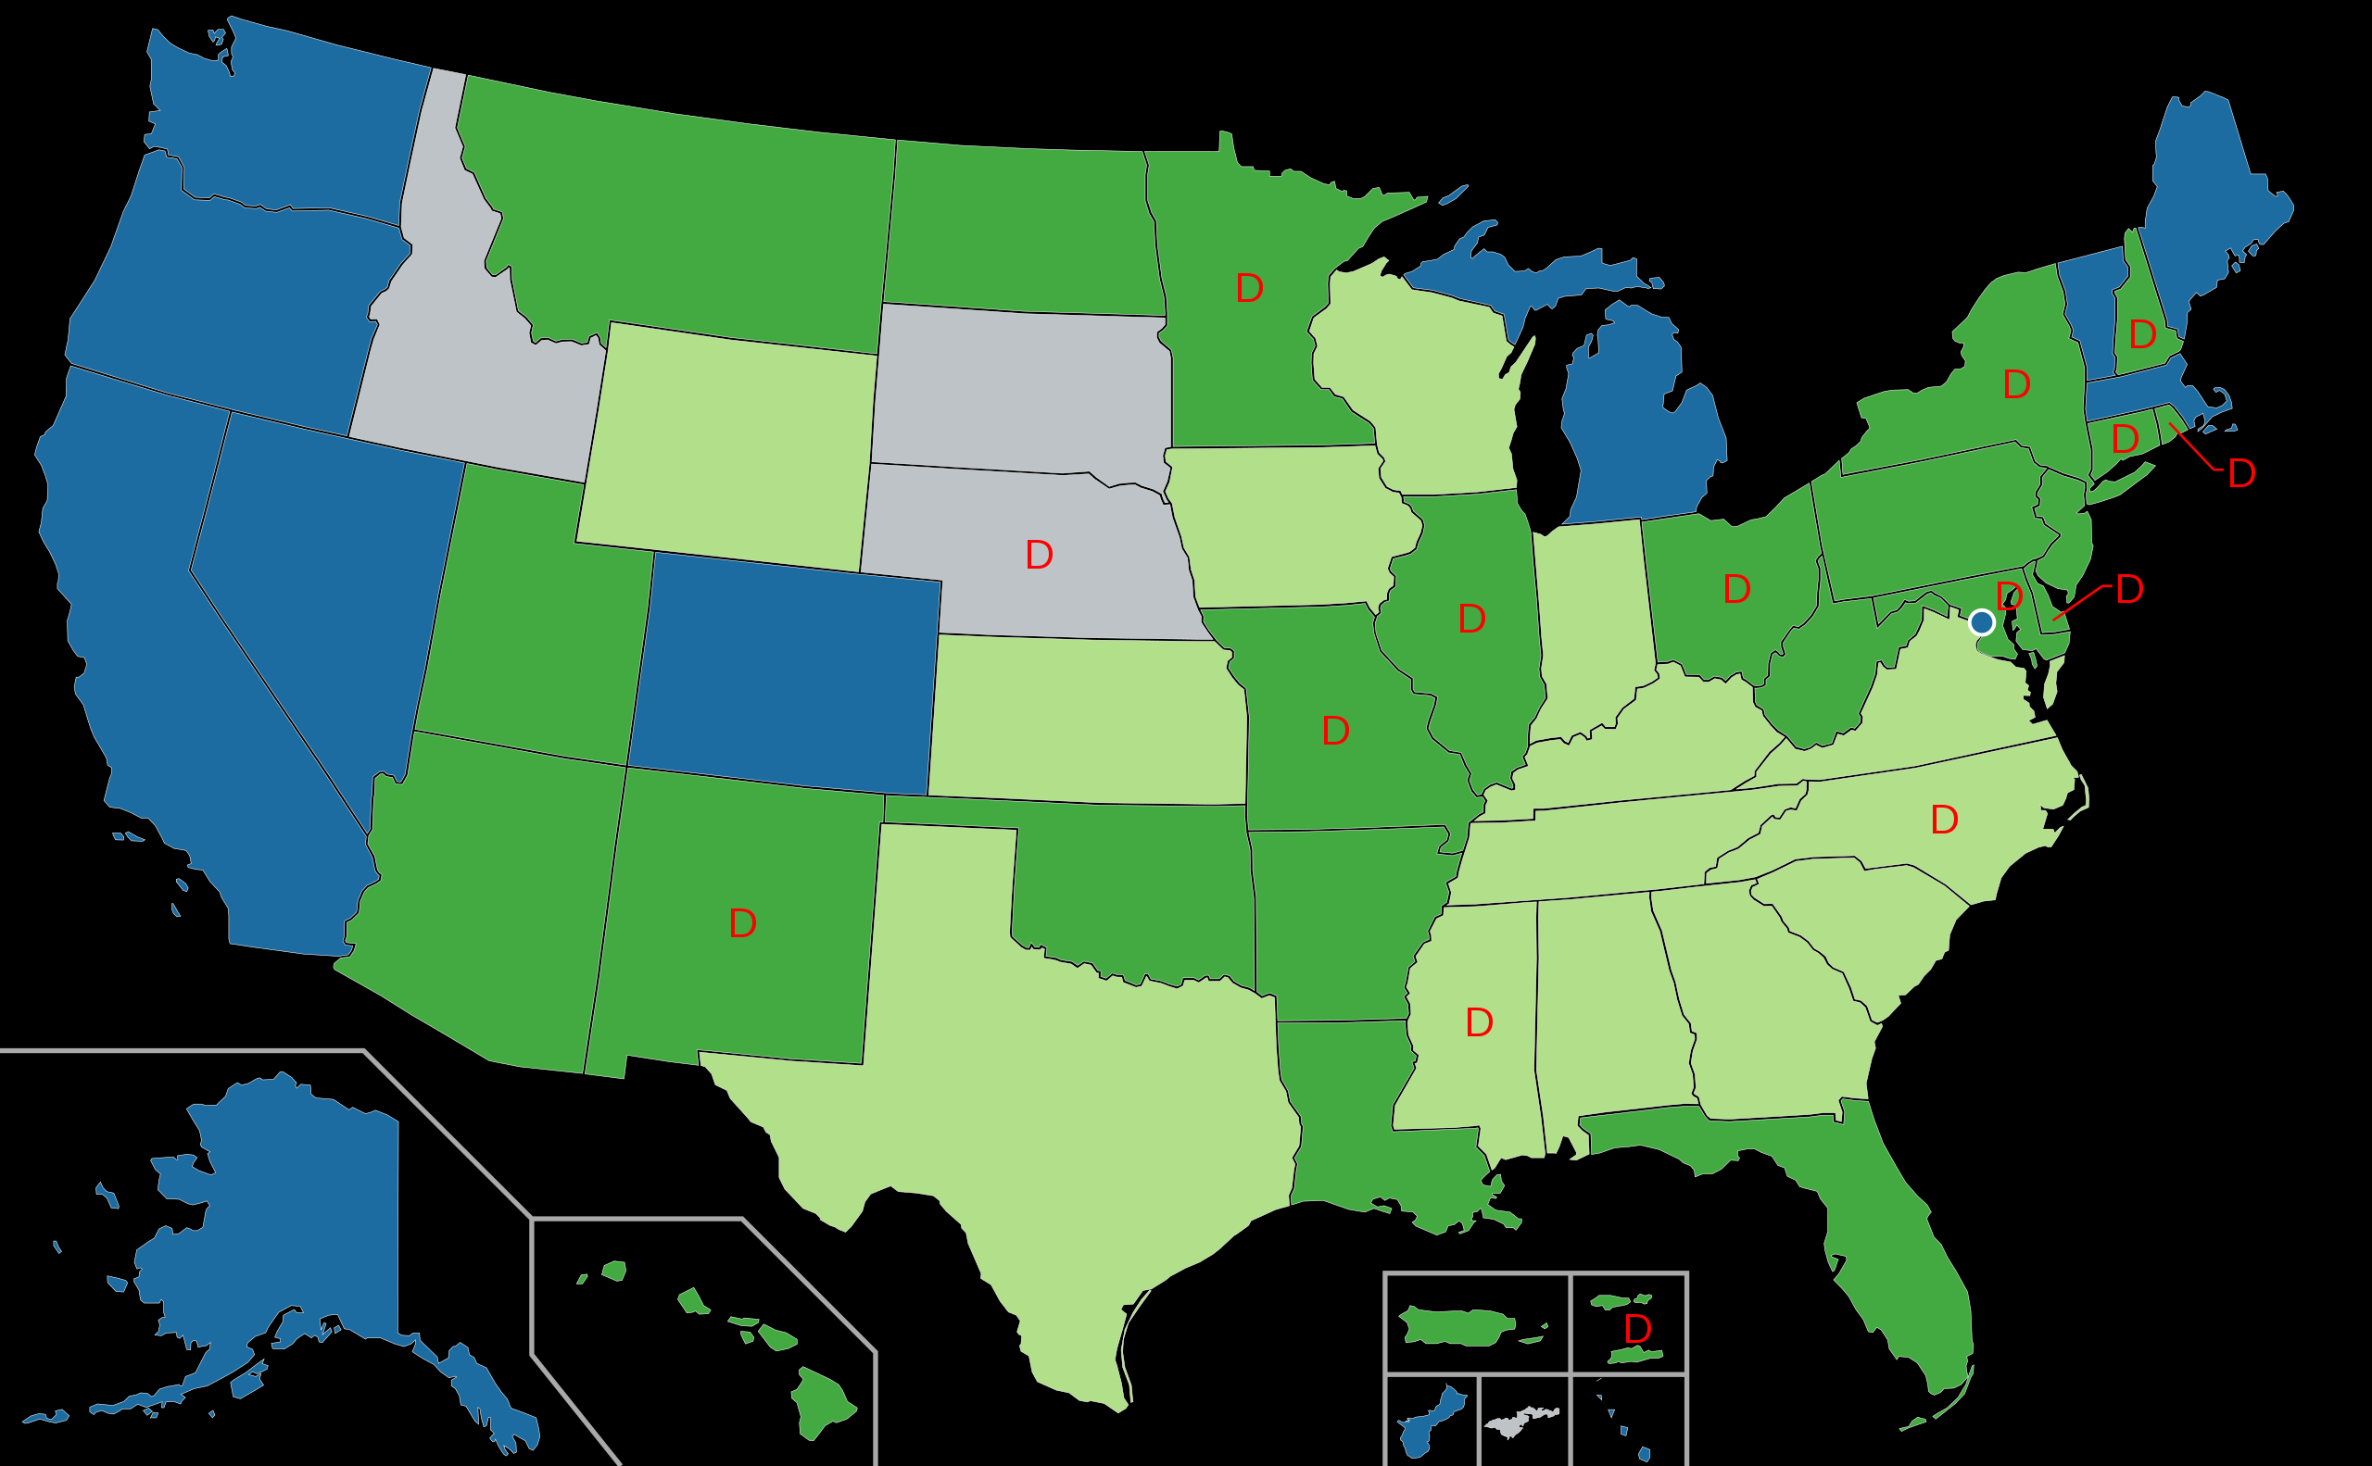
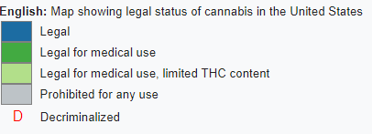

Slide 19

“medical marijuana”…

Slide 20
For which conditions might marijuana/THC have a therapeutic benefit?
Up to 259 conditions including:
Alzheimer’s disease
Anorexia
HIV/AIDS
Arthritis
Cachexia
Cancer
Crohn’s Disease
Epilepsy
Glaucoma
Migraines
Multiple Sclerosis
Nausea
Pain
Spasticity
Wasting Syndrome
ProCon.org: http://medicalmarijuana.procon.org/view.resource.php?resourceID=000884

Slide 21
CANNABIDOIDS HAVE DOCUMENTED THERAPEUTIC POTENTIAL… THC Administration & FDA Approved THC-based medications
Compound | Administration | FDA Status | Approved Locations | Purposes
Dronabinol (Marinol) | Oral capsule | FDA-approved (1985) | USA, Germany | Nausea & vomiting related to cancer chemotherapy and wasting associated with AIDS
Nabilone (Cesamet) | Oral capsule | FDA-approved (1985) *Marketed in the US in 2006 | USA, Canada, UK, Mexico | Nausea & vomiting related to cancer chemotherapy
Nabiximols (Sativex) | Oromucosal spray | Almost FDA-approved; late-stage clinical trials | Canada, UK, other European countries | Multiple sclerosis spasticity, cancer pain, neuropathic pain
Marijuana Site Reclamation and Restoration Cost Analysis.” U.S. Department of Interior, National Park Service. December 9, 2010 (unpublished data). http://www.whitehouse.gov/ondcp/frequently-asked-questions-and-facts-about-marijuana#difference
Notes:
Nabilone is an analog to Dronabinol. Differences are primarily related to dosing:
Dronabinol: 5 mg/m2 orally four to six times per day. May increase in 2.5mg/m2 increments up to 15 mg/m2 per dose. Schedule III controlled substance
Nabilone: 1 to 2 mg orally twice daily; maximum of 6 mg per day. Schedule II controlled substance

Slide 22
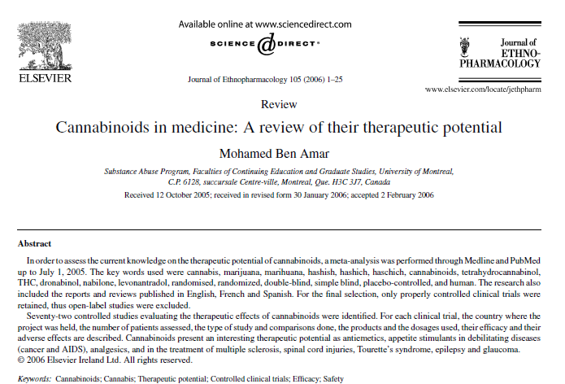

Slide 23
Controlled studies evaluating the therapeutic effect of THC by administration type
Ben Amar, M. (2006). Cannabinoids in medicine: A review of their therapeutic potential. Journal of ethnopharmacology, 105(1), 1-25.
Notes:
Author’s conclusions: “…based on the available data, oral cannabinoids should not be used as first-line anti-emetics. They may, however, prove effective to treat refractory emesis and have their place as adjuvants to other antiemetic medications. There is insufficient evidence on the efficacy of cannabis and its derivatives to control epilepsy. Further clinical trials, well-designed, carefully executed and powered for efficacy, are essential to clearly define the role of cannabinoids as appetite stimulants, as well as in the treatment of multiple sclerosis, spinal cord injuries, Tourette’s syndrome and glaucoma. For each pathology, it remains to be determined what type of cannabinoid and what route of administration are the most suitable to maximize the beneficial effects of each preparation and minimize the incidence of undesirable reactions”

Slide 24
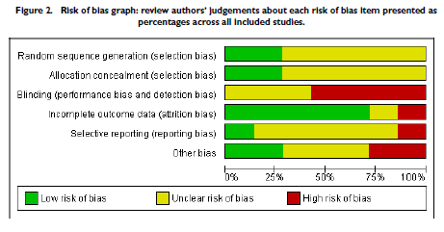
Issues with blinding in medical marijuana RCTs
More than 50% of studies are considered at high risk for unblinding
The use of cannabis and rapidly acting cannabinoids pose considerable challenges for blinding, as the psychoactive effects are expected to be quickly discernible to study participants, particularly those who have been previous users of such products.
Lutge, E. E., Gray, A., & Siegfried, N. (2013). The medical use of cannabis for reducing morbidity and mortality in patients with HIV/AIDS. status and date: New, published in, (4).
Notes:
Results: A total of seven relevant studies were included in the review, reported in eight publications. All were randomised controlled studies, with four utilising a parallel group design, two a within-subject randomisation and two a cross-over design. All of the studies were of a fairly short duration, ranging from 21 days to 84 days. In only four papers (in effect, three studies) were sequence generation and allocation concealment judged to be adequate. The use of cannabis and rapidly acting cannabinoids posed considerable challenges for blinding, as the psychoactive effects are expected to be quickly discernible to study participants, particularly those who have been previous users of such products. Dronabinol was expected to be more easily blinded. The outcomes measured were variable, including change in weight, change in body fat (measured as a percentage of total body weight), change in appetite (measured on a visual analogue scale), change in caloric intake (measured in kcals/kg/24hr), change in nausea and vomiting (measured on a visual analogue scale), change in performance (measured by Karnofsky performance score or specific tests for memory and dexterity) and change in mood (measured on a visual analogue scale).The evidence for substantial effects on morbidity and mortality is currently limited. Data from only one relatively small study (n=139, of which only 88 were evaluable), conducted in the period before access to highly-active antiretroviral therapy (HAART), showed that patients administered dronabinol were twice as likely to gain 2kg or more in body weight (RR 2.09), but the confidence interval for this measure (95% CI 0.72 - 6.06) included unity. The mean weight gain in the dronabinol group was only 0.1kg, compared with a loss of 0.4kg in the placebo group. However, the quality of sequence generation and allocation concealment in this study, in which participants were randomised by centre, could not be assessed.
Author’s Conclusions: Despite dronabinol being registered by at least some medicines regulatory authorities for the treatment of AIDS-associated anorexia, and some jurisdictions making allowances for the "medical" use of marijuana by patients with HIV/AIDS, evidence for the efficacy and safety of cannabis and cannabinoids in this setting is lacking. Such studies as have been performed have been of short duration, in small numbers of patients, and have focused on short-term measures of efficacy. Long-term data, showing a sustained effect on AIDS-related morbidity and mortality and safety in patients on effective antiretroviral therapy, has yet to be presented. Whether the available evidence is sufficient to justify a wide-ranging revisiting of medicines regulatory practice remains unclear.

Slide 25
Why should MJ be illegal?
Why should it be legalized?

Slide 26
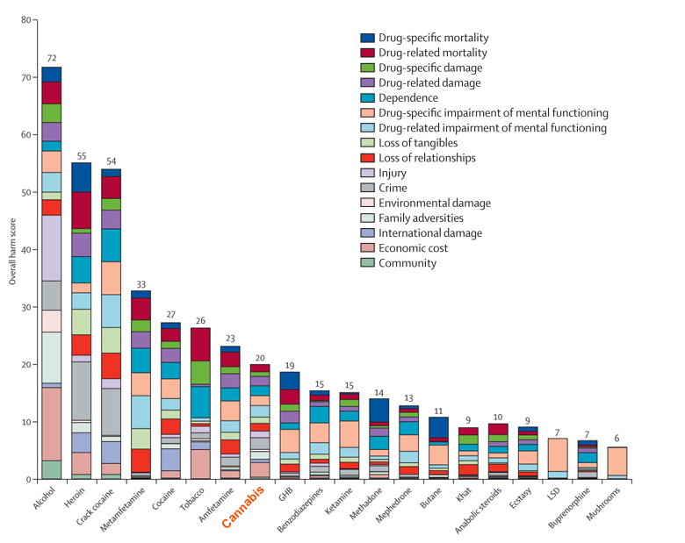
Health (and societal) risks of smoked marijuana
20 drugs ranked by overall harm along 16 criteria
Nutt, D. J., King, L. A., & Phillips, L. D. (2010). Drug harms in the UK: a multicriteria decision analysis. The Lancet, 376(9752), 1558-1565.

Slide 27
Arguments for cannabis legalization
“War on drugs” has failed
5% of world’s population -25% of world’s prisoners
2.5 Million locked up; about 500,000 of whom are there for drugs
Racial disparities in incarceration rates at same prevalence of use
Legalization would reduce arrests/criminal justice costs (2013- 41% of all illicit drug-related violations were MJ possession; 6% for MJ Sale/manufacturing
Demand is high- “gonna do it anyway” so why not regulate it and make it safe?
IT’s not Bad/as bad as alcohol/tobacco -Even good for you (medicinal)
Tax it and bring in revenue for states

Slide 28
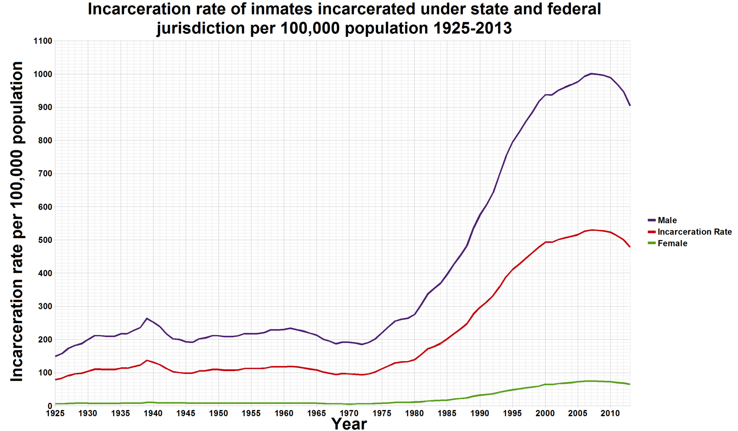
The War on Drugs
With 5% of the world’s pop, the US has 25% of its prisoners.
Avg US cost per prison inmate = (2010) = $31K (range 14K-60K); about $16 Billion for the 500,000 drug-related prisoners (20% of all prisoners)

Slide 29
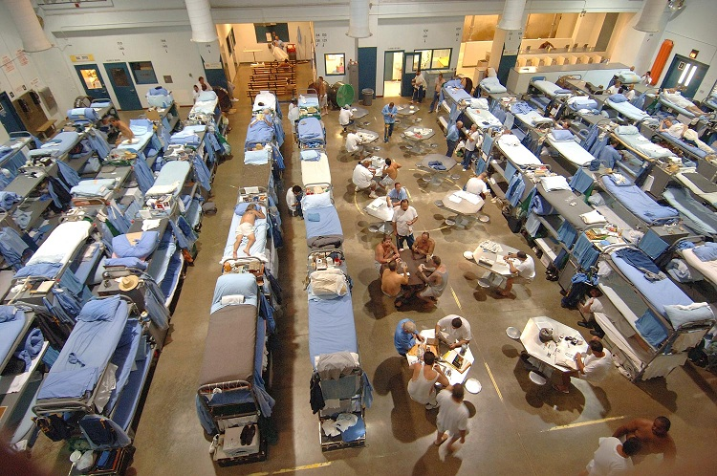
Prisons overcrowding: 20% (500,000) of US prisoners are in prison due to drug offences; the majority of inmates meet criteria for substance use disorder/psych illlness

Slide 30
So, legalize?
Of the 2.5 million prisoners in US about 500,000 are there due to drug law violations, but only about 40,000 of these are MJ
This would be justification for decriminalization NOT legalization but even so, to “end the war on drugs” by legalization of MJ won’t do it
What will happen is the reduction on the arrests annually (FOR POSSESSION) in the US – about 700,000 reduction in arrests annually
How to legalize? Industry – majority of market is heavy users/ADDICTED–(80% of volume used is by 20%)
If we make it more available and accessible, cheaper, remove social stigma and legal penalties and have industry aggressively advertising it, use will increase
Possible mj could have subtractive effect on opioid or alc use? Don’t know. Could use both?
Notes:
In 2015 in CO, 2/3 of drivers involved in accidents who tested positive for MJ, had alcohol or another drug in their system also

Slide 31
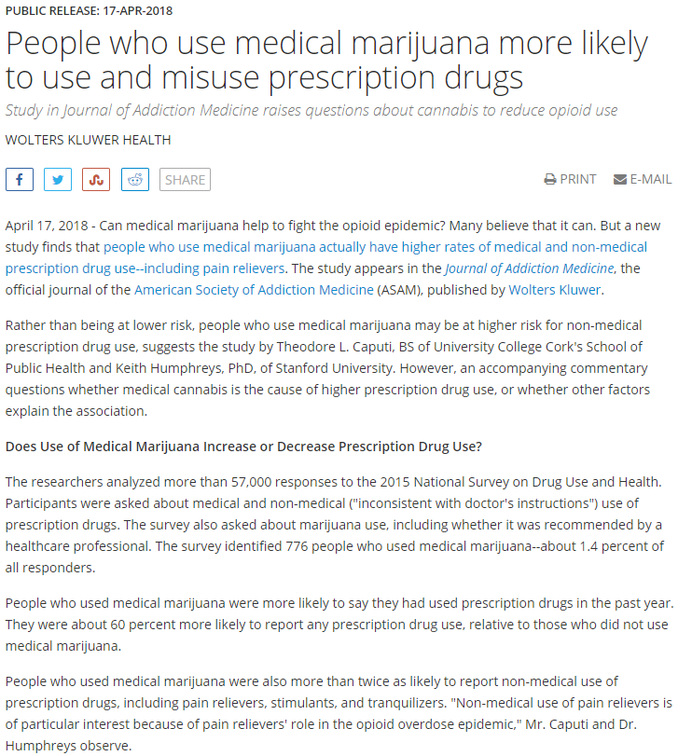
Medical Marijuana & Prescription Drugs
Study published in Journal of Addiction Medicine
RESEARCHERS analyzed 57,000+ responses to the 2015 National Survey on Drug Use and Health (NSDUH), identifying 776 people who reported using medical marijuana (~1.4% of respondents)
FINDINGS
Relative to those who did not use medical marijuana, those who did were 60% more likely to also report using prescription drugs in the past year
Those who used medical marijuana more than TWICE as likely to report non-medical use of prescription drugs (e.g., pain relievers, tranquilizers, sedatives)
Correlational findings inconsistent with studies reporting lower rates of prescription drug use (both “medical” and “non-medical”) among medical marijuana users
Findings do not prove a causal connection between marijuana and prescription drug use, but do highlight need for prospective, longitudinal studies to disentangle effects
VIA EurekAlert: https ://www.eurekalert.org/pub_releases/2018-04/wkh-pwu041718.php
Notes:
https://www.eurekalert.org/pub_releases/2018-04/wkh-pwu041718.php

Slide 32
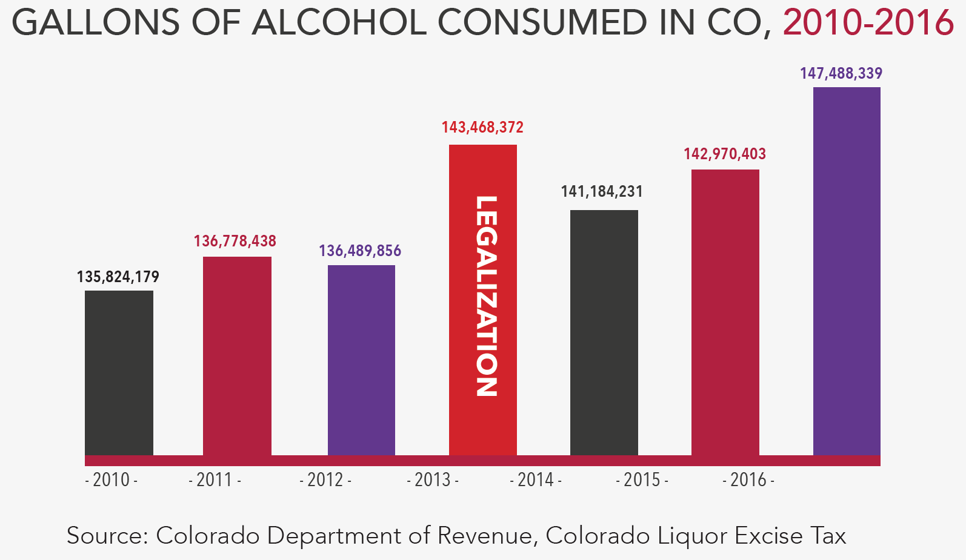
ALCOHOL & MARIJUANA LEGALIZATION
MARIJUANA & OTHER
SUBSTANCE USE
Since legalization, number of gallons of alcohol consumed has INCREASED 8% in CO, and in WA, AK, and OR, has either stayed the same or increased.
Haughwout, P., & Slater, M. (2017). Surveillance report #108: Apparent per capita alcohol consumption: National, state, and regional trends, 1977–2015. Bethesda, MD: National Institute on Alcohol Abuse and Alcoholism. Retrieved February 3, 2018, from https://www.niaaa.nih.gov/sites/ def ult/files/publications/Surveillance/Surveillance108/CONS15.pdf and Colorado Department of Revenue, Colorado Liquor Excise Tax. (2017). Retrieved February 6, 2018, from http://www.rmhidta.org/html/FINAL%202017%20Legalization%20of %20Marijuana%20in%20Colorado%20The %20Impact.pdf, as cited by Smart Approaches to Marijuana (SAM) (2018, March). Lessons learned from marijuana legalization in four U.S. States and D.C. March 2018. Retrieved from https://learnaboutsam.org/wp-content/uploads/2018/03/SAM-Digital-C-4.pdf.
Notes:
“Furthermore, researchers from Oregon State University found that college students who are binge drinkers under the age of 21 have been one of the primary groups of marijuana users after legalization (Darling, 2017).”
REFERENCE:
Haughwout, P., & Slater, M. (2017). Surveillance report #108: Apparent per capita alcohol consumption: National, state, and regional trends, 1977–2015. Bethesda, MD: National Institute on Alcohol Abuse and Alcoholism. Retrieved February 3, 2018, from https://www.niaaa.nih.gov/sites/default/files/publications/Surveillance/Surveillance108/CONS15.pdf and Colorado Department of Revenue, Colorado Liquor Excise Tax. (2017). Retrieved February 6, 2018, from http://www.rmhidta.org/html/FINAL%202017%20Legalization%20of%20Marijuana%20in%20Colorado%20The%20Impact.pdf, as cited by Smart Approaches to Marijuana (SAM) (2018, March). Lessons learned from marijuana legalization in four U.S. States and D.C. March 2018. Retrieved from https://learnaboutsam.org/wp-content/uploads/2018/03/SAM-Digital-C-4.pdf.

Slide 33
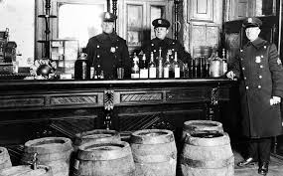
“Prohibition doesn’t work- everybody knows that!”
Notes:
Well, prohibition does have many positive effects – this argument is made for why should legalize “drugs”. Yes, it’s much harder to prohibit a legalized and culturally and historically embedded drug like alcohol than it is to keep a drug illegal that has not been legal (for a century).

Slide 34
So, legalize, regulate, tax, educate (“just like alcohol”)
Legalize
Regulate
Educate
Tax

Slide 35
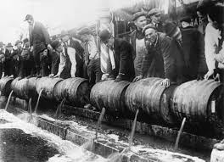
Just like alcohol … 21st amendment repealed alcohol Prohibition… and virtually ended our alcohol problems (?)

Slide 36
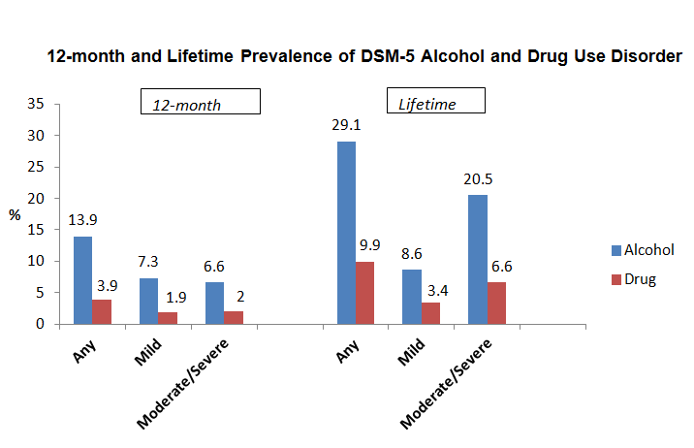
DSM-V Lifetime and 12-Month Prevalence of Alcohol and Drug Use Disorder
3-3.5x more addiction cases for alcohol in the past year/lifetime than ALL illicit
drugs combined

Slide 37
…Did alcohol re-legalization put an end to our alcohol problems?
Alcohol = addictive drug - Majority of addicted individuals in US are addicted to alcohol
Alcohol = level I carcinogen – known to cause cancer
40 million individuals drink at risky/harmful levels
100,000 deaths due to alcohol annually – 3rd leading cause preventable death
10,000 killed each year on roads in alcohol-related accidents - Hundreds of thousands more injured
Alcohol-related crashes cost taxpayers $100 billion; overall economic burden $250 billion (fed/state/local combined tax revenue from alcohol sales = $15 Billion)
3 Million alcohol-related arrests annually (e.g., liquor violations; underage sales; drunk and disorderly/violence/domestic violence); Nearly 1.4 million arrested for DUI
If “prohibition doesn’t work” it’s hard to make the case that Legalization is the solution…

Slide 38
Alcohol and harm
On alcohol containers, Why don’t we have:
“alcohol can cause addiction” or
“alcohol causes cancer”
??

Slide 39
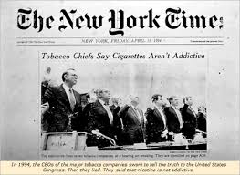
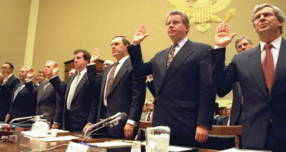
1994 – Congressional Hearing
Each CEO of major tobacco companies state nicotine nor their
products (cigarettes) are addictive

Slide 40
HOW COULD INCREASED USE OF MJ CAUSE HARM TO PUBLIC HEALTH AND PUBLIC SAFETY?
Toxicity, Intoxication, and Addiction
Patterns of use
Average volume
intoxication
Toxic Effects
Addiction
Chronic Disease
Accidents/injuries (acute disease)
Acute social problems
Chronic Social problems
Source: Babor et al, 2010

Slide 41


Slide 42
Addictiveness of marijuana
“Adolescents, especially troubled ones, and people with psychiatric disorders (including substance abuse) appear more likely than the general population to become dependent on marijuana… ”
-- Institute of Medicine
Anthony, J.; Warner, L.A.; and Kessler, R.C. Comparative epidemiology of dependence on tobacco, alcohol, controlled substances, and inhalants: Basic findings from the National Comorbidity Survey. Exp Clin Psychopharmacol 2:244–268, 1994;
Hall, W.; and Degenhardt, L. Adverse health effects of non-medical cannabis use. Lancet 374:1383–1391, 2009;
Hall, W. The adverse health effects of cannabis use: What are they, and what are their implications for policy? Int J of Drug Policy 20:458–466, 2009

Slide 43
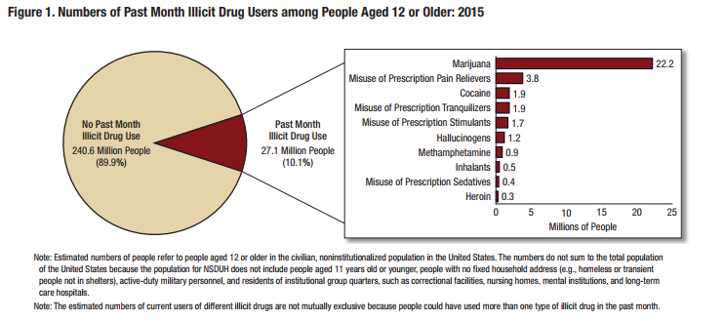
2015 Past MONTH USE OF specific drugs IN THE UNITED STATES
NSDUH 2015

Slide 44
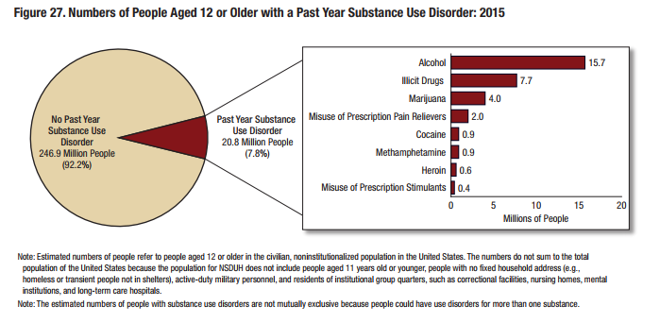

2015 SUBSTANCE USE DISORDER BY PRIMARY SUBSTANCE

Slide 45
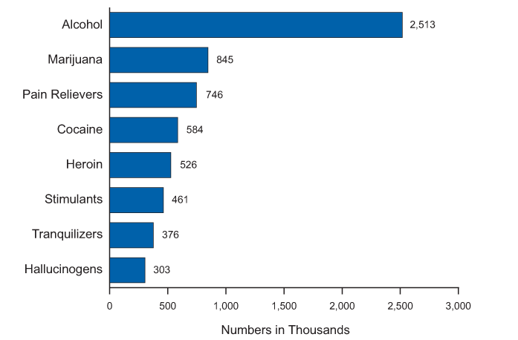
Substances For which Most recent treatment was received in the past year among persons aged 12 or older: 2013

Slide 46
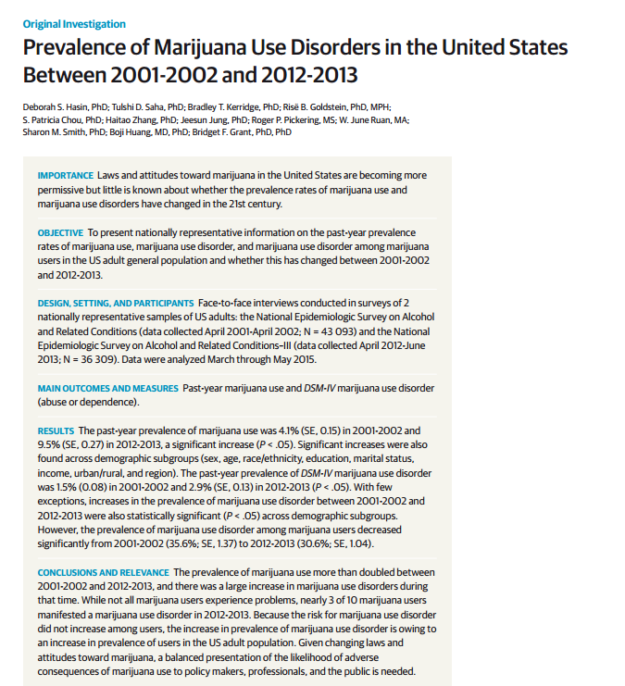

Slide 47
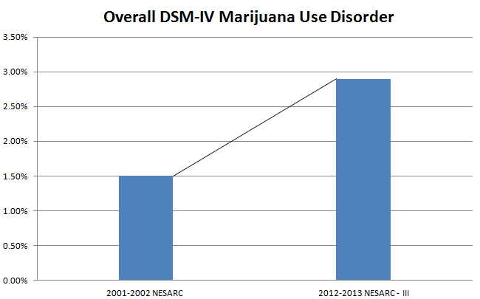
Past Year DSM-IV Marijuana Use Disorder
Notes:
Prevalence of DSM-IV marijuana use disorder nearly doubled between 2001-2002 and 2012-2013.

Slide 48


Slide 49

1. First Analysis (k=33)
Results: Neurocognitive deficits in most domains of functioning present early during abstinence
2. Second Sub-Analysis (k-13)
Results: Not present after 25 or more days of abstinence

Slide 50
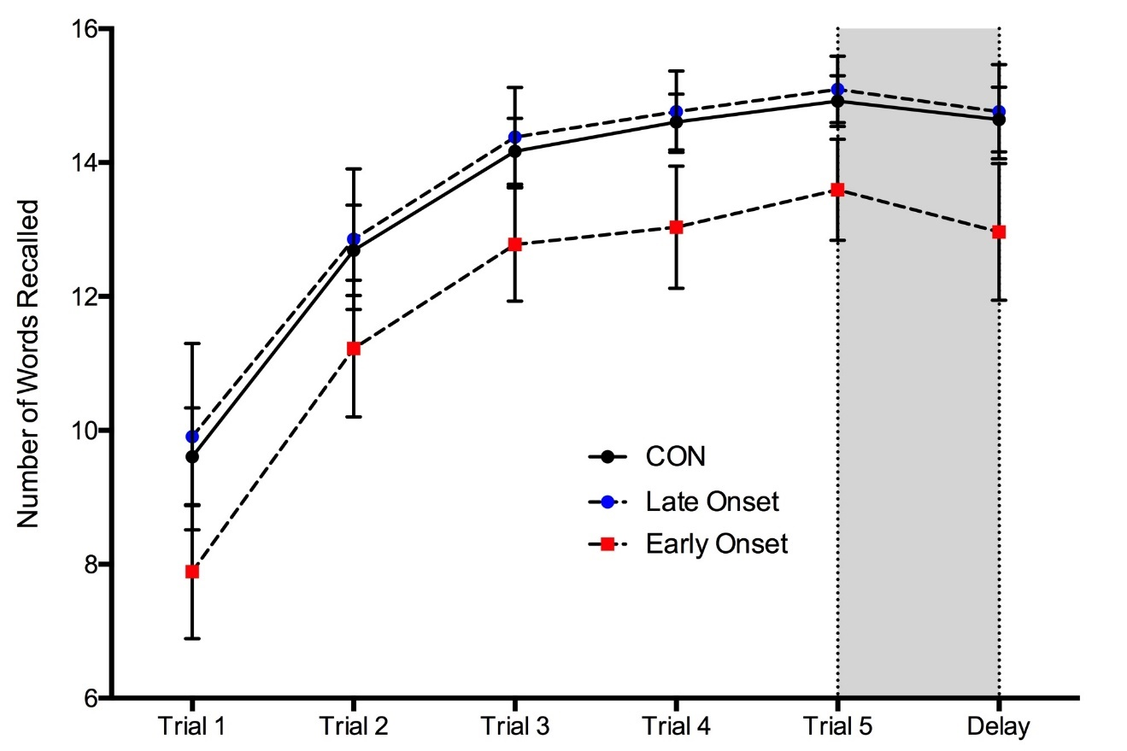
Marijuana Users Show Worse Performance on a Memory Test
MJ users, particularly early-onset users (<16), show impaired learning compared to non-users
Could mean students using MJ regularly could have difficulty attending to and learning new information

Slide 51
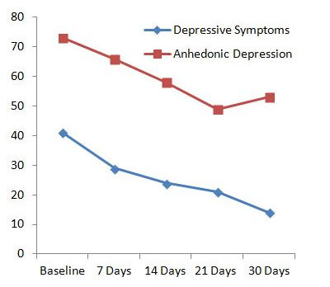
What Happens After 30 days of Abstinence?
Psychiatric
Improvement in mood
Cognition
↑ attention
↑ executive functions

Slide 52
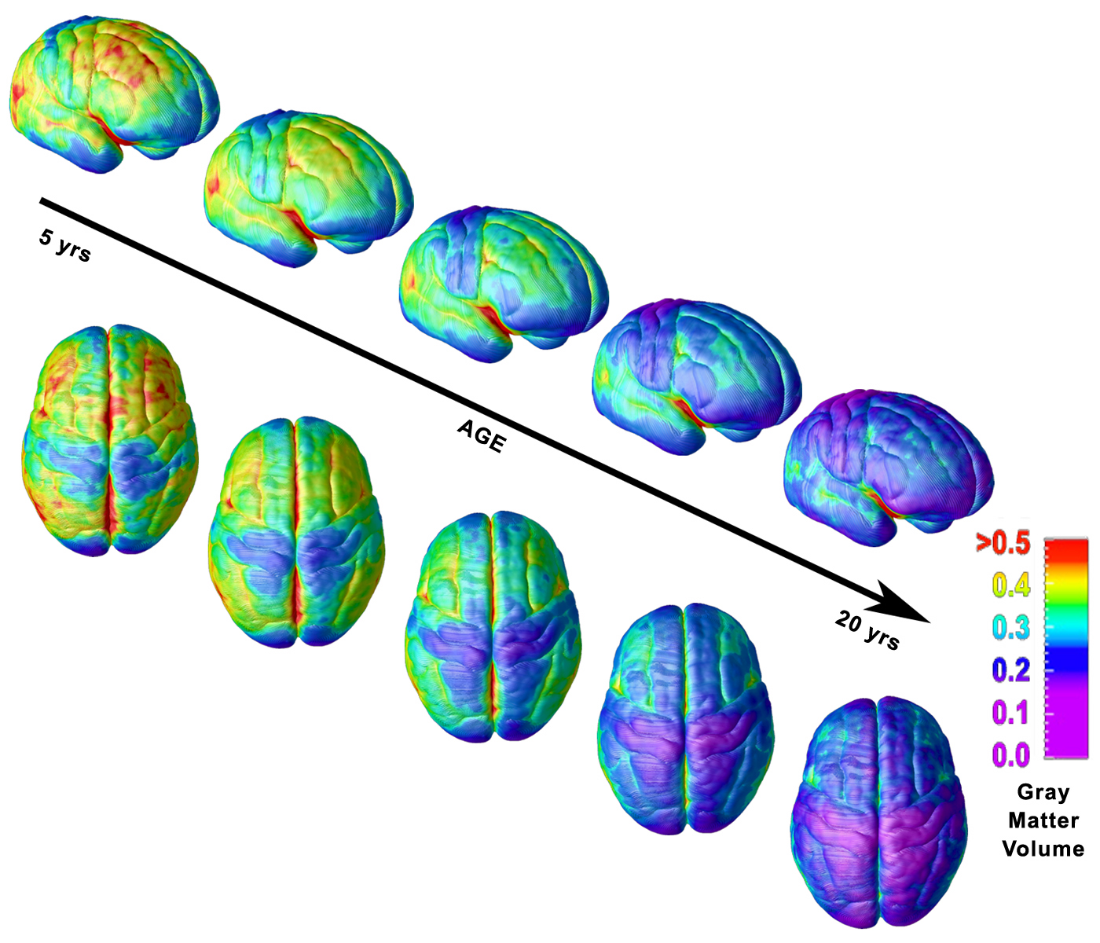
Pre-frontal cortex associated with weighing pros/cons, impulse control, judgment, abstract reasoning, planning last to develop…
There are “critical” periods in brain development wherein substances can have more profound developmental effects…

Slide 53
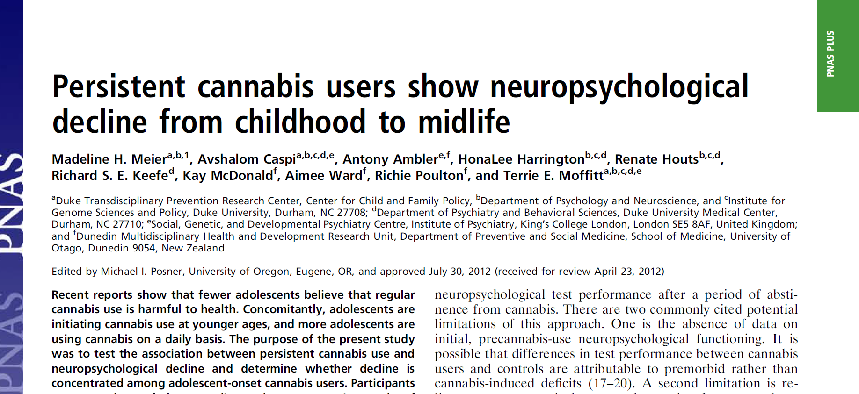

Slide 54
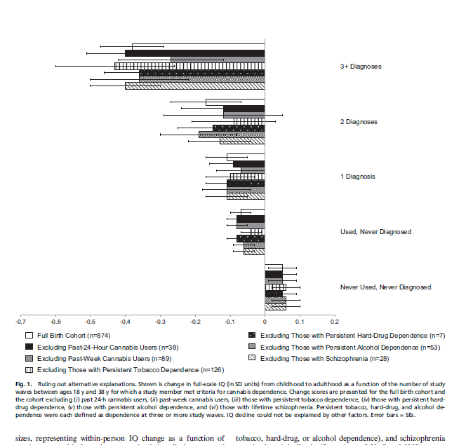
Even when recent MJ use was taken into account along with other confounds heavy use during teen years was associated with an 8 point drop in IQ

Slide 55
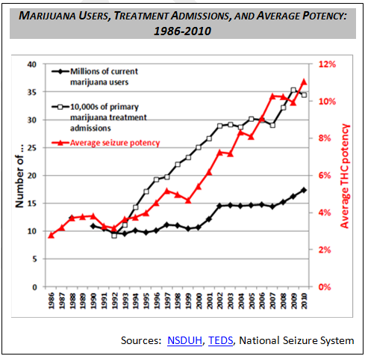
What will be the effects of higher potency MJ?
That study was done when MJ potency was lower…. Increased potency in past 20 years

Slide 56
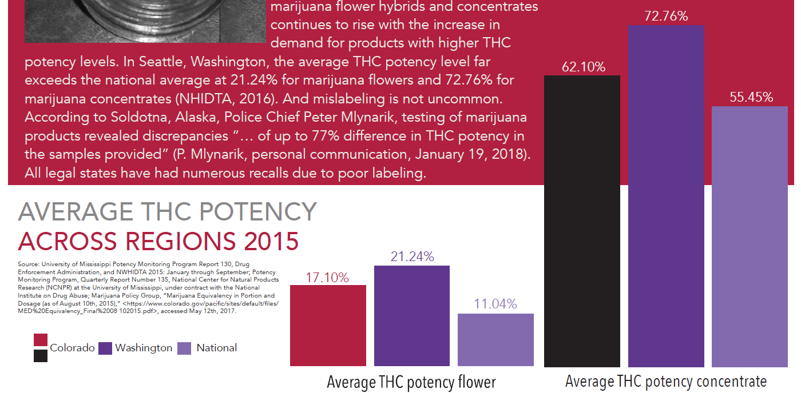
POTENCY
~20-50% of the market in legalized states is comprised of edibles, which are often highly potent and can be mistakenly consumed.
Relative to the national average, potency of marijuana products is higher in CO and WA.
As cited by Smart Approaches to Marijuana (SAM) (2018, March). Lessons learned from marijuana legalization in four U.S. States and D.C. March 2018. Retrieved from https://learnaboutsam.org/wp-content/uploads/2018/03/SAM-Digital-C-4.pdf.

Slide 58
MJ use during adolescence may affect
Brain development through two pathways:
Alters synaptic pruning (via disrupting glutamate
Transmission) leading to greater disinhibition in prefrontal
regions leading to psychotic symptoms
2. Decreased myelination altering development of white matter
leading to cognitive-emotional impairments

Slide 59
Implications for legal, commercialized recreational use
Important implications because CO, which has a legal age of use set at 21yrs or older, just released latest report on mj impact and found that while mj use nationally declined 4% in 2015 among youth, it went up 20% in co during the past 2 yrs in which MJ use was legalized

Slide 60

Does MJ affect:
Neuro-cognition?
Motivation?
Psychosis?

Slide 61
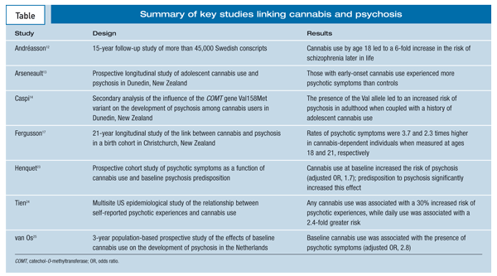
What about Psychotic symptoms and Schizophrenia?
Notes:
References
1. United Nations Office on Drugs and Crime (UNODC). World Drug Report 2010. Vienna: United Nations; 2010. 2. Koskinen J, Löhönen J, Koponen H, et al. Rate of cannabis use disorders in clinical samples of patients with schizophrenia: a meta-analysis. Schizophr Bull. 2010;36:1115-1130. 3. Iversen LL. The Science of Marijuana. 2nd ed. New York: Oxford University Press; 2008. 4. Ameri A. The effects of cannabinoids on the brain. Prog Neurobiol. 1999;58:315-348. 5. Pertwee RG. The diverse CB1 and CB2 receptor pharmacology of three plant cannabinoids: delta9-tetrahydrocannabinol, cannabidiol and delta9-tetrahydrocannabivarin. Br J Pharmacol. 2008;153:199-215. 6. Eggan SM, Lewis DA. Immunocytochemical distribution of the cannabinoid CB1 receptor in the primate neocortex: a regional and laminar analysis. Cereb Cortex. 2007;17:175-191. 7. Szabo B, Siemes S, Wallmichrath I. Inhibition of GABAergic neurotransmission in the ventral tegmental area by cannabinoids. Eur J Neurosci. 2002;15:2057-2061. 8. Murray RM, Morrison PD, Henquet C, Di Forti M. Cannabis, the mind and society: the hash realities. Nat Rev Neurosci. 2007;8:885-895. 9. Morrison PD, Murray RM. From real-world events to psychosis: the emerging neuropharmacology of delusions. Schizophr Bull. 2009;35:668-674. 10. Moore TH, Zammit S, Lingford-Hughes A, et al. Cannabis use and risk of psychotic or affective mental health outcomes: a systematic review. Lancet. 2007;370:319-328. 11. McLaren JA, Silins E, Hutchinson D, et al. Assessing evidence for a causal link between cannabis and psychosis: a review of cohort studies. Int J Drug Policy. 2009;21:10-19. 12. Andréasson S, Allebeck P, Engström A, Rydberg U. Cannabis and schizophrenia. A longitudinal study of Swedish conscripts. Lancet. 1987;2:1483-1486. 13. Arseneault L, Cannon M, Poulton R, et al. Cannabis use in adolescence and risk for adult psychosis: longitudinal prospective study. BMJ. 2002;325:1212-1213. 14. Caspi A, Moffitt TE, Cannon M, et al. Moderation of the effect of adolescent-onset cannabis use on adult psychosis by a functional polymorphism in the catechol-O-methyltransferase gene: longitudinal evidence of a gene X environment interaction. Biol Psychiatry. 2005;57:1117-1127. 15. Lachman HM, Papolos DF, Saito T, et al. Human catechol-O-methyltransferase pharmacogenetics: description of a functional polymorphism and its potential application to neuropsychiatric disorders. Pharmacogenetics. 1996;6:243-250. 16. Bilder RM, Volavka J, Lachman HM, Grace AA. The catechol-O-methyltransferase polymorphism: relations to the tonic-phasic dopamine hypothesis and neuropsychiatric phenotypes. Neuropsychopharmacology. 2004;29:1943-1961. 17. Fergusson DM, Horwood LJ, Swain-Campbell NR. Cannabis dependence and psychotic symptoms in young people. Psychol Med. 2003;33:15-21. 18. Bowers MB Jr, Mazure CM, Nelson JC, Jatlow PI. Psychotogenic drug use and neuroleptic response. Schizophr Bull. 1990;16:81-85. 19. Linszen DH, Dingemans PM, Lenior ME. Cannabis abuse and the course of recent-onset schizophrenic disorders. Arch Gen Psychiatry. 1994;51:273-279. 20. Rabin RA, Zakzanis KK, George TP. The effects of cannabis use on neurocognition in schizophrenia: a meta-analysis. Schizophr Res. 2011;128:111-116. 21. Zuardi AW, Crippa JA, Hallak JE, et al. Cannabidiol, a Cannabis sativa constituent, as an antipsychotic drug. Braz J Med Biol Res. 2006;39:421-429. 22. Fadda P, Robinson L, Fratta W, et al. Differential effects of THC- or CBD-rich cannabis extracts on working memory in rats. Neuropharmacology. 2004;47:1170-1179. 23. Henquet C, Krabbendam L, Spauwen J, et al. Prospective cohort study of cannabis use, predisposition for psychosis, and psychotic symptoms in young people. BMJ. 2005;330:11. 24. Tien AY, Anthony JC. Epidemiological analysis of alcohol and drug use as risk factors for psychotic experiences. J Nerv Ment Dis. 1990;178:473-480. 25. van Os J, Bak M, Hanssen M, et al. Cannabis use and psychosis: a longitudinal population-based study. Am J Epidemiol. 2002;156:319-327.
- See more at: http://www.psychiatrictimes.com/schizophrenia/cannabis-psychosis-link/page/0/3#sthash.rhb5egtj.dpuf

Slide 62
Effects of marijuana use on psychosis
Notes:
Meta-analysis of 11 studies examining the relationship between cannabis use and psychosis
Dose-related effect of cannabis use was seen, with vulnerable groups including individuals who used cannabis during adolescence, those who had previously experienced psychotic symptoms, and those at high genetic risk of developing schizophrenia.
Available evidence supports the hypothesis that cannabis is an independent risk factor, both for psychosis and the development of psychotic symptoms.
Six case–control studies rating psychotic symptoms in cannabis users vs. non-users in both ‘high risk’ and ‘general’ populations
Dunedin Birth Cohort Study (Arseneault et al., 2002) found that, even when psychotic symptoms at age 11 years were controlled for, cannabis users by age 15 years and by age 18 years had significantly more ‘schizophrenia symptoms’ compared to controls (although data did not permit calculation of ORs).

Slide 63
Meta-analysis of 11 studies examining the relationship between cannabis use and psychosis
Dose-related effect of cannabis use with vulnerable groups including individuals who used cannabis during adolescence, those who had previously experienced psychotic symptoms, and those at high genetic risk of developing schizophrenia.
Available evidence supports the hypothesis that cannabis is an independent risk factor, both for psychosis and the development of psychotic symptoms.
Six case–control studies found psychotic symptoms in cannabis users vs. non-users in both ‘high risk’ and ‘general’ population samples
Dunedin Birth Cohort Study (Arseneault et al., 2002) found that, even when psychotic symptoms at age 11 years were controlled for, cannabis users by age 15 years and by age 18 years had significantly more ‘schizophrenia symptoms’ compared to controls (although data did not permit calculation of ORs).

Slide 64
Influence of adolescent marijuana use on adult psychosis is affected by genetic variables

Slide 65
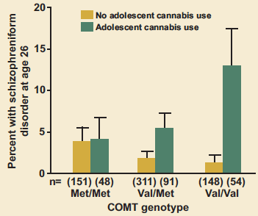
Influence of adolescent-onset cannabis use on adult psychosis is moderated by variations in the COMT gene
Individuals with copies of the Val variant have a higher risk of developing schizophrenic-type disorders if they used cannabis during adolescence
Those with only the Met variant were unaffected by cannabis use.
Caspi A, Moffitt TE, Cannon M, et al. Moderation of the effect of adolescent-onset cannabis use on adult psychosis by a functional polymorphism in the catechol-O-methyltransferase gene: longitudinal evidence of a gene X environment interaction. Biol Psychiatry. 2005;57(10):1117-1127. doi:10.1016/j.biopsych.2005.01.026.
Notes:
Whether adolescent marijuana use can contribute to developing psychosis later in adulthood appears to depend on whether a person already has a genetically based vulnerability to the disorder. The AKT1 gene governs an enzyme that affects brain signaling involving the neurotransmitter dopamine. Altered dopamine signaling is known to be involved in schizophrenia. AKT1 can take one of three forms in a specific region of the gene implicated in susceptibility to schizophrenia: T/T, C/T, and C/C. Daily users of marijuana with the C/C variant have a seven times higher risk of developing psychosis than infrequent marijuana users or nonusers. The risk for psychosis among those with the T/T variant was unaffected by whether they used marijuana.
Results
The rs2494732 locus was not associated with an increased risk of a psychotic disorder, with lifetime cannabis use, or with frequency of use. We did, however, find that the effect of lifetime cannabis use on risk of psychosis was significantly influenced by the rs2494732 locus (likelihood ratio statistic for the interaction = 8.54; p = .014). Carriers of the C/C genotype with a history of cannabis use showed a greater than twofold increased likelihood of a psychotic disorder (odds ratio = 2.18 [95% confidence interval: 1.12, 4.31]) when compared with users who were T/T carriers. Moreover, the interaction between the rs2494732 genotype and frequency of use was also significant at the 5% level (likelihood ratio = 13.39; p = .010). Among daily users, C/C carriers demonstrated a sevenfold increase in the odds of psychosis compared with T/T carriers (odds ratio = 7.23 [95% confidence interval: 1.37, 38.12]).
Di Forti M, Iyegbe C, Sallis H, et al. Confirmation that the AKT1 (rs2494732) genotype influences the risk of psychosis in cannabis users. Biol Psychiatry. 2012;72(10):811-816. doi:10.1016/j.biopsych.2012.06.020.

Slide 66
Whether adolescent marijuana use can contribute to developing psychosis later in adulthood may depend on existing genetically based vulnerability

Slide 67
AKT1 Gene Variants and Psychosis
Daily users with C/C variant have seven times higher risk of developing psychosis than infrequent marijuana users or nonusers
Risk for users with T/T variant unaffected by marijuana use
Di Forti M, Iyegbe C, Sallis H, et al. Confirmation that the AKT1 (rs2494732) genotype influences the risk of psychosis in cannabis users. Biol Psychiatry. 2012;72(10):811-816. doi:10.1016/j.biopsych.2012.06.020.
Notes:
Whether adolescent marijuana use can contribute to developing psychosis later in adulthood appears to depend on whether a person already has a genetically based vulnerability to the disorder. The AKT1 gene governs an enzyme that affects brain signaling involving the neurotransmitter dopamine. Altered dopamine signaling is known to be involved in schizophrenia. AKT1 can take one of three forms in a specific region of the gene implicated in susceptibility to schizophrenia: T/T, C/T, and C/C. Daily users of marijuana with the C/C variant have a seven times higher risk of developing psychosis than infrequent marijuana users or nonusers. The risk for psychosis among those with the T/T variant was unaffected by whether they used marijuana.
Results
The rs2494732 locus was not associated with an increased risk of a psychotic disorder, with lifetime cannabis use, or with frequency of use. We did, however, find that the effect of lifetime cannabis use on risk of psychosis was significantly influenced by the rs2494732 locus (likelihood ratio statistic for the interaction = 8.54; p = .014). Carriers of the C/C genotype with a history of cannabis use showed a greater than twofold increased likelihood of a psychotic disorder (odds ratio = 2.18 [95% confidence interval: 1.12, 4.31]) when compared with users who were T/T carriers. Moreover, the interaction between the rs2494732 genotype and frequency of use was also significant at the 5% level (likelihood ratio = 13.39; p = .010). Among daily users, C/C carriers demonstrated a sevenfold increase in the odds of psychosis compared with T/T carriers (odds ratio = 7.23 [95% confidence interval: 1.37, 38.12]).
Di Forti M, Iyegbe C, Sallis H, et al. Confirmation that the AKT1 (rs2494732) genotype influences the risk of psychosis in cannabis users. Biol Psychiatry. 2012;72(10):811-816. doi:10.1016/j.biopsych.2012.06.020.

Slide 68
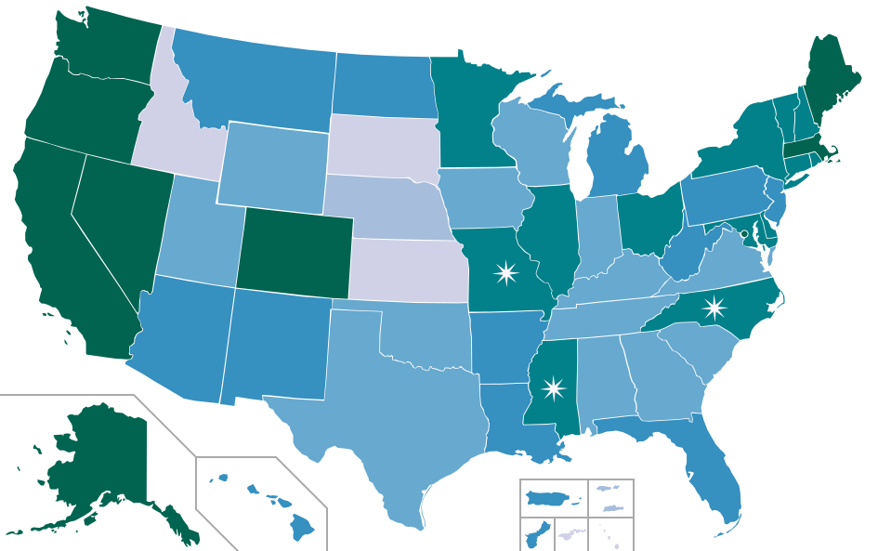
Marijuana Laws Across the United States

Slide 69
Marijuana Laws Across the United States
Positive moderate-strong correlation
across states, between less perceived harm and legalization and “medicalization” of MJ
Positive moderate to strong correlation
across states, between higher rates of teenage use
and legalization and “medicalization” of MJ
Top 10 states for highest rate of current marijuana use were all medical
marijuana states; bottom 10 were all non‐medical‐marijuana states.

Slide 70
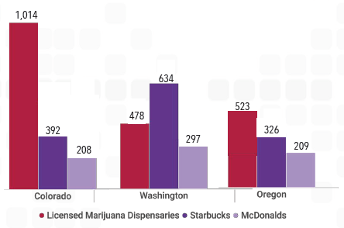
MARIJUANA ACCESSIBILITY/AVAILABILITY
In Colorado, there are now more marijuana stores than McDonald’s and Starbucks stores combined
(RMHIDTA, 2017; RMHIDTA, personal communication, January 25, 2018).
Notes:
(RMHIDTA, 2017; RMHIDTA, personal communication, January 25, 2018).
ACCESSIBILITY
Accessibility

Slide 71
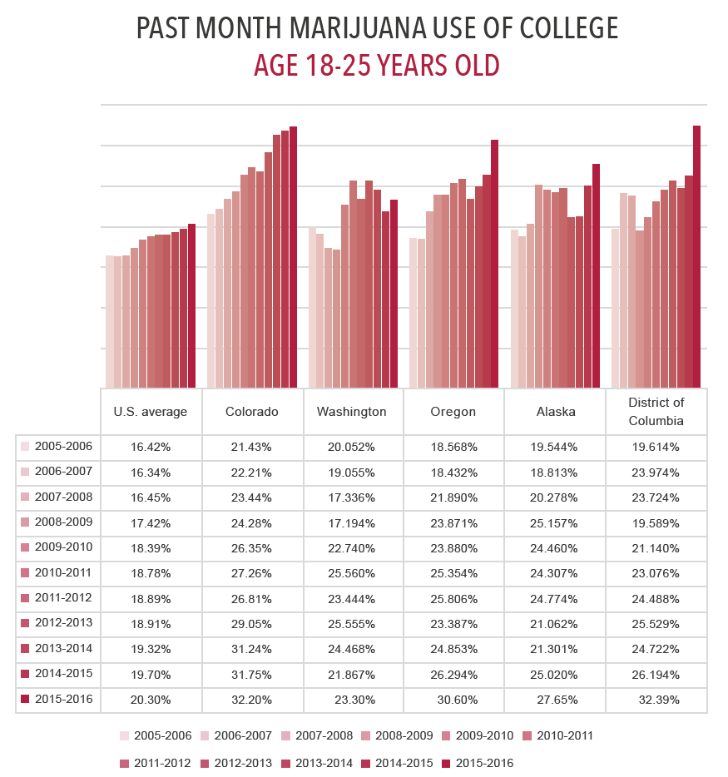
INCREASE IN MARIJUANA USE
MARIJUANA & YOUTH
Marijuana use has increased since legalization, particularly among young people
Past-month marijuana use among 12-17 year olds AND 18-25 year olds in CO, WA, OR, AK, and DC has continued to surpass the national average
Average rate of teen marijuana use is 30% higher in CO, WA, OR, and AK than the overall U.S. rate of teen use
National Survey on Drug Use and Health. (2006-2017). State use estimates [Data file]. Retrieved from https://www.samhsa.gov/data/population-data-nsduh - as cited by Smart Approaches to Marijuana (SAM) (2018, March). Lessons learned from marijuana legalization in four U.S. States and D.C. March 2018. Retrieved from https://learnaboutsam.org/wp-content/uploads/2018/03/SAM-Digital-C-4.pdf.
Notes:
(National Survey on Drug Use and Health [NSDUH], 2006-2017).

Slide 72
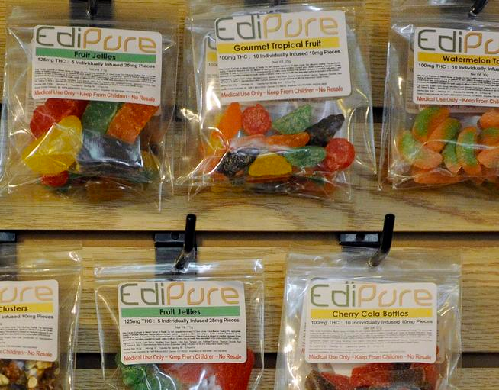
Impact of Edibles?

Slide 73
National Poisoning system data show that MJ exposure among kids <6yrs rose 148% from 2006-2013, particularly in states where Med MJ is legal

Slide 74
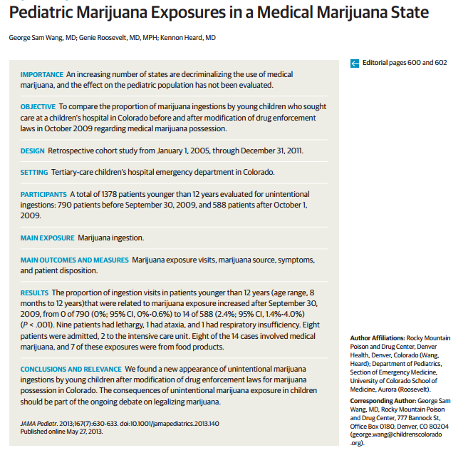


Slide 75
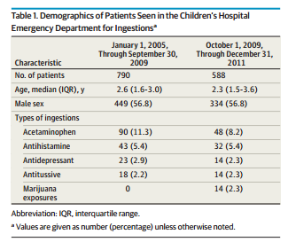
New increase in unintentional marijuana ingestions by young children
Opposite trend to all other toxic ingestions
Notes:
New increase in unintentional marijuana ingestions by young children after modification of drug enforcement laws for marijuana possession in Colorado.

Slide 76
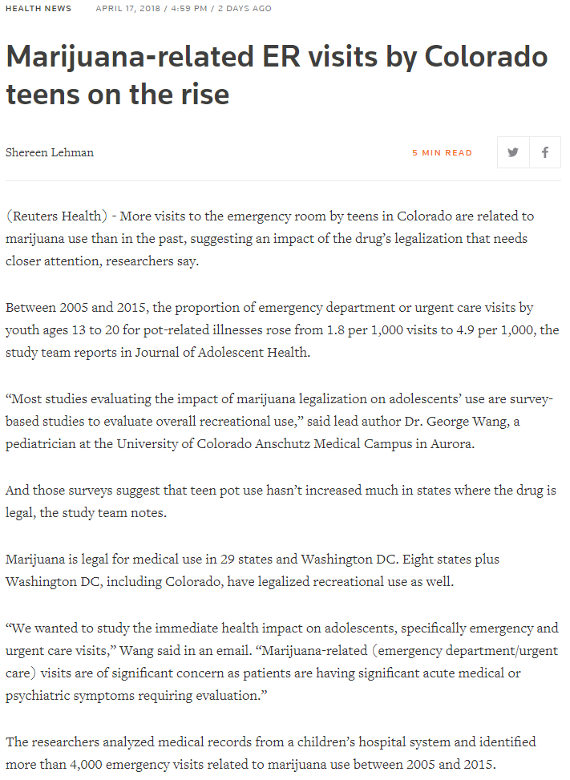
Marijuana Related ER Visits
Study published in Journal of Adolescent Health
RESEARCHERS IN CO analyzed medical records from over 4,000 marijuana use related emergency visits between 2005-2015 among 13-20 year olds
FINDINGS
Proportion of marijuana-related ER or urgent care visits INCREASED from 1.8 to 4.9 per 1,000 visits (2005-2015)
~50% sent home after emergency visit, 30% admitted to the hospital, rest were transferred to other facilities
Reports of overall use have not changed, but legalization has had INCREASING impact on adolescents’ physical and mental health
PART OF A LARGER TREND?
Children’s Hospital in Boston echoes the experience of CO doctors, reports INCREASE in kids presenting with psychotic symptoms (e.g., hallucinations) and chronic vomiting
VIA Reuters: https://www.reuters.com/article/us-health-marijuana-kids/marijuana-related-er-visits-by-colorado-teens-on-the-rise-idUSKBN1HO38A
Notes:
VIA Reuters: https://www.reuters.com/article/us-health-marijuana-kids/marijuana-related-er-visits-by-colorado-teens-on-the-rise-idUSKBN1HO38A

Slide 77
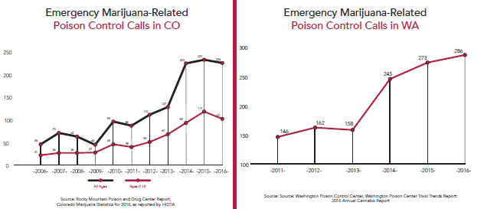
MARIJUANA-RELATED POISON CONTROL CALLS, ER VISITS & HOSPITALIZATIONS
Legalization of marijuana has led to increase in marijuana-related poison control calls, ER visits, and hospitalizations.
CO legalized in 2012
WA legalized in 2012
Colorado: 210% increase in calls to poison control between the 4-year averages before and after recreational legalization.
Washington: 70% increase in calls between the 3-year averages before and after legalization.
Rocky Mountain Poison and Drug Center. (2017). Retrieved December 22, 2017, from http://www.rmhidta.org/html/FINAL%202017%20Legalization%20of%20Marijuana%20in%20Colorado%20The%20Impact.pdf as cited by Smart Approaches to Marijuana (SAM) (2018, March). Lessons learned from marijuana legalization in four U.S. States and D.C. March 2018. Retrieved from https://learnaboutsam.org/wp-content/uploads/2018/03/SAM-Digital-C-4.pdf.
Notes:
“Central Oregon hospitals saw a nearly 2,000% increase in emergency room visits due to marijuana poisoning, with 434 marijuana-related emergency visits in January 2016 alone, compared to a maximum of 32 visits per month prior to legalization (Kent, 2016).“
“One hospital in Bend, Oregon, also had an increase in marijuana-related emergency room visits from 229 in 2012 to 2,251 in 2015; the average number of marijuana-related emergency room visits per month in the same hospital in 2016 was 552 (Hawryluk, 2017).”
REFERENCE: Rocky Mountain Poison and Drug Center. (2017). Retrieved December 22, 2017, from http://www.rmhidta.org/html/FINAL%202017%20Legalization%20of%20Marijuana%20in%20Colorado%20The%20Impact.pdf as cited by Smart Approaches to Marijuana (SAM) (2018, March). Lessons learned from marijuana legalization in four U.S. States and D.C. March 2018. Retrieved from https://learnaboutsam.org/wp-content/uploads/2018/03/SAM-Digital-C-4.pdf.

Slide 78
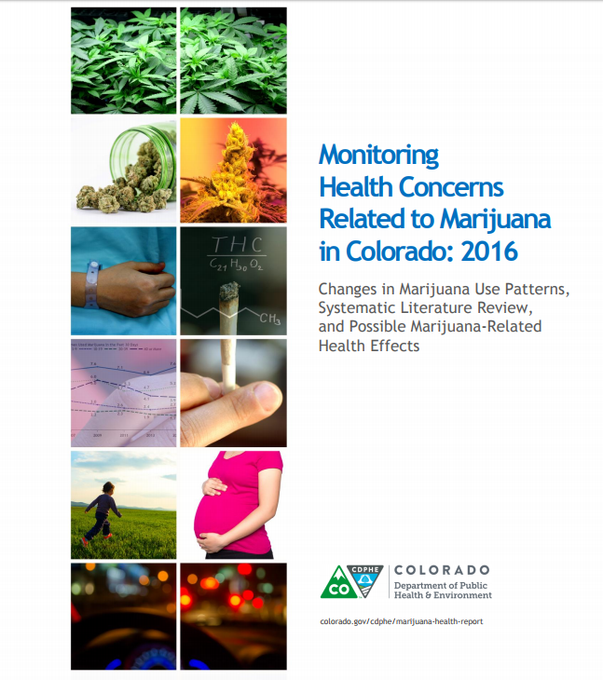

Slide 79
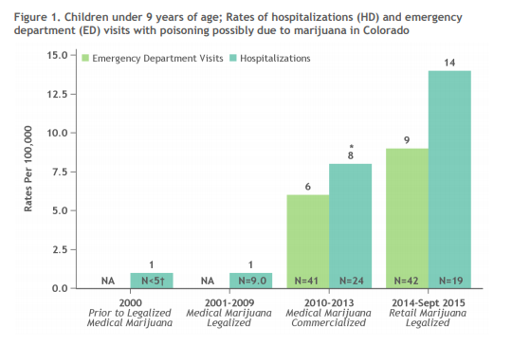

Slide 80
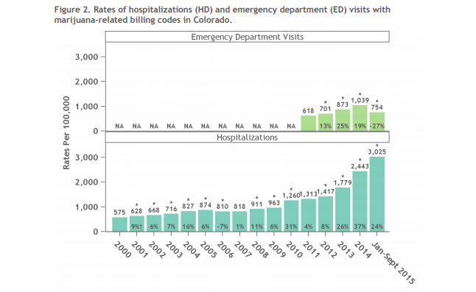
After retail marijuana was legalized, increasing trend in the amount of hospitalizations and ED visits…
Notes:
After retail marijuana was legalized, there is an increasing trend in the amount of hospitalizations ad emergency department visits.

Slide 81


Slide 82
Risk of motor vehicle accident increase about 2x after
smoking MJ.
Critical tracking tasks, reaction times
Divided-attention tasks, lane-position variability all show MJ-induced
Impairments. Dose dependent. Even among more tolerant regular users, impairments persist.

Slide 83
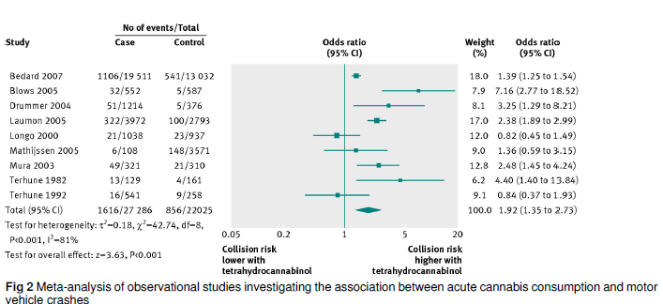
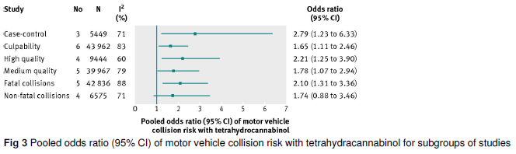
Public Health risks of marijuana
Motor vehicle collision risk over all studies
Motor vehicle collision risk
by type of study
Asbridge, M., Hayden, J. A., & Cartwright, J. L. (2012). Acute cannabis consumption and motor vehicle collision risk: systematic review of observational studies and meta-analysis. BMJ: British Medical Journal, 344.

Slide 84
Method: Online survey of past month MJ users in WA and CO states (N=865)
Results: Prevalence of past-yr driving under influence of MJ was 44%
Prevalence of driving within 1 hour of using MJ 5+ times in past month = 24%
69% lower odds of driving if perceived risky
37% lower odds of driving if had knowledge of MJ DUI laws

Slide 85
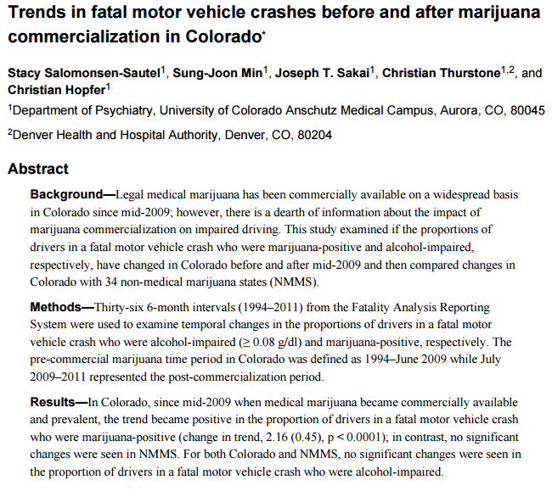

Slide 86
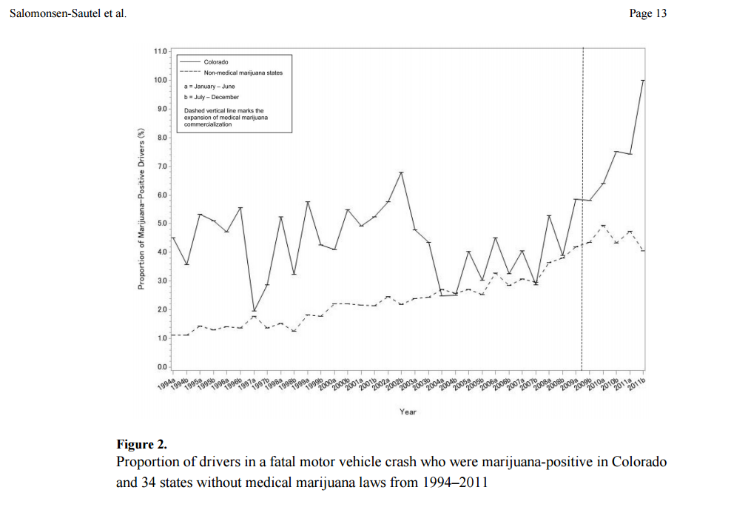
Commercialization of
medical MJ in CO
Notes:
Dashed line marks the expansion of medical marijuana commercialization

Slide 87
Notes:
“Commercialization” refers to the commercialization
• 2006 – 2008: Medical marijuana pre‐commercialization era
• 2009 – Present: Medical marijuana commercialization and expansion era
• 2013 – Present: Recreational marijuana era

Slide 88
Notes:
Rocky Mountain High Report, Sept 2016

Slide 89
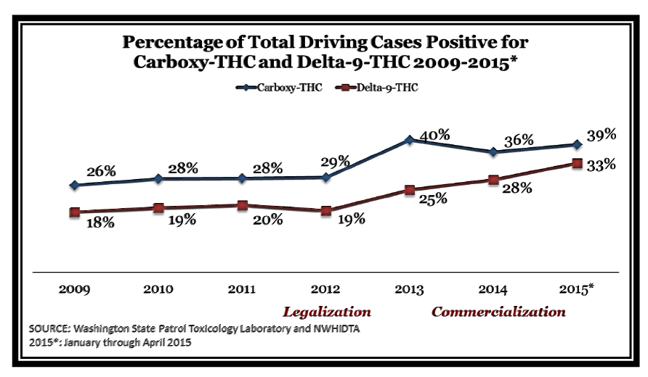
Washington State MARIJUANA IMPACT Report 2016
Notes:
Delta-9-THC represents the compound in marijuana responsible for the psychoactive ‘high’ users’ experience.
Carboxy-THC is the second stage metabolite of THC – it stays in an individual for a period of time and is not taken into account for DUI but in this case is used to show past use in an individual.

Slide 90
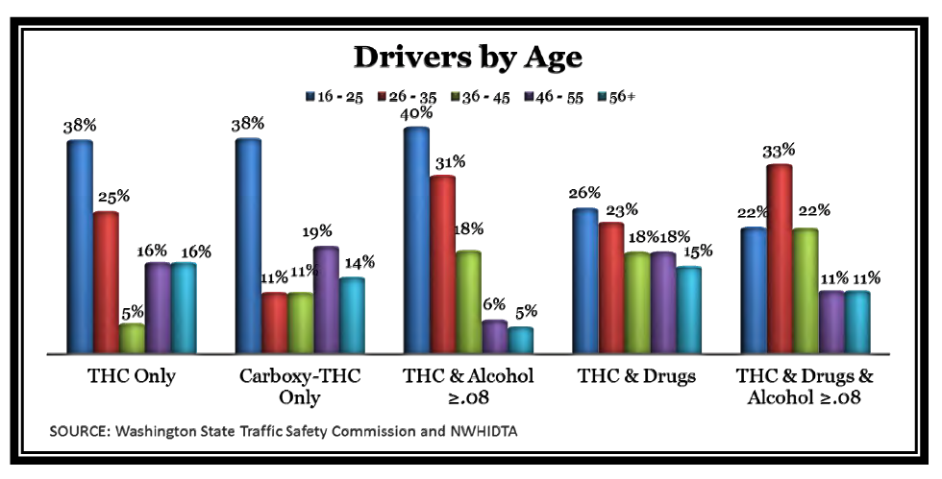
Notes:
Graph shows the amount of individuals involved in a fatal car accident by age. Highest percentage of drivers who were positive for THC, carboxy-THC ad TCH & Alcohol were people between the ages of 16-25.

Slide 91
Summary
POTENTIAL PROS
Legalization means improvements in product quality control
eradication of arrests to due to possession (if 21yrs +; decriminalization already does this)
Minimization/eradication of black market
Tax revenue/jobs
POTENTIAL CONS
Public health and safety harms
Consumption will increase
Addiction cases will increase and harms related to acute intoxication (e.g., driving accidents) will increase
Toxicity-related poisoning and neurocognitive effects among children and teenagers are likely to increase
Enforcement of legalization regulations will be needed – arrests for violations (and related costs) could be high even if substantially less than alcohol
Productivity could go down in the population as more people could miss work days/underperform at work contributing to economic increased burden

Slide 92
Degree of Problems Associated with Various Policy Approaches to Addressing the Drug Problem
Source: Canada Drug Policy Coalition, 2015

Slide 93
Summary
Degree of Problems Associated with Various Policy Approaches to Addressing the Drug Problem
Decriminalization/controlled non-commercialized/Market regulated legalization –best middle ground options
If legalized - It matters how you do it – full commercialization “like alcohol” or state regulated (quality) controlled, ban on advertising, plain packaging
Tax revenue, depending on how much is levied, may only be a fraction of societal costs; industry lobbying down the road may gradually move taxes lower

Slide 94
Summary
There are many vested interests and pressures on policy makers.
Ultimately in a civilized society, good policy preserves individual freedoms, while respecting the rights and liberties of others likely to be affected.
In the case of drugs (e.g., marijuana), added layer because while people make a free choice to use a drug initially, a proportion suffer from radically impaired ability to continue to make that rational choice- they become addicted (may also suffer from illnesses related to toxicity or intoxication)
So, with regard to complexities of the ‘drug problem,’ if you hear someone proffer, “Listen, all you gotta do is…,” you know they may be suffering from a case of the ‘clear-and-simple,’ but ultimately ‘wrong’ solution, described by Henry Mencken.
“War on drugs” vs “the war on the war drugs” may each produce different types of casualties (lesser or greater degrees of criminalization, public health/safety)
The “drug problem” is complex and obstinate; may never eradicate it completely only change its nature
As different experiments with different policy positions naturally occur, time will tell if there are “sweet” spots in reducing overall societal harms

Slide 95


